Slide 1
Evidence-Based Practices
Identification and Dissemination of the
Best Available Evidence

Slide 2

Today’s Discussion
Part 1: Identification of EBPs
Terminology Review
General process for EBP review
Standards used in Special Education
Analyze one published EBP review
Part 2: Dissemination of EBPs
Resources for practitioners
Sources for EBPs
Considerations and challenges for supporting implementation

Slide 3
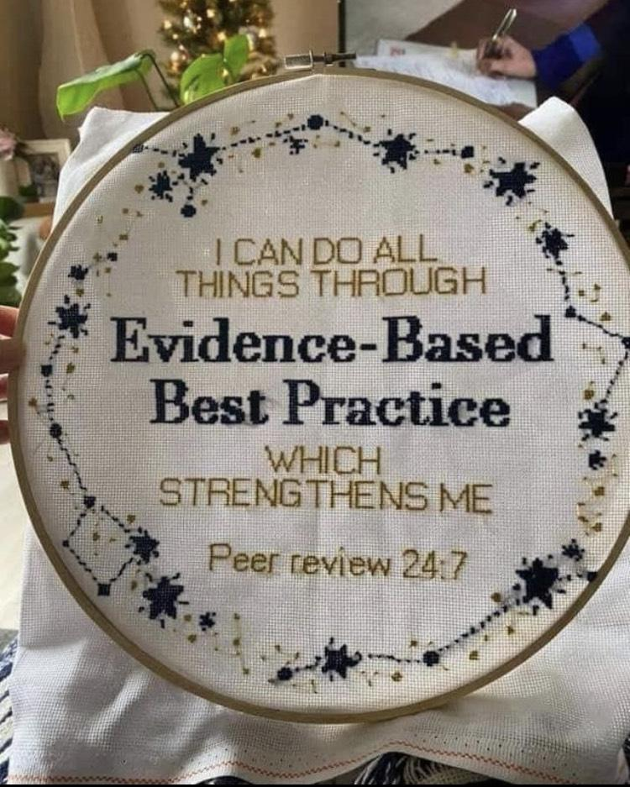
Objectives
Understand the differences between evidence-based practices (EBPs) and related terms.
Describe three unique characteristics of an evidence-based review.
Examine components of an evidence-based review to
identify strengths/limitations
discuss findings and implications for practice
Discuss considerations and challenges to supporting the implementation of EBPs.

Slide 4
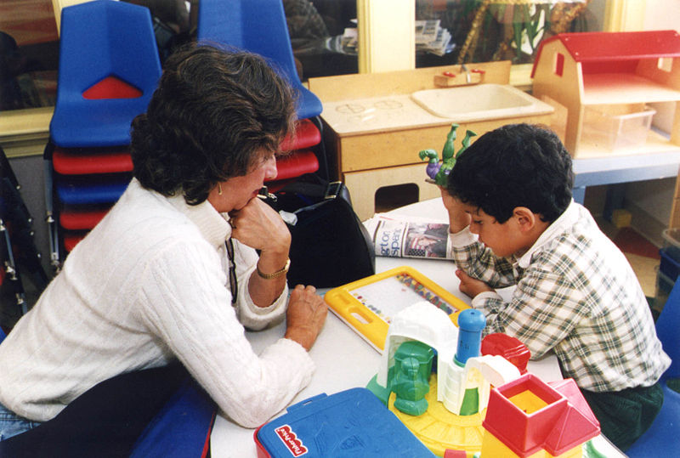
Effective Practices in Special Education
Definition
A practice that has positive and socially meaningful effects
Identification
Scientific research is the most reliable way to determine “what works”
More research, more confidence
Importance
Critical for meeting the unique needs of students with disabilities

Slide 5
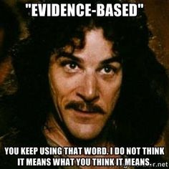
Related Terminology
Term | Synonyms | Definition
Best Practice | Recommended practice | May or may not be evidence based May be promoted because of research, expert opinion, theory
Research-based practices | Promising practices | Supported by some research but may not meet standards for design, quantity or quality to be an EBP
Cook et al., 2016
Notes:
Over the years the field of education has used so many terms to indicate a practice is “effective” but these terms may be used to refer to practices that have not been validated as effective through high quality experimental research.

Slide 6
What are Evidence Based Practices (EBPs)?
Represent practices with the best of evidence of “what works”
Research Design | Experimental
Quality | Description of context/setting, participants, interventionist, practice Implementation fidelity Internal validity Outcome measure/data analysis
Quantity | A number of high quality studies support a practice’s effectiveness
Magnitude of effect | Positive and meaningful effects
AND
(in the most conservative application of the definition)
Have been classified as such through a
FORMAL
EVIDENCE-BASED REVIEW
(Cook & Cook, 2013, Cook et al., 2016)

Slide 7

Why EBPs?
No one study is perfect
Researchers conduct systematic reviews to synthesize the findings across studies
Example: Video modeling
IDEA
Scientifically validated, scientifically based, research based
EBPs critical for specially designed instruction
meet individual needs
improve outcomes
ESSA
evidence-based strategies, intervention, coursework
Benefits
More likely that student outcomes will be improved
Less trial and error
less time wasted
Notes:
Update

Slide 8
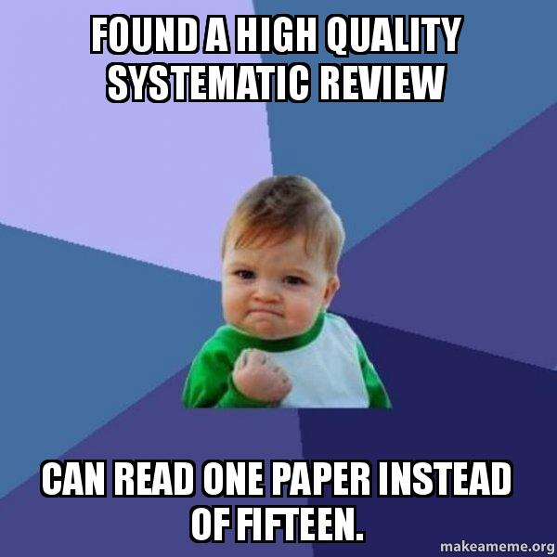
Evidence Based Reviews
A type of Systematic Review

Slide 9
Characteristics of Evidence-Based Reviews
THREE distinguishing characteristics from other types of reviews (e.g., meta-analyses):
Classify the evidence base of an instructional practice
e.g., EBP, potential EBP, Ineffective practice
ONLY experimental studies with appropriate methodological quality are used to classify
Quality indicators used to determine methodological rigor
Used a set of predetermined set of standards for determining sufficient level of quality and quantity
e.g., Council for Exceptional Children, What Works Clearinghouse
(Cook et al, 2019)

Slide 10
Steps of an EBP review
Step 1: Identify a practice and set scope of review
Step 2: Identify standards and set inclusion/exclusion criteria
Step 3: Locate all relevant studies that employ a design from which causality can be inferred
Step 4: Use a set of EBP standards (e.g., CEC 2014) to Identify methodologically sound studies
Step 5: Determine whether there is enough evidence (i.e., methodologically sound studies) to classify an EBP

Slide 11
Step 1: Identify a Practice/Program and Scope of review
Scope of the review:
Define the practice
Define WHO
Define WHAT OUTCOMES
Define Context/Setting
Discuss:
Why is it important for review teams to clearly define the scope of the review?
Who? Outcomes?

Slide 12
Step 2: Identify standards and finalize inclusion/exclusion criteria
Standard | Classifications | Important Notes
WWC (2013) | Positive effects Potentially positive effects Mixed effects No discernable effects Potentially negative effects Negative effects | Institute of Educational Science Original publication 2003 Originally included only experimental/quasi-experimental designs Reviews educational programs
Gersten et al. (2005) | Evidence-based Promising Not evidence-based | Standards designed to review special education research Group designs only
Horner et al. (2005) | Evidence-based Not evidence-based | Standards designed to review special education research Single-case design only
Council for Exceptional Children (2014) | Evidence-based practice Potentially-evidenced based practice Mixed evidence Insufficient evidence Negative effects | Adapted from Gersten et al. (2005) and Horner et al. (2005) Adopted by CEC Combined set of quality indicators for BOTH group and SCD
Kratochwill (2010, 2013) | Positive effects Potentially positive effects Mixed effects No discernable effects Potentially negative effects Negative effects | WWC standards for SCD
National Autism Center | Established Emerging Unestablished Ineffective/Harmful
Reichow et al. (2008) | Established EBP Promising EBP Not an EBP
Best Evidence Encyclopedia (n.d.) | Strong Evidence of Effectiveness Moderate Evidence of Effectiveness Limited Evidence of Effectiveness: strong Evidence of Modest Effects Limited Evidence of Effectiveness: Weak Evidence with notable effects No qualifying Studies
(Cook, Collins, Cook, Cook, & Ray, 2019)

Slide 13
Step 2: Identify standards and finalize inclusion/exclusion criteria
Set inclusion/exclusion criteria for studies included
Based on Scope
Participants
Outcomes
Context/setting
Types of publications:
Peer reviewed?
Dissertations?
Types of design
Group?
SCD?
Discussion
Why are only studies with certain designs included in EBP reviews?

Slide 14
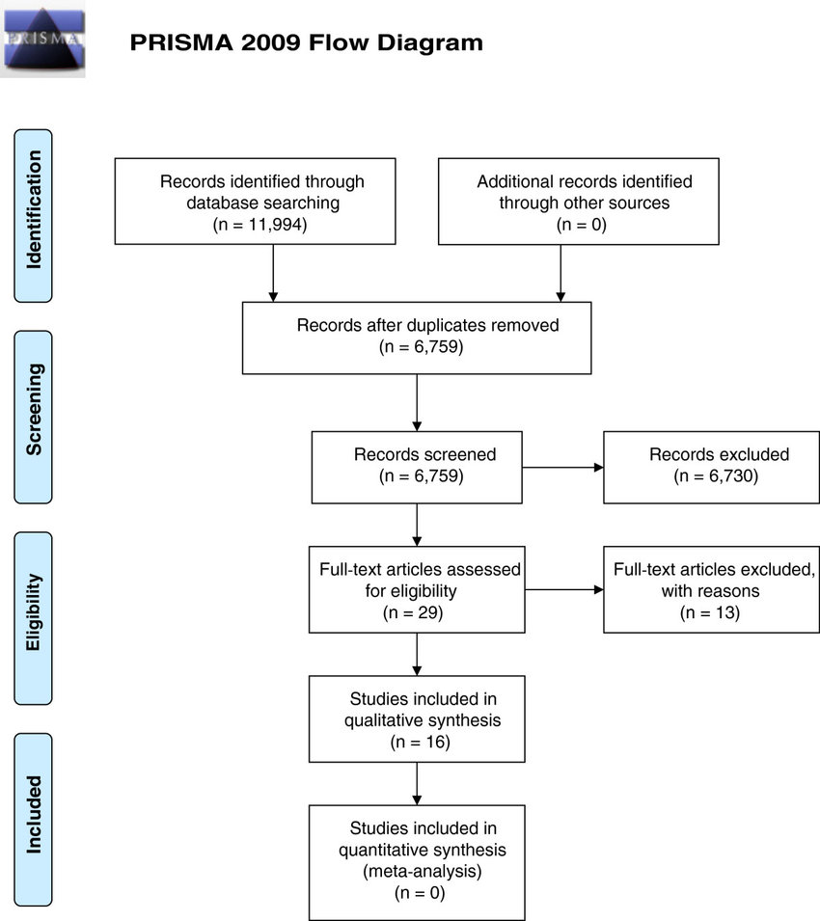
Step 3: Locate all relevant studies
Electronic Database Search
Hand Search

Slide 15
Step 4a: Identify methodologically sound studies
Process
Examples of Quality Indicators
“Quality Indicators” assist review teams with identifying the high quality studies
Each study identified in the search is coded to determine whether it meets methodological rigor
ONLY studies that meet the specific criteria are used to make EBP classification
Different standards (e.g., CEC. 2014; National Autism Center) have different levels of QIs
Studies provide:
Sufficient information regarding context and setting of study, participants, interventionist
Evidence of implementation fidelity
Internal validity
Controls and systematically manipulates IV
Control/comparison
Outcome measures are appropriate
Appropriate data analysis

Slide 16
Step 5: Determine the evidence
Using the METHODOLOGICALLY sound studies:
Classify the effects of each study
e.g., positive, mixed/neutral, negative
Make an evidence-based classification
Examples
CEC (2014): EBP, promising practice, mixed evidence, insufficient evidence, negative effects
WWC (2013): positive effects, potentially positive effects, mixed effects, no discernable effects, potentially negative effects, negative effects

Slide 17
Activity: Analyzing an EBP Review
Review the process and reporting
Understand the classification of a specific practice/program
including scope of the review
Practice how to articulate findings
if it is not an EBP, we need to understand the evidence more broadly
Materials:
Cook, S.C., Cook, B.G., . & Cook, L. (2017). Classifying the evidence base of classwide peer tutoring for students with high-incidence disabilities. Exceptionality, 9-25. doi: 10.1080/09362835.2016.1196448
Organizer with guiding questions

Slide 18
Reasons for a Practice NOT being Classified as an EBP
Has not been subject of an evidence-based review
Has been subject of an evidence-based review:
but did not meet standards of quality
evidence suggest the practice is not effective for target population
Discuss for each case:
What does this tell us about the “effectiveness” of a practice?

Slide 19
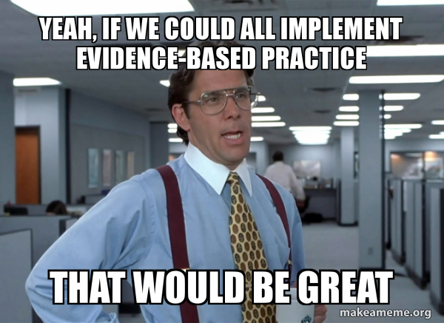
Disseminating EBPs
S
Considerations for Bridging the Research-to-Practice Gap

Slide 20
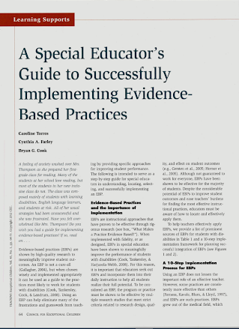
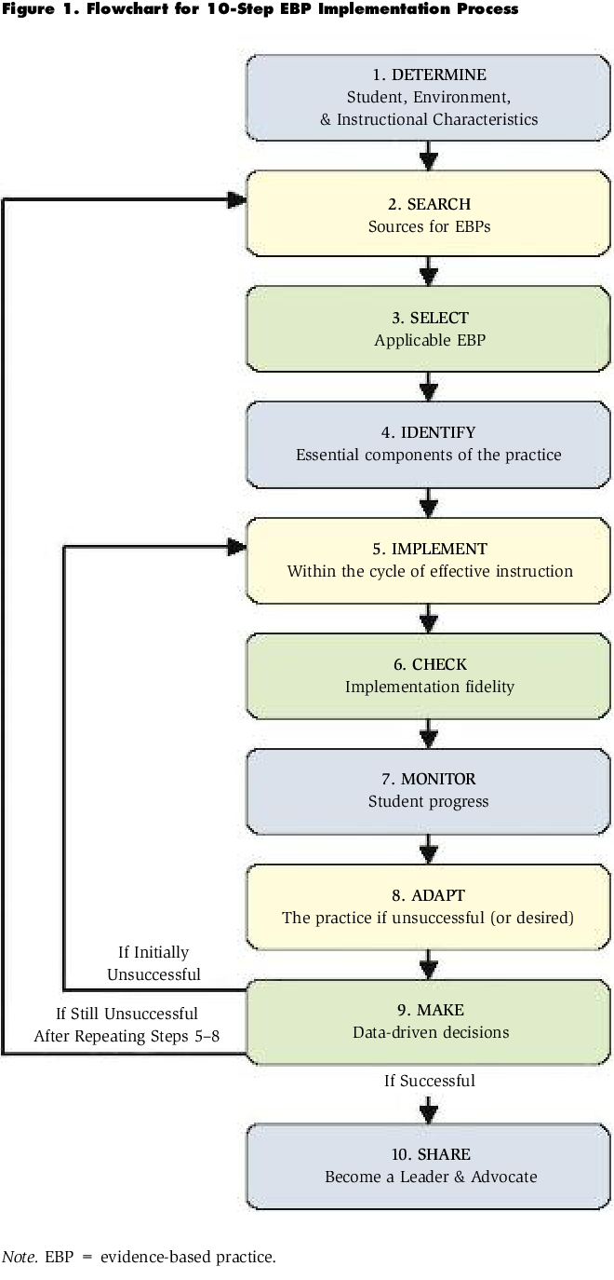

Steps for Implementation
Determine Characteristics
SEARCH for EBPs
SELECT EBP
IDENTIFY essential components
IMPLEMENT
CHECK implementation fidelity
MONITOR student progress
ADAPT (if necessary)
MAKE data driven decisions
SHARE
?
?
?
Torres et al., 2012

Slide 21

Supporting Dissemination
How can we support practitioners in:
Using reliable resources?
Selecting an appropriate EBP from a reliable source?
Implementing the practice with fidelity?

Slide 22
Reliable Resources
Sources for EBPs:
Organizations that publish their own EBP reviews online
e.g., WWC
Organizations/sites that link to EBPs
e.g., IRIS Evidence-based practice summaries
Peer reviewed journals
independent EBP reviews
Other online reliable resources:
Provides practitioners with information regarding effective practices, but may not provide information to whether the practices have undergone FORMAL evidence-based reviews.
Varied “levels” of evidence
May be EBPs, may be “promising” or “potential” EBPs

Slide 23
Online Reliable Resources
Sources for published EBP reviews:
IRIS Evidence-based Practice Summaries
https://iris.peabody.vanderbilt.edu/resources/ebp_summaries/#content
What Works Clearinghouse:
http://ies.ed.gov/ncee/wwc/
National Professional Development Center on Autism Spectrum Disorder
http://autismpdc.fpg.unc.edu/evidence-based-practices
Evidence--based Instructional Practices for Young Children with Autism and Other Disabilities
https://ebip.vkcsites.org/
Other Reliable Resources:
Center for Early Literacy Learning (CELL)
Research syntheses (no quality review or classification)
http://www.earlyliteracylearning.org/index.php
Early Childhood Technical Assistance Center
Links to both EBP review sources and other reliable sources
https://ectacenter.org/topics/evbased/evbased.asp
The University of Kansas Life Plan Institute
http://kskits.dept.ku.edu/ta/virtualKits/BecomingAnEvidence.shtml
Notes:
Update right side

Slide 24
Using Resources to Select an EBP
Considerations | Challenges | Support Considerations
Alignment is critical The closer the “match” the more likely it will lead to improved outcomes student needs environmental Family input Professional judgment to determine which is more likely to improve outcome(s) Always consider the best available evidence | Information difficult to locate and interpret e.g., Information published in peer reviewed journals Background in EBPs/Research Design, Reporting Inventory is constantly changing Organizations and sites have their own rating system (if applicable) Familiarity with ratings allows a more informed decision Not all EBPs are determined equally | Pre-service and in-service teachers may benefit from Professional development and coaching in Using reliable resources identifying a practice that aligns locating resources for additional information Support in selecting practices using the best available evidence Providing options of EBPs to address target outcome
(Cook et al., 2016; The IRIS Center, 2014)

Slide 25
Implementation
Considerations | Challenges | Support Considerations
In order to be confident that an EBP will work: Practitioners understand the critical components Implement with fidelity Balance with individualization, Professional judgment | Information on implementation can be difficult to locate and interpret Examination of multiple sources before understanding steps of implementation | Identify active ingredients Providing information on resources that are “practitioner” friendly IRIS modules Link to Evidence-Based Instructional Practices website. Effective professional development/coaching modeling/demonstrating practice feedback
(Cook et al., 2016; Harn et al., 2013; The IRIS Center, 2014)

Slide 26
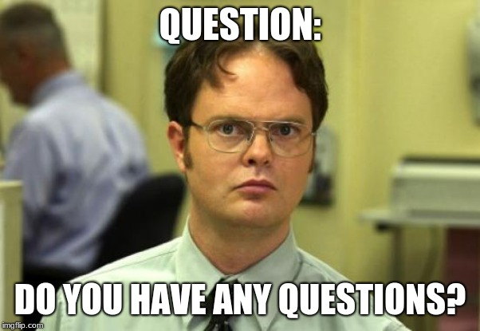
Questions?
cothren@hawaii.edu

