Slide 1
Characteristics and Etiology of Infants and Young Children with Disabilities
Sensory Impairments:
Hearing impairment, Vision Impairment, and Deaf-Blindness

Slide 2
Agenda
Individuals with Disabilities Education Act
Sensory impairments
Hearing Impairment
Vision Impairment
Deaf-blindness
Topics
Anatomy, physiology, function
Assessment and intervention
Effects on development
Services and resources

Slide 3
Individuals with Disabilities Education Act (IDEA) I
Part A: General provisions
Part B: Assistance for all children with disabilities (ages 3-21)
Part C: Infants and toddlers with disabilities (ages 0-3)
Part D: National activities to improve education of children with disabilities
Individuals with Disabilities Education Act (IDEA);
(Lenihan, et al., 2020). Chapter 10 Educational Settings

Slide 4
Individuals with Disabilities Education Act (IDEA) II
Elements
Individualized Education Program (IEP)
Free Appropriate Public Education (FAPE)
Least Restrictive Environment (LRE)
Parent and Teacher Participation
Procedural Safeguards
Individuals with Disabilities Education Act (IDEA);
(Lenihan, et al., 2020). Chapter 10 Educational Settings

Slide 5
IDEA Part C: Early Intervention Services
Services are voluntary for parents of eligible children ages 0 - 3
Eligibility for early intervention services is determined by individual states
Services are provided in the “natural environment,”
Environment in which child would be (home, daycare) with or without a disability

Slide 6
IDEA Part B: Educational Services
Transition to Part B at age 3
Services are typically delivered in a school setting

Slide 7
Placement
Terms
Setting/Environment
Inclusion
Mainstreaming
Reverse mainstreaming
Local district public school: general education classroom
Local district public school: general education classroom with resource room support
Local district public school: separate or self-contained classroom
Nonresidential (public or private/out-of district)
Residential
(Lenihan, et al., 2020). Chapter 10 Educational Settings

Slide 8
Services
Supports and Curriculum Access
Setting/Environment
Remediation
Modification
Accommodations
Class within a class, or co-teaching
Push-in services
Pull-out services
Resource room
(Lenihan, et al., 2020). Chapter 10 Educational Settings

Slide 9

Hearing Impairment

Slide 10
Introduction to Hearing Impairment
Ear anatomy & physiology
Types of hearing impairment
Hearing tests
Hearing technology
Effects on development
Services
Resources for families

Slide 11
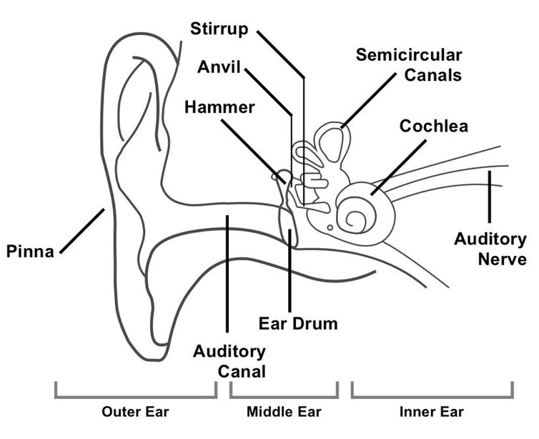
Anatomy and Physiology of the Ear
Outer ear
Middle ear
Inner ear
Image Source: https://www.researchgate.net/figure/Diagram-showing-the-structure-of-the-human-ear-detailing-the-parts-of-the-outer_fig1_324547019

Slide 12
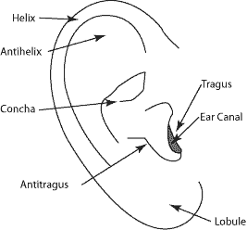
The Outer Ear
Pinna or aurical
Made of cartilage
Cone/conch shaped to collect sound
Includes ear canal
Tympanic membrane (eardrum) is dividing line between outer ear and middle ear
Image Source: https://med.uth.edu/orl/online-ear-disease-photo-book/chapter-3-ear-anatomy/ear-anatomy-outer-ear/

Slide 13
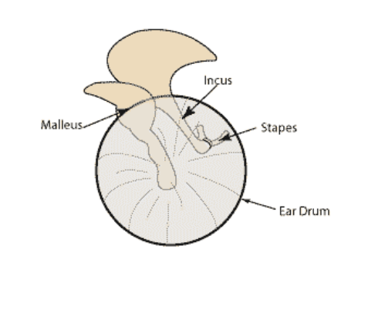
The Middle Ear
Space inside the eardrum
Smallest bones in the body
Malleus (hammer)
Incus (anvil)
Stapes (stirrup)
Ossicles is term for chain of all 3
Vibrations from eardrum set ossicles in motion to amplify the sound
Image Source: https://med.uth.edu/orl/online-ear-disease-photo-book/chapter-3-ear-anatomy/ear-anatomy-outer-ear/

Slide 14
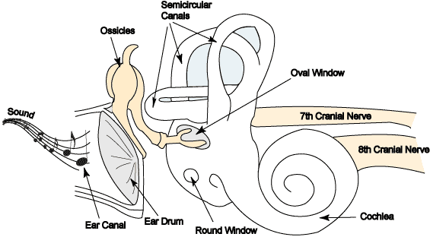
The Inner Ear
Cochlea
Snail shaped
Hairs send electrical impulses to brain
Auditory nerve
Cranial nerve 8
Semicircular canals
Regulates balance
Image Source: https://med.uth.edu/orl/online-ear-disease-photo-book/chapter-3-ear-anatomy/ear-anatomy-inner-ear/

Slide 15
Discussion Questions
Talk and turn to the person next to you:
How might damage to different parts of the ear affect hearing differently?
Why is it important for educators to understand ear anatomy?

Slide 16
Types of Hearing Impairment
Hearing impairment can be:
Bilaterial or unilateral
Temporary or permanent
Types
Conductive
Sensorineural
Mixed

Slide 17
Conductive Hearing Loss
Sound cannot get through outer and middle ear
Obstruction
Poor Eustachian tube function
Can be due to fluid or infection
Structural abnormality
Sometimes medicine or surgery can correct

Slide 18
Sensorineural Hearing Loss
Due to inner ear damage
Problems with nerve pathway
Hearing aid or cochlear implant may help
Sensorineural hearing loss is the most common permanent hearing loss.

Slide 19
Mixed Hearing Loss
Simultaneous conductive and sensorineural hearing loss
Caused by same factors as independent conductive or sensorineural
Having both can be more severe effect on hearing

Slide 20
Levels of Hearing Impairment Severity
Degree of hearing loss | Hearing loss range (dB HL)
Normal | -10 to 15
Slight | 16 to 25
Mild | 26 to 40
Moderate | 41 to 55
Moderately severe | 56 to 70
Severe | 71 to 90
Profound | 91+
ASHA, Degree of Hearing Loss

Slide 21
Discussion
How might a child with moderate hearing loss experience the classroom differently than one with profound loss?

Slide 22
Pediatric Physiologic Hearing Tests
Acoustic immittance
Otoacoustic emissions (OAE)
(Automated) Auditory brainstem response (AABR)
Tympanometry

Slide 23
Pediatric Behavioral Hearing Tests
Behavioral observation audiometry
Visual reinforcement audiometry
Conditioned play audiometry
Speech audiometry
Speech recognition threshold
Word recognition testing

Slide 24
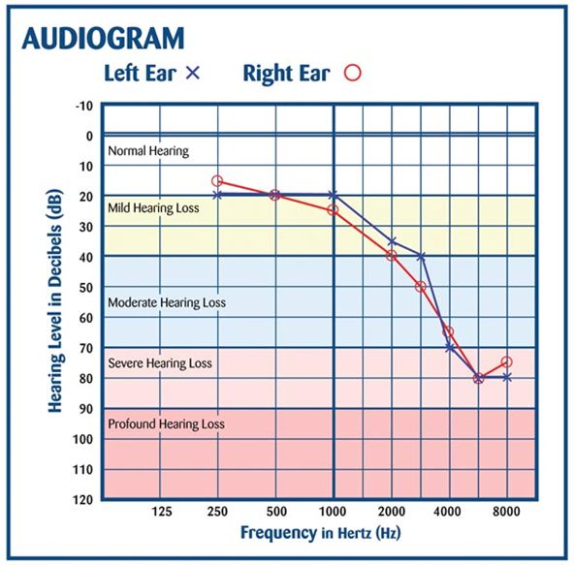
Audiogram
Results of pure-tone hearing test
Type, degree, and configuration of hearing loss
Horizontal lines are pitches/frequencies
Vertical lines are loudness/intensity
Red/“O” is right ear
Blue/“X” is left ear
National Hearing Test, How to Read an Audiogram

Slide 25
Causes of Hearing Impairment in Children
Congenital
Acquired
Intrauterine infections including rubella, cytomegalovirus, and herpes simplex virus
Complications with Rh factor in the blood
Prematurity
Maternal diabetes
Toxemia during pregnancy
Lack of oxygen (anoxia)
Ear infections
Ototoxic drugs
Meningitis
Measles
Encephalitis
Chicken pox
Influenza
Mumps
Head injury
Noise exposure
ASHA, Causes of Hearing loss in children

Slide 26
Early Identification and Prevention Protocols
Early Hearing Detection and Intervention (EHDI)
Newborn hearing screening: Usually AABR, OAE, or both
1-3-6 Rule
Screened by 1 month
Full assessment by 3 months
Intervention services by 6 months
CDC, Newborn Hearing Screening

Slide 27
Assistive Devices: Hearing
Hearing aids
Cochlear implants
FM systems/other

Slide 28
Hearing Aids
Types
Air conduction or bone conduction
Behind-the-ear (BTE)
In-the-ear (ITE)
Parts
Microphone
Receiver
Volume control
On/off and battery door
Ear mold/ear hook

Slide 29
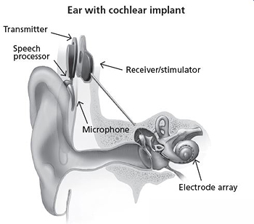
Cochlear Implants
Requires surgery
Sound processor behind the ear
Receiver and stimulator implanted under skin
Electrodes threaded into cochlea
Image Source: https://www.nidcd.nih.gov/health/cochlear-implants

Slide 30
FM Systems and Other Technology
Frequency modulation
Use radio waves to transmit sound
Infrared systems
Induction loop systems
Telephone amplifiers or text telephones (TDD or TTY)
Alerting devices
ASHA, Hearing Assistive Technology Systems

Slide 31
Effect on Child Development
Communication/language development
Cognitive development
Social development
Academic success

Slide 32
Communication Development
Early identification leads to best outcomes
Family communication modality choice
Support families through options
Delayed speech and language skills
Professionals play a role in early intervention and school settings

Slide 33
Communication Modalities
Auditory or Listening and Spoken Language (LSL) approaches
Auditory verbal
Auditory oral
Manual or Signed approaches
Cued speech
Manually coded English
American Sign Language
Total communication
Lenihan, et al., 2020. Chapter 2 Communication Options

Slide 34
Language Development
Language
Learn concrete words first (nouns)
Understand and use shorter sentences
Speech
Difficulties related to not hearing sounds clearly
Errors with high frequency/soft sounds (s, sh, f, t, or k)
Volume/pitch modulation
Signs
Approximated at young age
Develops into fully formed language
Lenihan, et al., 2020. Chapter 2 Communication Options

Slide 35
Cognitive Development
Cognitive skills develop in context of other skills
Influenced by experience/input
Can be impacted by other domains
Visual impairment
Motor impairment
Working memory impacted
Fluency and speed of processing slower
Executive function difficulties
Lenihan, et al., 2020. Chapter 3 Cognitive Development

Slide 36
Social Development
Closely related to cognitive skills
Hearing impairment is risk factor for social difficulties
Many variables related to language development
Importance of early identification and intervention
Importance of social relationships
Lenihan, et al., 2020. Chapter 4 Social Development

Slide 37
Disciplines Involved: Hearing
Family
Teacher of the Deaf
Special Education teacher
Speech Language Pathologist
General Education teacher
Sign Language Interpreters
Paraprofessionals
Audiologists
Other professionals as needed
Lenihan et al., 2020. Chapter 10 Educational Settings

Slide 38
Early Intervention Services for Hearing
IDEA Part C
Should start by 6 months
Automatic qualification in most states
Coaching model to train caregivers
Family-centered

Slide 39
Activity: Early Identification and Intervention
Present a brief fictional case (e.g., a 2-month-old infant with suspected hearing loss).
Break into small groups:
Identify which assessments would be appropriate.
Outline the timeline using the 1-3-6 Rule.
Recommend early intervention strategies based on IDEA Part C.

Slide 40
Family Empowerment: Hearing
Prioritizes family goals
Participatory decision-making
Service coordination and collaboration
Supports families to overcome challenges
Enables families to access resources
Improves overall quality of life

Slide 41
Resources for Families: Hearing
Screening and assessment resources
Information about hearing impairment
Resources regarding communication options
Local and state resources
Federal programs
Educational resources
Professional organizations

Slide 42

Vision Impairment

Slide 43
Introduction to Visual Impairment
Eye anatomy & physiology
Types of visual impairment
Visual tests
Assistive technology
Effects on development
Services
Resources for families

Slide 44
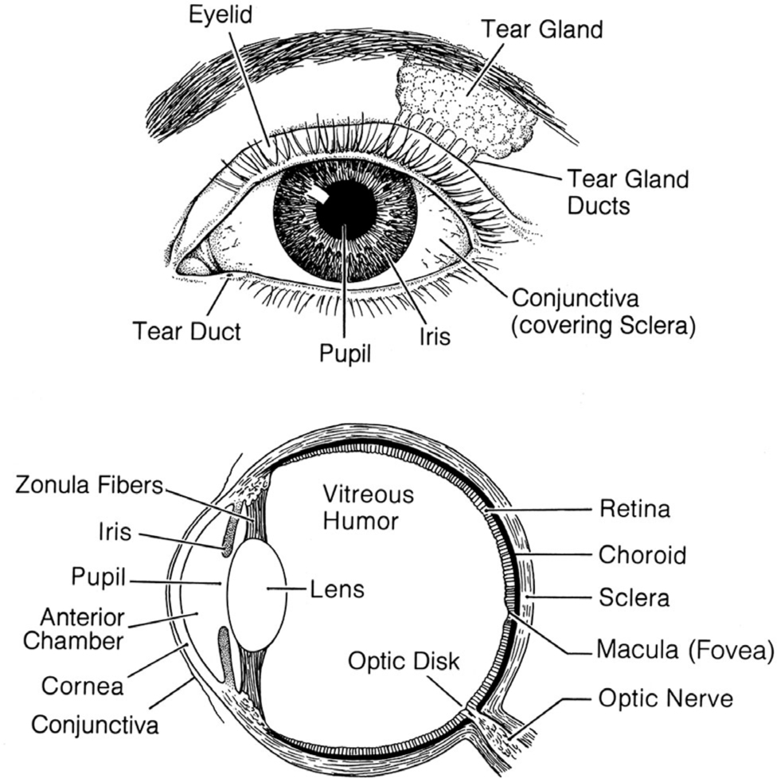
Outer Eye
Conjunctiva
Eyelid
Tear gland
Tear gland ducts
Tear ducts
Batshaw, et al., 2019. Chapter 7 The Senses

Slide 45
Eyeball
Set in an orbit (socket)
Surrounded by soft, fatty tissue to protect the eye and enables it to turn easily

Slide 46
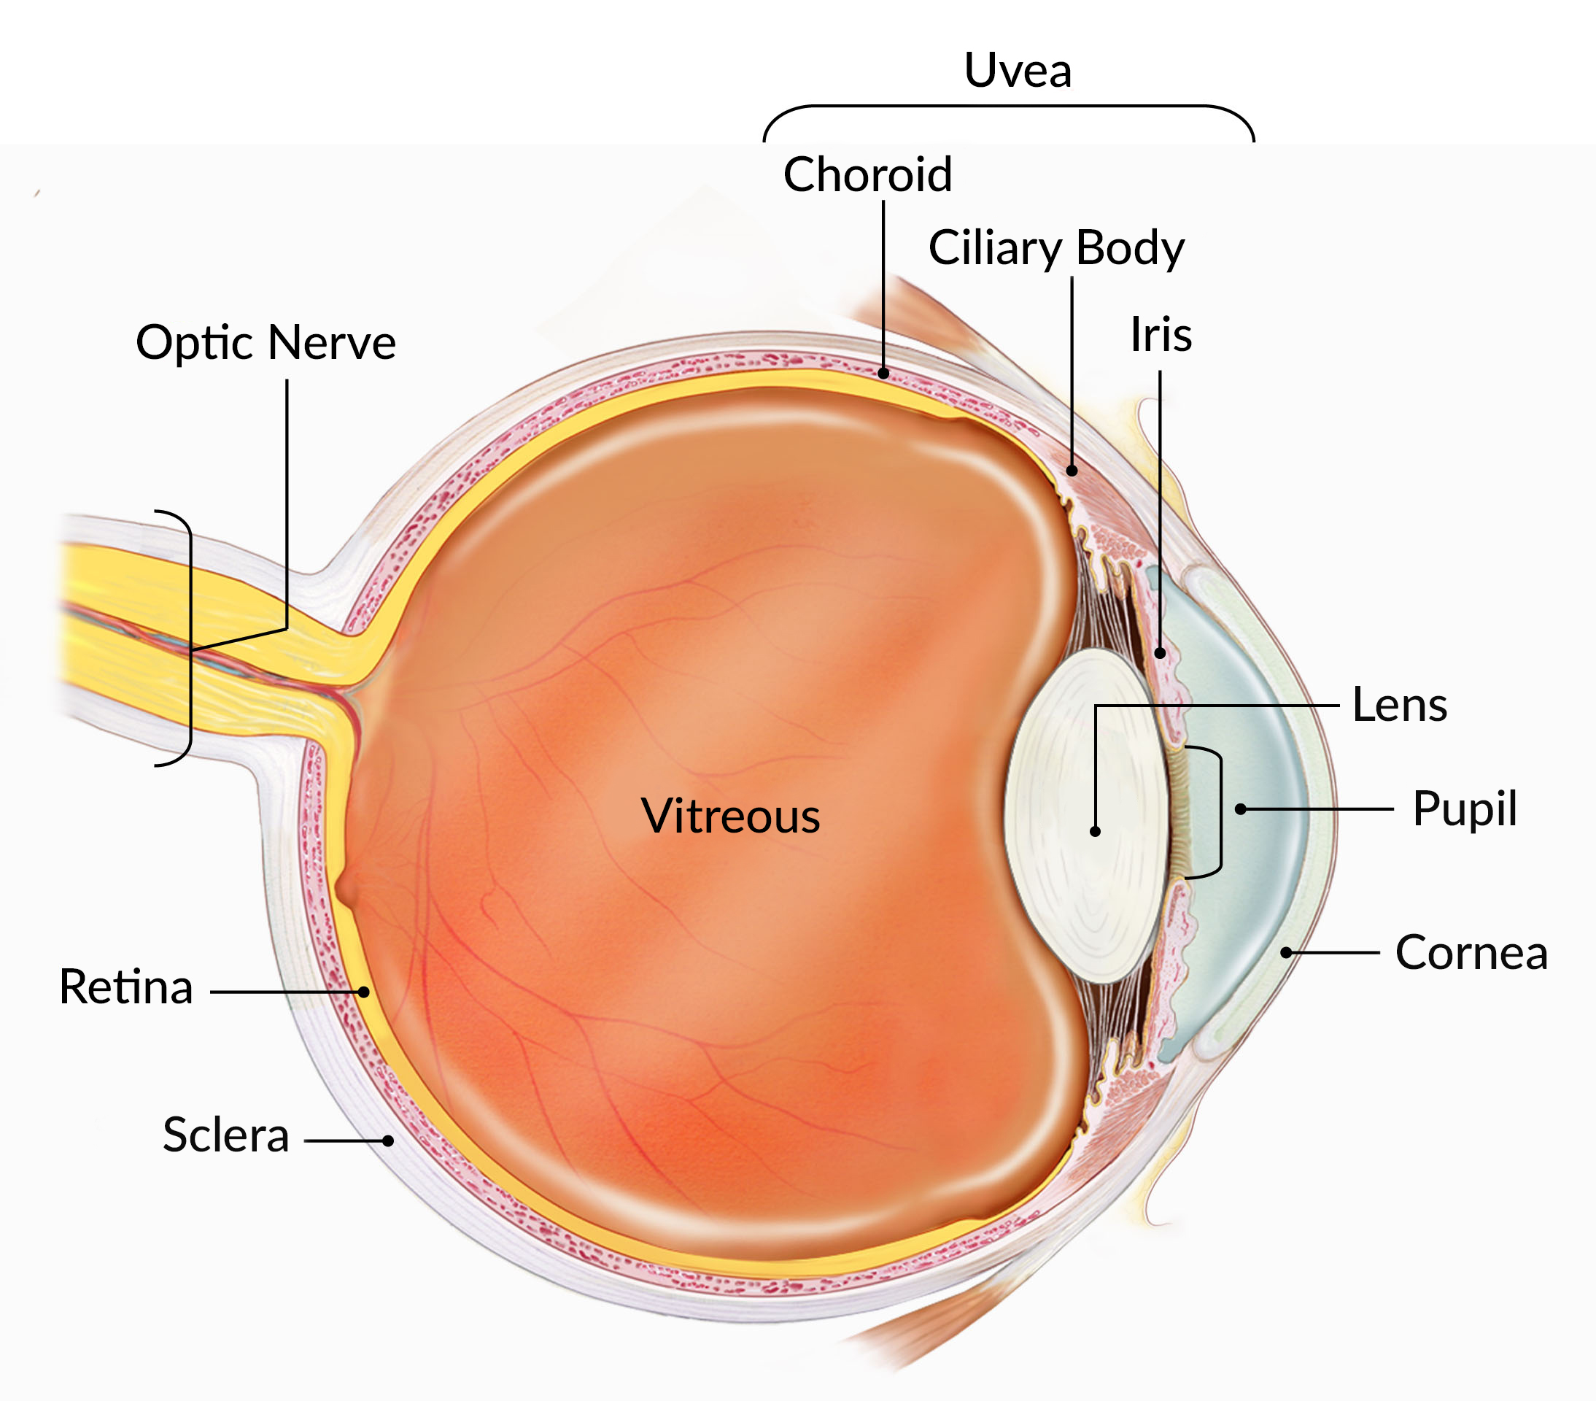
How the Eye Works
Cornea bends light to help the eye focus
Light passes through the lens to focus correctly on the retina
Light hits the retina
Special cells turn the light into electrical signals
Electrical signals travel from the retina to the brain
NIH National Eye Institute, How the eyes work

Slide 47
Optic nerve and visual processing
Optic nerve transports signals to the brain
Signal is processed by visual cortex
Lens forms an inverted image of an object and projects it onto the retina

Slide 48
Types of vision impairment
Nearsighted (Myopia)
Trouble seeing objects that are far away
Farsighted (Hyperopia)
Trouble seeing objects that are close
Irregular vision (Astigmatism)
Abnormal eye shape makes vision blurry or distorted
Lazy eye (Amblyopia)
One eye is weaker than the other
Wandering eye (Strabismus)
Eyes don’t line up or are crossed

Slide 49
Type of Vision Impairment: Amblyopia
Sometimes called “lazy eye”
Decrease in vision occurs when one or both eyes send a blurry image to the brain
Brain learns to see only blurry with that eye
Can happen even with no structural problems of the eye
Found in about 2% of 6- to 72-month-old children
Most common cause of vision impairment in children

Slide 50
Type of Vision Impairment: Strabismus
Sometimes called “wandering eye”
Caused by abnormality of neuromuscular control of eye movement or poor eye muscle strength (less common)
Eyes don’t line up or are crossed
The eyes (one or both) may turn inward, outward, up, or down
More than one condition may be present
One of the most common, intermittent eye problems in infants younger than 6 months

Slide 51
Less Common Visual Impairments
Congenital Cataracts: Lens of the eye is cloudy
Retinopathy of Prematurity: Retina hasn’t developed sufficiently before birth
Retinitis Pigmentosa: Rare inherited disease that destroys the retina
Coloboma: A portion of the structure of the eye is missing
Optic Nerve Hypoplasia: Underdeveloped fibers in the optic nerve affect depth perception, sensitivity to light, and acuity of vision
Cortical Visual Impairment (CVI): Damage to the part of the brain related to vision, not to the eyes themselves

Slide 52
Vision Screening for Infants and Toddlers
Response to light
An infant will blink in response to a bright light
Pupil response
Shining a penlight in the eye
Ability to follow a target
Look at and follow an object or toy
Visually evoked response testing
Stimulate the eyes with a bright light or pattern
Cover and uncover test (toddlers)
Movement and alignment of the eyes that may happen when a child is focusing on an object

Slide 53
Visual Screening Tests for a Preschooler
Visual acuity tests
Specific tests and charts used to measure near and distant vision
Charts may consist of pictures or stories instead of letters of the alphabet
Color testing
Determine color blindness

Slide 54
Discussion
What are the key differences in screening approaches for infants vs. preschoolers?
How can early screening improve long-term outcomes?

Slide 55
Early Identification
The American Academy of Pediatrics (AAP) and the American Academy of Ophthalmology (AAO) recommend:
Vision screenings during newborn period
Eye exams at regular wellness visits

Slide 56
Prevention Protocols
The U.S. Preventive Services Task Force (USPSTF) recommends:
Specific screenings for amblyopia and strabismus, and visual acuity defects
Appropriate between ages 3-5 years old

Slide 57
Assistive Devices/Visual Aids
Glasses or corrective lenses
Specialized low vision aids
Assistive technology

Slide 58
Glasses/Corrective Lenses
Glasses/corrective lenses help eyes to focus light properly onto retina.
Glasses
Contacts
Intraocular lenses

Slide 59
Low Vision Aids
Designed to improve visual performance
Enable academic and social adaptation
Provide enrichment of daily experiences
Can be optical or optical and electronic

Slide 60
Assistive Technology
Type of accommodation
Helps students with disabilities gain access to the curriculum
IEP team is responsible for considering assistive technology for students with disabilities
Providers and educators should be familiar with the process of trialing, choosing, requesting, training use of assistive technology

Slide 61
Effect on Child Development
Communication/language development
Cognitive development
Social development
Academic success

Slide 62
Early Intervention Services for Vision
IDEA Part C
Qualification varies by state
Coaching model to train caregivers
Family-centered

Slide 63
Sensory Training
A child with vision impairment should be taught to use the remaining senses effectively and collect information from the environment.

Slide 64
Disciplines Involved: Vision
Family
Vision Specialist
Special Education teacher
General Education teacher
Paraprofessionals
Other professionals as needed

Slide 65
Family Empowerment: Vision
Prioritizes family goals
Participatory decision-making
Service coordination and collaboration
Supports families to overcome challenges
Enables families to access resources
Improves overall quality of life

Slide 66
Resources for Families: Vision
Screening and assessment resources
Information about vision impairment
Resources regarding communication options
Local and state resources
Federal programs
Educational resources
Professional organizations

Slide 67
Deaf-Blindness

Slide 68
Causes and Types of Deaf-Blindness
Congenital
Acquired
Infection during pregnancy
Premature birth
Birth trauma
Rare genetic conditions
Illness
Injury/Accident

Slide 69
Assessment of Deaf-Blindness
Authentic assessment
Communication, social, motor skills
Type and severity of vision and hearing loss
Interests and temperament
Cognitive development
Strengths and difficulties
Family involvement
Team of specialists
Observations across settings and activities
National Center on Deaf-Blindness, Authentic Assessment
Notes:
https://www.nationaldb.org/info-center/authentic-assessment-practice-perspective/

Slide 70
Life Skills Programs
Goal is to enable greatest level of personal independence
Instruction is provided through a multisensory approach:
Visual
Tactual
Auditory
Olfactory
Gustatory
Kinesthetic

Slide 71
Communication
Common Difficulties
Additional Difficulties
Speech
Sign
Pictures
Drawings
Communication boards
Moving to an object
Standing near an object
Eye gaze
Withdrawal
Changes in muscle tone

Slide 72
Disciplines Involved: Deaf-Blind
Family
Deaf-blind Specialist
Teacher of the Deaf
Vision Specialist
Special Education teacher
Speech Language Pathologist
General Education teacher
Paraprofessionals
Audiologists
Other professionals as needed

Slide 73
Family Empowerment: Deaf-Blind
Prioritizes family goals
Participatory decision-making
Service coordination and collaboration
Supporting families to overcome challenges
Enable families to access resources
Improve overall quality of life

Slide 74
Family Empowerment: Deaf-Blind
Prioritizes family goals
Participatory decision-making
Service coordination and collaboration
Supports families to overcome challenges
Enables families to access resources
Improves overall quality of life

Slide 75
Resources for Families: Deaf-Blind
Screening and assessment resources
Information about vision impairment
Resources regarding communication options
Local and state resources
Federal programs
Educational resources
Professional organizations

Slide 76
Conclusion
The senses provide children with a means to adapt and regulate their responses to the world around them.
As service providers and educators, we strive to support how children learn to live in and at times cope with the world around them, and find healthy outlets for expressing their needs, wants, and desires.

Slide 77
Resources for Families
American Association of the Deafblind (AADB)
American Federation for the Blind (AFB)
CDC: Hearing Loss in Children: Resources
National Center on Deafblindness (NCDB)
National Family Association for Deafblind (NFADB)
Perkins School for the Blind
State Deafblind Projects

Slide 78
References
Batshaw, M. L., Roizen, N. J., & Pellegrino, L. (Eds.). (2019). Children with disabilities (8th ed.) Paul H. Brookes.
Boothroyd, A., & Gatty, J. (2011). The deaf child in a hearing family: Nurturing development. Plural Publishing.
Goodman, S., & Wittenstein, S. (Eds.). (2003). Collaborative assessment: Working with students who are blind or visually impaired, including those with additional disabilities. AFB Press.
Kyzar, K. B., Brady, S. E., Summers, J. A., Haines, S. J., & Turnbull, A. P. (2016). Services and supports, partnership, and family quality of life: Focus on deaf-blindness. Exceptional Children, 83(1), 77-91. https://doi.org/10.1177/0014402916655432
Lenihan, S., Voss, J, White, E., & Salvucci, D. (Eds.). (2020). Preparing to teach, committing to learn: An introduction to educating children who are deaf/hard of hearing. National Center for Hearing Assessment and Management, Utah University. https://www.infanthearing.org/ebook-educating-children-dhh/
Nicholas J. (2020). Cognitive assessment of children who are deafblind: Perspectives and suggestions for assessments. Frontiers in Psychology, 11, 571358. https://doi.org/10.3389/fpsyg.2020.571358

Slide 79
Disclaimer
This is a product of the Early Childhood Intervention Doctoral Consortium (ECiDC), a project of the A.J. Pappanikou Center for Excellence in Developmental Disabilities at UConn Health. The Center is funded through cooperative agreement number H325H190004 from the Office of Special Education Programs, U.S. Department of Education. Materials and opinions expressed herein do not necessarily represent the Department of Education’s position or policy.

