Slide 1
Characteristics and Etiology of Infants and Young Children with Disabilities Introduction to Traumatic Brain Injury

Slide 2
Discussion
Injured portions of the brain do not recover, but other areas can take over lost functions through therapy and rehabilitation (neuroplasticity).
How does this concept align with early intervention goals, and what specific strategies might support recovery and skill rebuilding for children with TBI?

Slide 3
Discussion
Children with TBI often require collaboration among medical, therapeutic, and educational teams.
What are the biggest challenges to achieving effective interdisciplinary collaboration, and how can early intervention programs overcome these barriers?

Slide 4
Agenda
Definition of TBI
Etiology and characteristics
History, policies, and legislation
Classification and categories of brain injuries
Early signs and symptoms
Effects on child development
Placement and services
Family empowerment
Prevention

Slide 5
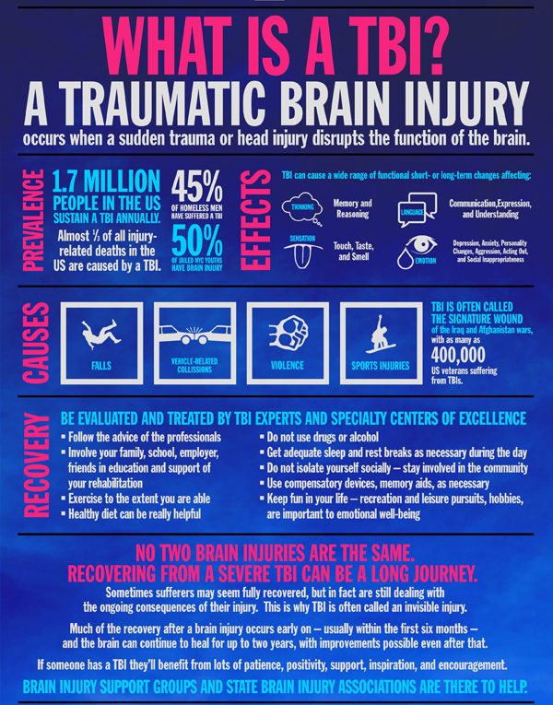
What is a Traumatic Brain Injury?
A traumatic brain injury (TBI) is any injury that affects how the brain works. TBIs may be caused by:
A bump, blow, or jolt to the head, or
A penetrating injury to the head.
CDC. Get the facts about TBI (2021). https://www.cdc.gov/traumaticbraininjury/get_the_facts.html
Notes:
What is Traumatic Brain Injury?
The Centers for Disease Control and Prevention (CDC) defines Traumatic Brain Injury as “an injury that affects how the brain works. It may be caused by a: bump, blow, or jolt to the head, or penetrating injury to the head.” (Get the facts about TBI 2021) “A TBI can have a profound impact on an individual’s life in one or more of the following areas: “interpersonal, social, and occupational functioning.” The impact of a TBI does not end with the individual it can also influence their family and community.

Slide 6
More about TBIs
A TBI can have a profound impact on a person’s life in one or more of the following areas:
Interpersonal functioning
Social functioning
Occupational functioning
CDC. Get the facts about TBI (2021). https://www.cdc.gov/traumaticbraininjury/get_the_facts.html

Slide 7
Prevalence of TBI in children
Over
Almost
16,000
3,000
Children (0-17)
were
Hospitalized for TBI
(2019)
Children (0-17)
died of
TBI
(2020)
https://www.cdc.gov/traumaticbraininjury/data/index.html
Notes:
According to the CDC in 2019 there were approximately 61,000 TBI-related deaths in the United States. (Get the facts about TBI 2021) Anyone can sustain a TBI at any point in their lives; however, some groups are more likely to have a TBI including “racial and ethnic minorities, service members and Veterans, people who experience homelessness, people who are in correctional and detention facilities, survivors of intimate partner violence, and people living in rural areas.” The most common causes of TBI include falls, firearm-related suicide, motor vehicle crashes, and assaults. (Get the facts about TBI 2021)

Slide 8
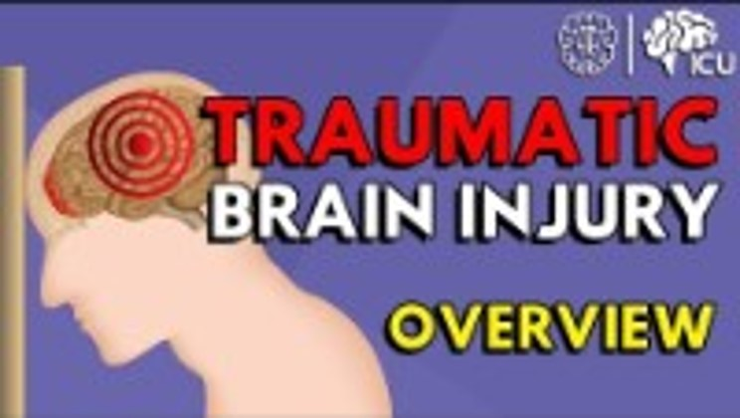
TBI: Etiology and Characteristics
Link to video
Notes:
Watch this video about the characteristics of TBI. https://www.youtube.com/watch?v=i7GidKRUzrY

Slide 9
History, Policies and Legislation
1996: The TBI Act (P. L. 104-166) signed into law. Addressed TBI prevention, research and service delivery.
Definition of TBI: “An acquired injury to the brain. Such term does not include brain dysfunction caused by congenital or degenerative disorders, nor birth trauma, but may include brain injuries caused by anoxia due to near drowning.”
National Conference on Rehabilitation
1996
2000
2008
2014
2018
Notes:
History
On July 29th, 1996, the Traumatic Brain Injury Act (P.L. 104-166) was signed into law by President Bill Clinton. This was the first time that legislation was applied at the federal level to address traumatic brain injury (TBI). This law addressed TBI prevention, research, and service delivery. The law provided a definition of TBI which stated that a traumatic brain injury is “[A]n acquired injury to the brain. Such term does not include brain dysfunction caused by congenital or degenerative disorders, nor birth trauma, but may include brain injuries caused by anoxia due to near drowning.”
The law was intended to help with prevention, service delivery, and research. It also allowed States to create surveillance systems to collect information on the number of people affect by traumatic brain injury (TBI) as well as the causes and severity of those injuries. The information obtained from these systems was necessary for states to create cost-effective programs for individuals living with TBI. These programs included vocational rehabilitation, school and community support, as well as evaluating the effectiveness of these programs. The Centers for Disease Control and Prevention’s (CDC) National Center for Injury Prevention and Control (NCIPC) worked to develop a surveillance system to obtain representative data on the incidence, causes, and risk factors of TBI nationally. This information would allow them to compare different areas.
This law required that the National Center for Medical Rehabilitation Research and the National Institutes of Health (NIH) to conduct a national consensus conference on rehabilitation. $3 million dollars a year from 1997 to 1999 was allocated to the CDC for projects and research for prevention. NIH was authorized to provide grants or contracts to public or nonprofit entities to
conduct research. This money also helped states establish an advisory board that would make recommendations on service coordination for those with a TBI.
In 2000 amendments (P.L. 106-310) specific to TBI were added to the Children’s Health Act.
This amendment extending funding to five years, provided additional funding to increase advocacy services, established a National Education and Awareness Campaign, and replaced the phrase “anoxia due to near drowning” with “anoxia due to trauma” in the definition of TBI.
The Traumatic Brain Injury Act was reauthorized in 2008. The amendments added the American Indian Consortium to be eligible for grants. It also made some minor changes to the language used in the bill to be in line with the language used by the CDC. In 2014 the TBI Act was amended again to
reauthorize funding, as well as declared that the CDC and NIH were to identify areas in need of research after reviewing the scientific evidence of brain injury management in children.
The most recent authorization of this act was in 2018, a year earlier than needed to honor the Republican Senator from Utah, Orrin Hatch, who was one of the original sponsors of the 1996 bill. These amendments will be in effect until 2024.
Federal agencies that work with TBI include the Centers for Disease Control and Prevention (CDC), National Institutes of Health (NIH), and the Administration for Community Living (ACL). The CDC provides the public with information about TBI such as incidence and prevalence as well as strategies for preventing TBI. The NIH focuses on research related to prevention; diagnosis as well was
treatment of TBI. The ACL focuses on independent living, service delivery.
Legislation
On July 29, 1996, President Bill Clinton signed the Traumatic Brain Injury Act (PL 104-166). This was the first federal legislation to specifically address TBI. The law was intended to help with prevention, service delivery, and research. It also allowed States to create surveillance systems to collect information on the number of people affect by traumatic brain injury (TBI) as well as the causes and severity of those injuries. The information obtained from these systems was necessary for states to create cost-effective programs for individuals living with TBI. These programs included vocational rehabilitation, school and community support, as well as evaluating the effectiveness of these programs. The Centers for Disease Control and Prevention’s (CDC) National Center for Injury Prevention and Control (NCIPC) worked to develop a surveillance system to obtain representative data on the incidence, causes, and risk factors of TBI nationally. This information would allow them to compare different areas.

Slide 10
History, Policies and Legislation II
2000: The Children’s Health Act (P. L. 106-310) amended to include TBI.
Extended external funding for advocacy and education.
2008: TBI Act is reauthorized.
2014: TBI Act amended.
Reauthorized funding.
CDC and NIH to identify areas in need of research related to brain injury management in children.
1996
2000
2008
2014
2018
Notes:
History
In 2000 amendments (P.L. 106-310) specific to TBI were added to the Children’s Health Act.
This amendment extending funding to five years, provided additional funding to increase advocacy services, established a National Education and Awareness Campaign, and replaced the phrase “anoxia due to near drowning” with “anoxia due to trauma” in the definition of TBI.
The Traumatic Brain Injury Act was reauthorized in 2008. The amendments added the American Indian Consortium to be eligible for grants. It also made some minor changes to the language used in the bill to be in line with the language used by the CDC. In 2014 the TBI Act was amended again to
reauthorize funding, as well as declared that the CDC and NIH were to identify areas in need of research after reviewing the scientific evidence of brain injury management in children.

Slide 11
History, Policies and Legislation III
2018: TBI Act reauthorized.
CDC: information to public about TBI and TBI prevention
NIH: research to prevent TBI; research on the diagnosis and treatment of TBIs
ACL: independent living; service delivery
1996
2000
2008
2014
2018
Notes:
The most recent authorization of this act was in 2018, a year earlier than needed to honor the Republican Senator from Utah, Orrin Hatch, who was one of the original sponsors of the 1996 bill. These amendments will be in effect until 2024.
Federal agencies that work with TBI include the Centers for Disease Control and Prevention (CDC), National Institutes of Health (NIH), and the Administration for Community Living (ACL). The CDC provides the public with information about TBI such as incidence and prevalence as well as strategies for preventing TBI. The NIH focuses on research related to prevention; diagnosis as well was
treatment of TBI. The ACL focuses on independent living, service delivery.

Slide 12
Classification of TBIs
A TBI can be classified as:
Mild
Moderate
Severe
CDC. Get the facts about TBI (2021). https://www.cdc.gov/traumaticbraininjury/get_the_facts.html
Notes:
Classification
TBIs are classified as mild (concussion), moderate, or severe. TBI has been described as a “disease process” because there is a potential for non-reversible and chronic health effects. Individuals who sustain a mild or severe TBI are twice as likely to die within 3.5 years following their injury compared to the general population.

Slide 13
Categories of Brain Injuries
Accidental Trauma | Non-Accidental Trauma | Non-Traumatic Brain Injury
Falls Motor vehicle crashes Striking an object Being struck by an object | Abusive head trauma caused by shaking or inflicted via a forceful impact | Virus Stroke Exposure to toxins
Notes:
Falls, motor vehicle accidents, striking an object or being struck by an object.
Refers to abusive head trauma caused by shaking or inflicted via a forceful impact.
Includes virus, stroke, exposure to toxins.

Slide 14
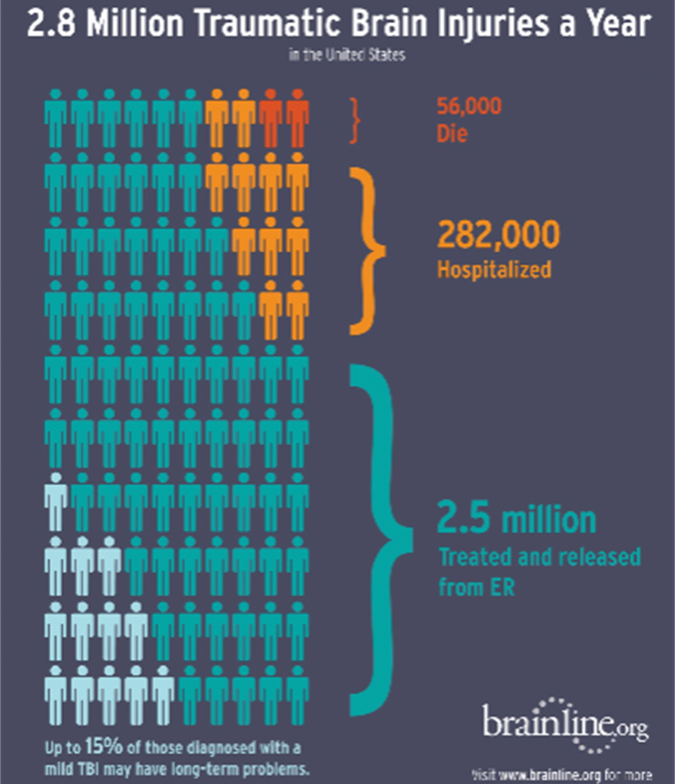
Accidental Trauma
Can be caused by:
Falls
Poisoning
Burns
Motor vehicle, bicycle, and pedestrian accidents
Notes:
Many types of accidental traumatic injuries are preventable. For children ages 0-4, the majority of brain injuries are caused by striking or being struck by an object. Prevention strategies are available for each of these situations such as the use of window guards and gates near stairways. Locking away harmful chemicals and medication. Seat belts, car seats following state guidelines. Bicycle helmets are essential and have been shown to mitigate risk of more severe brain injury.

Slide 15
Non-Accidental Trauma
Abusive Head Trauma (AHT)
Child presents with non-specific symptoms.
Caregiver accounts do not match severity of injuries.
Notes:
Also know as shaken baby syndrome, inflicted head injury, AHT, or non-accidental trauma. Children present to emergency care with symptoms of irritability, vomiting, lethargy, trouble feeding, trouble breathing, and can present with seizures. Diagnosis of AHT is determined by history, physical exam, and medical evaluation so it is critical for providers to recognize signs. Attention needs to be paid to caregiver accounts especially if they cannot report how the injury occurred or their explanation does not sufficiently explain the injuries. Again, the best treatment for ABT is prevention with attention paid to systemic barriers and structural inequities that can put parents more at risk for child maltreatment.

Slide 16
Non-Traumatic Brain Injury
Can be caused by:
Anoxic/hypoxic-ischemic brain injury
Pediatric stroke
Meningitis and Encephalitis
Other
Notes:
While the physiological origin of these injuries may be unique to each child, they share acute disruption in neurological function and potential for neurological impairment.
Anoxic- absence of oxygen- cardiac arrest, drowning, asphyxiation
Hypoxic-ischemic – consequence of respiratory failure.
Patterns of injury depend on age of child and severity of the injury. Non-fatal drownings occur most frequently in swimming pools and among children from minority populations, especially African Americans. Again, addressing the issue at the systemic level is necessary for prevention.
Pediatric stroke – Categorized by age, risk factors, presentation, and outcomes. Birth -18 years ranges 1-13 per 100,000 children per year. Risk factors such as conditions associated with increase risk of blood clots or congenital heart disease.
Infectious Encephalitis/Meningitis, Autoimmune Encephalitis
- inflammation of brain tissue or membranes surrounding brain. Vaccinations have reduced incidence of certain strains, but can still be acquired through ticks or other viruses such as enterovirus. Brain injury rehab, early assessment, and long term neurodevelopmental monitoring are recommended. Autoimmune occurs when body’s own immine system mistakenly attacks brain tissue. Children less than 3 may present with behavioral changes, movement disorders, and speech arrest.
Exposure to radiation, toxins, other autoimmune disorders.

Slide 17
TBI: Signs
Disturbed cognition resulting in challenges with:
Memory
Attention
Learning
Coordination
May also experience difficulties with:
Behavior
Emotion
Motor function

Slide 18
TBI: Symptoms
Some people who experience TBI also have these symptoms:
Headaches
Fatigue
Sleep difficulties
Epilepsy

Slide 19
Effects on Child Development
The prognosis of a TBI depends on factors such as the severity of the injury. TBI can have the following effects on child development:
Motor Impairments
Sensory Impairments
Feeding Disorders
Communication and Language
Cognitive Impairments
Behavior, Socialization and Family
Notes:
Prognosis
The prognosis of a TBI depends on a variety of factors such as the severity of the injury. Health problems related to a TBI can last for as little as a few days or the rest of the individual’s life. Prognosis is different for a child who sustains a TBI compared to an adult. Regardless of the severity of the initial injury the child’s development could be disrupted and they may have miss out on important activities such as school. Children may experience a delay in health effects following a TBI such as difficulties with organization and problem solving.
Children who have sustained a TBI are more likely to have challenges in the areas of motor skills, sensory skills, feeding, communication and language, behavior, socialization and family as well as difficulties in the areas of cognitive skills (esp. in the areas of reading, math, attention, concentration and memory). Neuropsychological testing is essential to get a complete view of the child’s impairments.

Slide 20
Motor Impairments
Research shows that 70% of children admitted to inpatient rehabilitation regained mobility after an average of 7 ½ months and self-care as well as mobility skills improved for over 5 years after the injury.
Some impairments may continue to persist in the areas of strength, balance, speed and coordination as well as decreased fine motor skills in the hands.
(Risen, Schultz and Trovoto, 2019)
Notes:
Motor: Research shows that 70% of children admitted to inpatient rehabilitation regained mobility after an average of 7 ½ months and self-care as well as mobility skills improved for over 5 years after the injury (Risen, Schultz and Trovoto, 2019). Some impairments may continue to persist in the areas of strength, balance, speed and coordination as well as decreased fine motor skills in the hands.

Slide 21
Sensory Impairments
Vision: may be affected due to injury to the optic nerve, visual processing centers in the brain, cranial nerve:
Reduced visual acuity
Difficulty tracking
Limited fields of vision
An evaluation with an ophthalmologist is recommended following a TBI.
Notes:
Sensory: vision and hearing might be affected by a TBI due to injury of the optic nerve, visual processing impairments in the brain or due to cranial nerve damage that would limit eye movements or cause double vision. Other possible results are reduced visual acuity, difficulty with tracking and limitations in the field of vision. Injury to the optic nerve is not reversible and can cause blindness.

Slide 22
Sensory Impairments II
Hearing: Hearing loss can also occur and is generally on one side only due to trauma in the middle or inner ear.
An audiological evaluation is recommended following a TBI.
Notes:
Hearing loss can also occur and is generally on one side only due to trauma in the middle or inner ear. Ophthalmologist and audiological evaluations are recommended following a TBI.

Slide 23
Feeding Disorders
Changes in tongue movements
Jaw stability
Chewing
Lip closure and
Reduced attention and impulsivity during feeding
It’s important the child receives adequate nutrition since it greatly impacts their ability to recover from the brain injury
Notes:
Feeding Disorders: TBI can cause difficulty swallowing (aka: dysphagia) which impacts the child’s nutrition and hydration as well as airway which increases the risk of developing pneumonia. The incidence of dysphagia is low: 68%-76% but may require a feeding tube (Risen,Schultz and Trovoto, 2019). It’s possible for changes in tongue movements, jaw stability, chewing, lip closure and reduced attention and impulsivity during feeding to occur after brain injury. It’s important to make sure the child receives adequate nutrition since that severely impacts the child’s ability to recover from the brain injury.

Slide 24
Feeding Disorders II
Dysphagia—difficulty swallowing. Impacts:
Nutrition
Hydration
Airway (increased risk developing pneumonia)

Slide 25
Communication and Language
Brain injury can influence many speech, language and communication skills
10-60% of children will have Dysarthria – changes in motor control of the muscles used for articulation and intelligibility.
Expressive and receptive language skills can be impacted
Greater challenges with initiating and maintaining conversation.
It is important to get a speech and language assessment following a brain injury.
Notes:
Communication: brain injury can influence many speech, language and communication skills. Between 10-60% of children who experience a TBI will have Dysarthria (changes in the motor control of the muscles used for articulation and intelligibility). Both expressive (ability to express thoughts in words) and receptive language skills (the ability to understand language) can be impacted as well as speech production (articulation, vocab and grammar). The more complex language processing impairments are due to cognitive deficits that can increase difficulty with judgement skills of what topic to talk about, turn-taking and pause timing. Children with a TBI use language and speech that are less appropriate and experience greater challenges with initiating and maintaining a conversation which also impact their social interactions which in turn might cause more challenging behaviors to occur due to social isolation/frustration. Researchers have found that “Children who sustained moderate to severe TBI between 4-6 years of age were found to have more significantly impaired verbal abilities and language skills compared with children without TBI (Risen, Schultz and Trovoto, 2019) It’s important to get a speech and language assessment following a brain injury.

Slide 26
Cognitive Impairments
Most children experience impairments in:
Attention
Memory
Executive functioning
Processing speed
The more severe the injury, the longer the recovery time, and the worse the outcomes across all areas
Notes:
Cognitive Impairment:
After a brain injury, most children experience impairments in their cognitive functioning, particularly in the areas of attention, memory, executive functioning (which is the ability to plan, initiate and problem solve), and their processing speed. The more severe the injury, the longer the child’s recovery time and the worse the outcomes across all of those areas. Recovery speed has also been found to be dependent on parent occupation, the child’s adaptive abilities before the injury, their age at the time of injury and their behavior pre-injury. Researchers have found that preschool children with severe TBI have slower recovery time and worse cognitive outcomes and some of the effects might not show up until they reach school age (due to greater academic challenges in upper grades). It’s important to have the child be evaluated by a neuropsychologist to assess cognitive impairments and those results can help with treatment planning and education placement as well as accommodations and therapies necessary for recovery. (Risen, Schultz and Trovoto, 2019)

Slide 27
Behavior, Socialization, and Family
Children who have sustained a TBI are more likely to have challenges in the areas of motor skills, sensory skills, feeding, communication and language, behavior, socialization and family as well as difficulties in the areas of cognitive skills (esp. in the areas of reading, math, attention, concentration and memory). Neuropsychological testing is essential to get a complete view of the child’s impairments.
Notes:
It’s important to have the child be evaluated by a neuropsychologist to assess cognitive impairments and those results can help with treatment planning and education placement as well as accommodations and therapies necessary for recovery. (Risen, Schultz and Trovoto, 2019)

Slide 28

Case Study: Zander
Link to video
Notes:
Here’s a story of a child named Zander who sustained a TBI at the age of 18 months. Click on the video to view. https://www.youtube.com/watch?v=MCY45ralBpA

Slide 29
TBI: Placement and Services
TBI is one of the eligibility categories for Special Education for children ages 0-21.
Children with TBI often experience challenges that can make learning difficult as we discussed earlier.
An educational specialist can help school staff and students understand how the TBI is affecting the student, develop an IEP,
and help with transition to school.
Notes:
The diagnosis of TBI qualifies a child under age 21 for special education services. Many will experience challenges in the area of cognitive, learning, language, motor, social and behavioral difficulties that can make learning and performing in school difficult. An educational specialist acts as a liaison typically between the rehabilitation program the child typically transitions from into the education setting. They will also educate school staff and students on how TBI is influencing this student, develop an IEP (an individualized education plan) for them, monitor their progress and adjust the educational supports and services as the child needs them. The Educational specialist also helps ease the transition to school and makes sure they are in an appropriate learning environment.*

Slide 30
TBI: Placement and Services II
Physical therapy
Occupational therapy
Speech therapy
Medications can be used to treat spasticity, dystonia, and tremors.
(Risen, Schultz and Trovoto, 2019)
Notes:
Medications might be used to treat spasticity, dystonia and tremors*Physical, occupational, or speech therapy might be incorporated into the child’s educational plan.
Medications might be used to treat spasticity, dystonia and tremors
Physical, occupational, or speech therapy might be incorporated into the child’s educational plan
(Risen, Schultz and Trovoto, 2019).

Slide 31
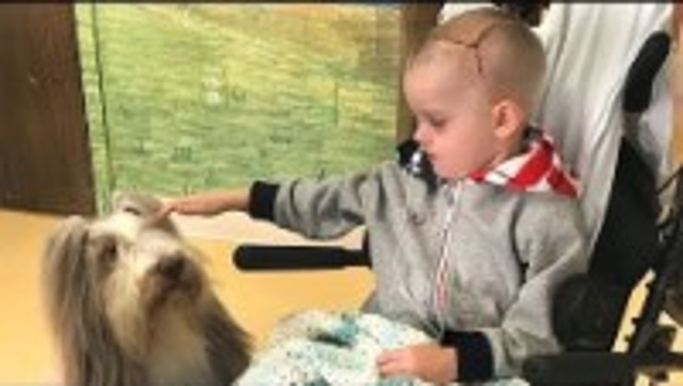
Case Study: Ryan’s Recovery Story
Link to video
Notes:
Click the video to watch Ryan’s recovery story. https://www.youtube.com/watch?v=YpdCspyn4co

Slide 32
Discussion
The medical team in the video emphasized that injured portions of the brain do not recover, but other areas can take over lost functions through therapy and rehabilitation.
How does this concept of neuroplasticity align with the goals of early intervention services, and what specific early intervention strategies might support recovery and skill rebuilding for a child like Ryan?
Ryan’s recovery involved multiple professionals (medical staff, therapists, and rehabilitation specialists) and consistent follow-up after discharge.
How can early intervention programs ensure effective collaboration across medical, therapeutic, and educational teams for children recovering from TBI? What barriers might exist, and how could they be addressed?

Slide 33
TBI: Rehabilitation and Outcomes
Rehabilitation Hospital
Recovery
Compensation
Identification and treatment
Level of care
Notes:
After a child experiences a traumatic brain injury, they are generally moved to a rehabilitation hospital for inpatient therapy or outpatient if less severe. It’s important to make sure the rehab hospital has expertise working with children, use developmentally appropriate treatments, utilize family-centered care and attend to the child’s education and reintegration back to school. The goals of rehabilitation are the promotion of recovery, attaining compensation and receiving identification and treatment for the impairments they are likely to be struggling with. A multidisciplinary team is usually working together to care for the child and may include professionals for any of the following fields depending on the level of care needed: physical therapy, occupational therapy, speech therapy, neuropsychology, special education and social workers.
(Risen, Schultz and Trovoto, 2019).

Slide 34
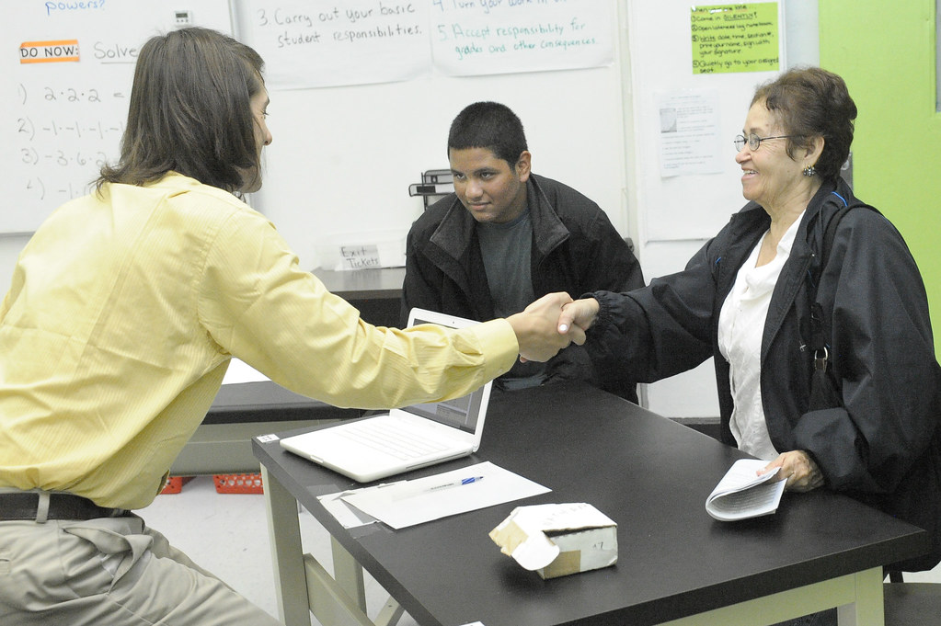
Family Empowerment
Helping families who may feel guilt and shame.
Family partnership in decision-making around treatment planning.
Engaging parents and children in school re-entry.
Parent support groups.
Respect, Equity, Dignity.
Notes:
Empowerment comes from partnership and a non-judgmental empathic stance. Dr. Ann Glang reports that 99% of services a child will need following TBI will be found in school, as that is where children spend most of their day. Having everyone be involved in treatment decisions can give families a sense of agency and control. Support groups can be helpful for parents to share their experience and decrease isolation. Parents who have harmed their child or whose child may have accidentally been injured under their supervision may present as angry, resistant, and disengaged. These are grief and trauma responses, and providers need specialized training to de-escalate parents therapeutically while always maintaining and prioritizing the relationship.
Click on the videos to learn more.

Slide 35

Family Empowerment: Video 1
Being Flexible and Creative in Helping children with TBI Navigate School
Link to video
Notes:
Empowerment comes from partnership and a non-judgmental empathic stance. Dr. Ann Glang reports that 99% of services a child will need following TBI will be found in school, as that is where children spend most of their day. Having everyone be involved in treatment decisions can give families a sense of agency and control. Support groups can be helpful for parents to share their experience and decrease isolation. Parents who have harmed their child or whose child may have accidentally been injured under their supervision may present as angry, resistant, and disengaged. These are grief and trauma responses, and providers need specialized training to de-escalate parents therapeutically while always maintaining and prioritizing the relationship.
Click on the videos to learn more. https://www.youtube.com/watch?v=nGwsbbohAM0

Slide 36

Family Empowerment: Video 2
How Parents Can Best Work with the Teachers of their Child with TBI
Link to video
Notes:
Empowerment comes from partnership and a non-judgmental empathic stance. Dr. Ann Glang reports that 99% of services a child will need following TBI will be found in school, as that is where children spend most of their day. Having everyone be involved in treatment decisions can give families a sense of agency and control. Support groups can be helpful for parents to share their experience and decrease isolation. Parents who have harmed their child or whose child may have accidentally been injured under their supervision may present as angry, resistant, and disengaged. These are grief and trauma responses, and providers need specialized training to de-escalate parents therapeutically while always maintaining and prioritizing the relationship.
Click on the videos to learn more. https://www.youtube.com/watch?v=_DLI9WjyMEY

Slide 37
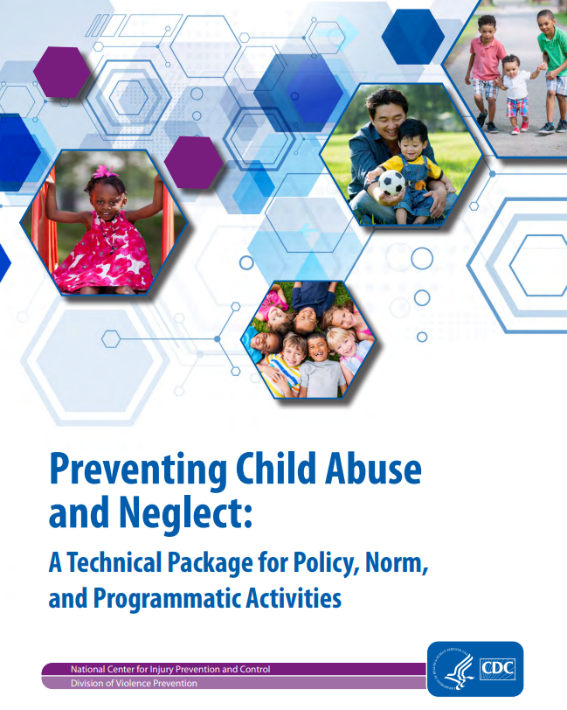
Prevention
https://www.cdc.gov/violenceprevention/pdf/CAN-Prevention-Technical-Package.pdf
https://www.cdc.gov/injury/pdfs/ColorMeSafe_eng-a.pdf
Notes:
Since most Acquired brain injuries can be prevented, the CDC has resources available to educate and support parents. This coloring book is also available in Spanish and takes children and parents along with the Safe Family as they explore their home and community safely. The CDC has identified treatments such as Parent-Child Interactive Therapy (PCIT) and Trauma-Focused Cognitive Behavioral Therapy (TF-CBT) for evidence-based practices. The CDC also created a policy package advocating for systemic changes to families to further prevent accidental and non-accidental brin injury in children such as: Strengthening economic supports to families, changing social norms to support parents and positive parenting through legislative approaches to reduce corporal punishment, provide quality care and education early in life through preschool enrichment with family engagement, enhance parenting skills to promote healthy child development through parenting skill and family relationship approaches, and intervening to lessen harms and prevent future risk through enhanced primary care, behavioral parent training programs, etc. In addition, free and universal water safety/swimming courses to preschoolers and engaging schools and communities to engage with parents who are struggling in a non-judgmental way.

Slide 38
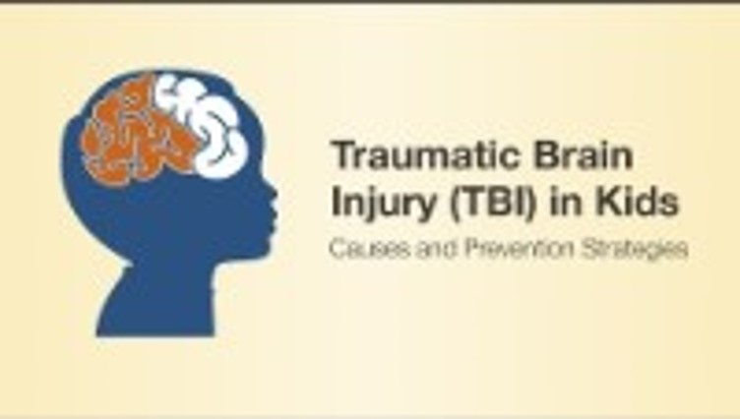
TBI in Kids: Causes and Prevention
Link to video
Notes:
Click on the video to view. https://www.youtube.com/watch?v=OiLBPsTRLnQ

Slide 39
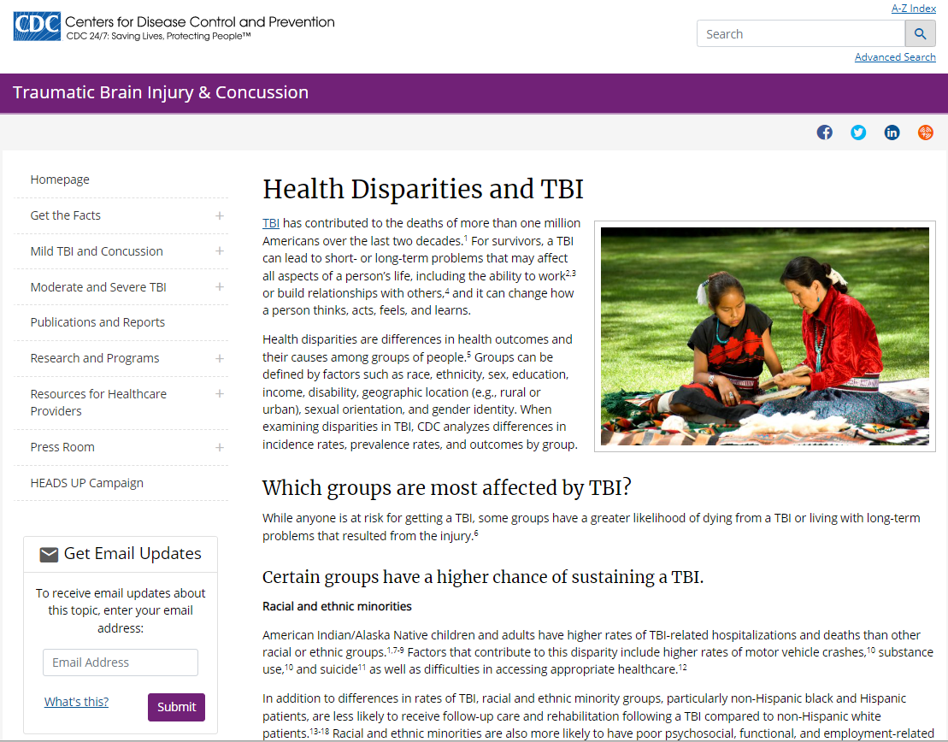
Additional Resources from the CDC
Get the Facts about TBI
Health Disparities and TBI

Slide 40
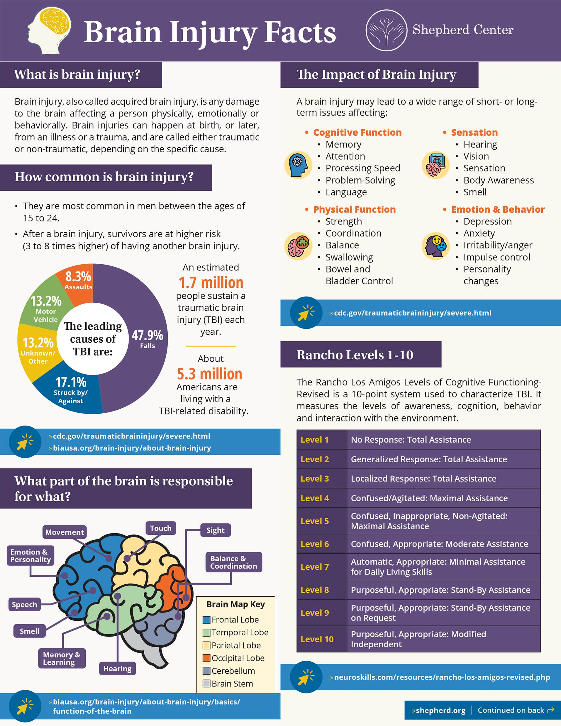
Brain Injury Facts
https://www.shepherd.org/docs/Brain%20Injury/Brain-Injury-Facts_Infographic_4-8-21-1-min.jpg

Slide 41
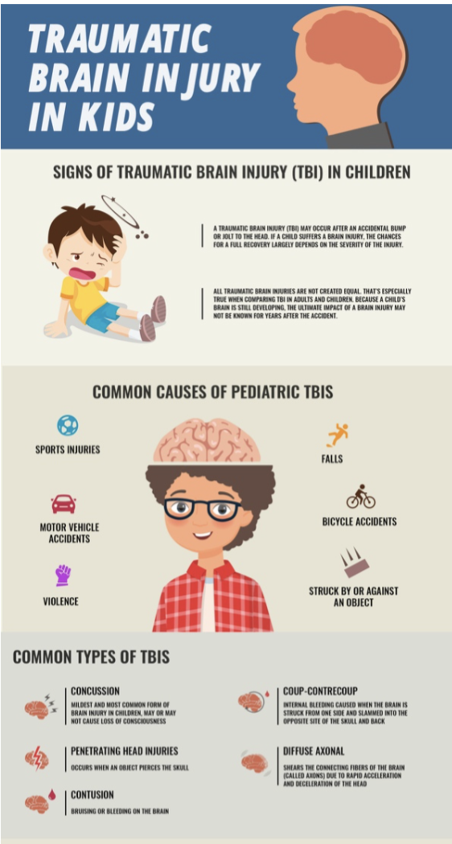
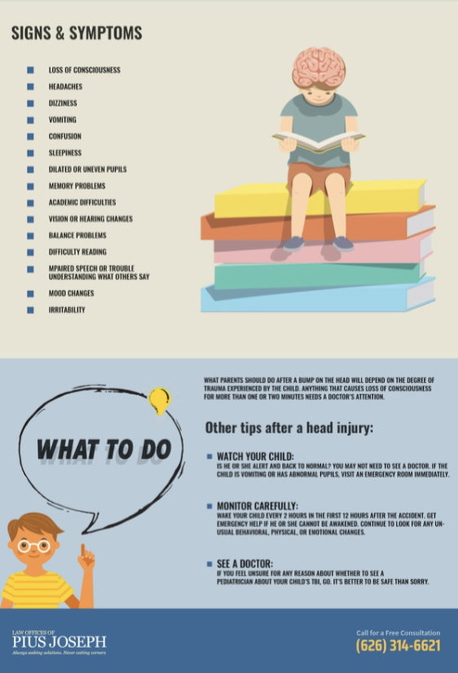
Informational Flyer
Children and Adolescents – Brain Injury Peer Visitor Association
Notes:
Available from: Children and Adolescents – Brain Injury Peer Visitor Association (https://braininjurypeervisitor.org/children/)
There is lots of other information on this webpage as well.

Slide 42
References
Batshaw, M., Roizen, N., & Pellegrino, L. (2019). Children with disabilities (8th ed.). Paul H Brookes.
Bertullo, G. (2015). History of traumatic brain injury (TBI). American Journal of BioMedicine, 3(7). https://doi: 10.18081/2333-5106/015-06/381-409
Centers for Disease Control and Prevention. (2021, May 12). Get the facts about TBI. https://www.cdc.gov/traumaticbraininjury/get_the_facts.html
Centers for Disease Control and Prevention. (2016, January 22). Report to congress: Traumatic brain injury in the United States. https://www.cdc.gov/traumaticbraininjury/pubs/tbi_report_to_congress.html
Risen, S., Schultz, S., & Trovoto, M. (2019). Acquired brain injury. In M. Batshaw (Ed.), Children with disabilities (8th ed., pp. 481-505). Paul H. Brooks.
Rose F. C. (1997). The history of head injuries: An overview. Journal of the History of the Neurosciences, 6(2), 154–180. https://doi.org/10.1080/09647049709525700
Turnbull, A. P., Turnbull, H. R., Francis, G., Burke, M., Kyzar, K. K., Haines, S., Gershwin, T., Shepard, K., Holdren, N., & Singer, G. (2021). Families and professionals: Trusting partnerships in general and special education. (8th ed.). Pearson.

Slide 43
Disclaimer
This is a product of the Early Childhood Intervention Doctoral Consortium (ECiDC), a project of the A.J. Pappanikou Center for Excellence in Developmental Disabilities at UConn Health. The Center is funded through cooperative agreement number H325H190004 from the Office of Special Education Programs, U.S. Department of Education. Materials and opinions expressed herein do not necessarily represent the Department of Education’s position or policy.

