Slide 1
Characteristics and Etiology of Infants and Young Children with Disabilities
Prader-Willi Syndrome and Angelman Syndrome

Slide 2
Purpose
Provide a general overview of chromosome and genomic imprinting.
Provide participants with a basic understanding of Angelman syndrome and Prader-Willi syndrome as well as the impact that the conditions have on a child and his/her family.
Provide participants with a knowledge of interventions for children with Angelman syndrome and Prader-Willi syndrome.
Familiarize participants with resources for families, providers, and the general community.

Slide 3
Objectives
Following completion of this module, participants will be able to:
Describe the genetic basis of imprinting disorders.
Provide an overview of Prader-Willi syndrome and Angelman syndrome and including diagnosis, primary features, and co-occurring for each condition.
Compare and contrast the similarities and differences between PWS and AS.

Slide 4
Objectives II
Following completion of this module, participants will be able to:
Identify early signs of each disorder and how they are diagnosed.
Describe current evidence-based interventions and emerging treatments for each condition.
Identify resources available to children with PWS and AS, as well as their families and care providers.

Slide 5
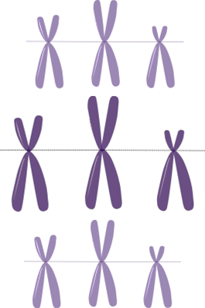
Agenda
For both Prader-Willi syndrome and Angelman syndrome:
General overview of genes, chromosomes, and genomic imprinting
Topics:
  History and Prevalence
  Early Signs and Diagnosis
  Clinical Features
  Co-Occurring Conditions
  Treatments and Supports

Slide 6

Activity 1
Talk to those around you:
Have you heard of either of these syndromes?
What do you know about them?
Do you know anyone that has either of them?
Are they similar to one another?

Slide 7
General overview of genes, chromosomes, and genomic imprinting

Slide 8
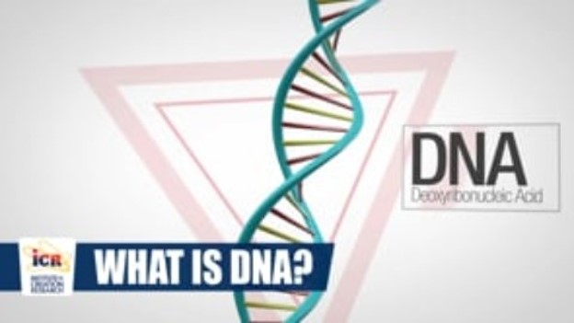
DNA—Deoxyribonucelic Acid
“The blueprint of what we are” - Institute for Creation Research
Link to video
Notes:
Click to watch the video. https://vimeo.com/108520146

Slide 9
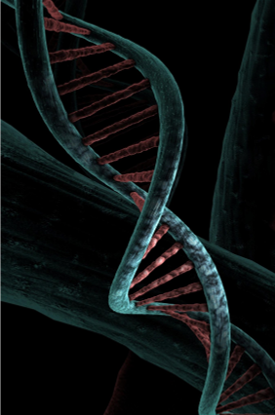
Genetic Disorder
“A disease caused in whole or in part by a change in the DNA sequence away from the normal sequence.”
- National Human Research Genome Institute

Slide 10
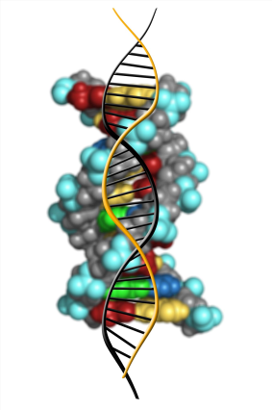
Genetic Disorder II
Can be caused by:
A mutation in 1 gene
Mutations in multiple genes
A combination of gene mutations and environmental factors
Damage to chromosomes

Slide 11
Genetic Disorder III
Can be:
Inherited/Present at birth
Random occurrence
Environmental exposure

Slide 12
Chromosomes and Genes
Chromosomes—Tiny structures that are present in nearly all cells in the body. Made up of tightly coiled DNA.
DNA—Molecules that contain our genetic code.
Genes—Specific genes direct our cells to produce proteins, enzymes, and other essential substances.
Notes:
Chromosomes are the tiny structures that are present in nearly all of our body cells and are composed of tightly coiled DNA (double helix) which contain our genes are located and contain the specific information that instructs our cells to produce things such as proteins and enzymes and other Essentials substances.

Slide 13
Chromosomes and Genes II
Each gene is located on a specific chromosome.
Majority of body cells contain 46 chromosomes (23 from each parent)
      Exception – gamete cells contain 23 chromosomes
        Egg cells
        Sperm Cells
Notes:
Chromosomes are the tiny structures that are present in nearly all of our body cells and are composed of tightly coiled DNA (double helix) which contain our genes are located and contain the specific information that instructs our cells to produce things such as proteins and enzymes and other Essentials substances.

Slide 14
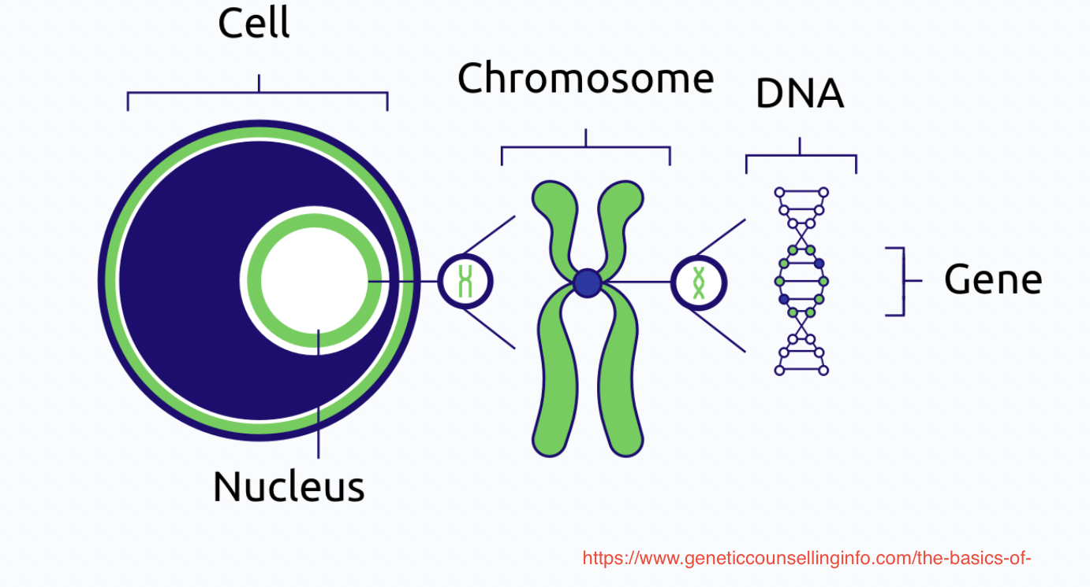
Diagram of a cell
Notes:
This is a diagram visually showing chromosomes are located in the nuclei of cells and that within the chromosomes are genes that make up DNA

Slide 15
Genomic Imprinting
Refers to differential expression of an allele depending on the parent of origin.
    Only the paternal or maternal allele is expressed/active.
Deletion, duplication, or mutation of the active allele results in complications.
Prader-Willi syndrome and Angelman syndrome result from abnormalities on the 15q11.2-q13 region of chromosome 15.
Notes:
For the majority of genes, alleles from both the father and mother are expressed. However, there are a small number of genes on certain chromosomes that are subject to genomic imprinting.
Genomic imprinting results in certain genes being turned off and therefore only one active allele it left (either maternal or paternal)
B/C genomic imprinting affects some genes, genetic information is needed from both a mother and a father for normal development of offspring. interference with genomic imprinting can result in developmental disorders such as Prader-Willi and Angelman syndromes.

Slide 16
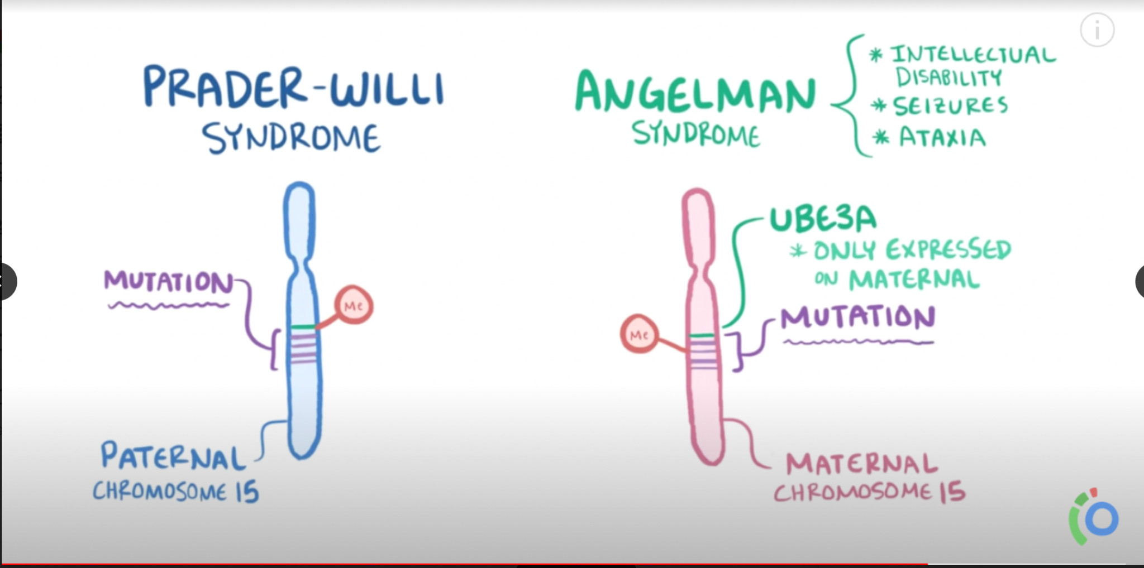
Prader-Willi v. Angelman Syndrome
Notes:
This is a diagram illustrating that both PWS and AS are caused by the lack of expression of the chromosomal region’s imprinted genes 15q11-q13.
In the case of PWS the silencing occurs in the chromosome coming from the father whereas in AS the loss of information takes place in the maternal chromosome

Slide 17
Prader-Willi Syndrome (PWS)

Slide 18
PWS - History
1956: First described in medical literature by Swiss doctors Andrea Prader, Alexis Labhart & Heinrich Willi:
9 Children with common characteristics
Small hands and feet
Abnormal growth and body composition
Hypotonia at birth
Insatiable hunger
Extreme obesity
Intellectual disability

Slide 19
PWS – History continued
1981: Ledbetter and colleagues identified deletions located between bands 15q11 and 15q13 and determined it to be the site for Prader-Willi syndrome. PWS is the first disorder confirmed to be due to imprinting errors.
The next ten years resulted in 3 recognized genetic causes.
1993: Clinical diagnostic criteria established by consensus.
PWS was once known as hypogonadism, hypotonia, hypomentia, obesity (HHHO).

Slide 20
PWS - Prevalence
1:10,000 - 1:30,000 births
Males and females
All ethnicities

Slide 21
PWS – Diagnosis
Diagnostic test required, but:
Prenatal blood draw screening at 9-10 weeks after gestation.
Not on Recommended Uniform Screening Panel.
Some symptoms present at birth:
  Hypotonia
  Almond eyes, narrow head, thin upper lip
  Poor sucking reflex
  Poor responsiveness
  Underdeveloped genitals

Slide 22
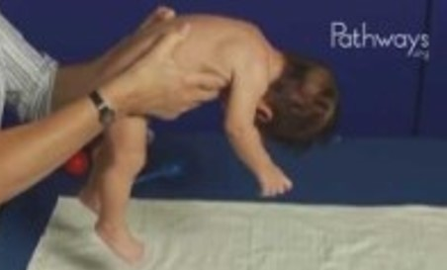
PWS – Diagnosis II
Hypotonia
Watch this video that compares an infant with hypotonia with an infant that does not have hypotonia. What do you see as the differences between the two?
Link to video
Notes:
https://www.youtube.com/watch?v=BasXYtKOjSs

Slide 23
PWS – Diagnosis III
DNA based testing is 99% effective
Blood or cultured specimens
Specimen sources:
Amniocytes (amniotic fluid)
Cell culture
Chorionic villi
Umbilical cord blood
Fetal blood
Fibroblasts
Fresh tissue
Frozen tissue
Isolated DNA
Peripheral (whole) blood, product of conception

Slide 24
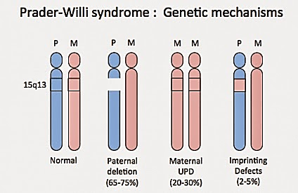
PWS - Genetics
http://adrakesprogress.blogspot.com/2015/05/genetics.html
Notes:
This slide displays the 3 ways in which PWS can occur
Approximately 70% of cases are due to a deletion at 15q11-13 of the paternal chromosome.
Approximately 25% of individuals have a uniparental disomy - that both copies of chromosome 15 have been inherited from the mother (inactive)
​Translocation, mutation or other defects: occasionally caused by a translocation which is where the chromosomes are rearranged. It can also be caused by a defect of the imprinting mechanism which means that some of the genes on the paternal copy of 15q11-13 become inactive or ‘silenced’ when they are supposed to be active.

Slide 25
PWS - Early Signs
Prenatal
Reduced fetal activity—Mothers commonly report decreased fetal movement.

Slide 26
PWS - Early Signs II
Infancy-Toddlerhood
Hypotonia—Low muscle tone results in infant appearing and feeling “floppy” when held.
Poor sucking reflex—Decreased muscle tone causes poor sucking which leads to feeding difficulties and can result in failure to thrive.
Under-Responsiveness—Infants appear unusually fatigued, respond poorly to stimulation, have a hard time waking up , and/or have a weak cry.
Underdeveloped Genitals—Males may have small testes and scrotum and females may have small clitoris and labia.
Strabismus—Some children may exhibit a lack of eye coordination.

Slide 27
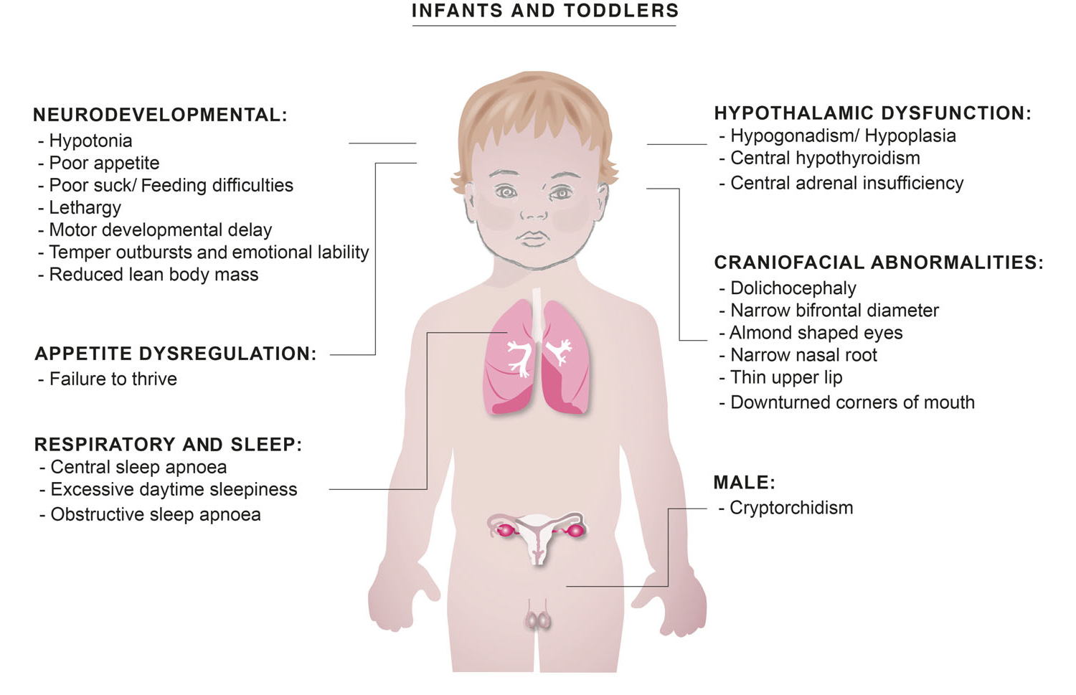
Signs of PWS - Infants and Toddlers
(McKay et al., 2019)
Notes:
This is a diagram that really nicely illustrates how PWS affects multiple systems including the neural, endocrine, respiratory, and reproductive systems.
For example- multiple issues with hypothalamic functioning contribut to hypogonadism, short stature, central obesity,and osteoporosis

Slide 28
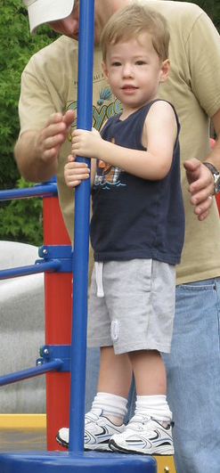
PWS - Clinical Features
Physical
Distinct facial features:
  Thin upper lip
  Narrow forehead
  Almond shaped eyes
Light colored skin and hair
Small hands/feet, short stature

Slide 29
PWS - Clinical Features II
Childhood
Global Developmental Delays—Child may have motor delays, speech impairments, and cognitive impairments.
Delayed physical growth and development—Child may have low muscle tone and mass as well as a high percentage of body fat.
Excessive eating and obsession with food coupled with lower metabolic rate commonly leads to weight gain.
Sleep disturbances—Excessive daytime sleepiness and sleep apnea.

Slide 30
PWS - Clinical Features III
Functional/Behavioral Characteristics
Intellectual disability—Majority of affected individuals score in the mildly intellectually disabled range on IQ tests
Delays in motor and language development
Distinct Behavioral tendencies:
  Obsessive compulsive features
  Anxiety
  Skin Picking
  Stubbornness
  Difficulty with changes in routine
Notes:
Intellectual - Individuals with PWS tend to have mild to moderate intellectual disability; around 40% have a mild intellectual disability and around 20% have a moderate intellectual disability. IQs are estimated to fall between 50 and 85 with a mean of 60. This means that some individuals with Prader-Willi syndrome have borderline intellectual disabilities.
Some children are able to attend mainstream education with the right level of support; however many have multiple learning difficulties that can impact their academic performance. Long term memory is usually good, although some may have difficulty with their short term memory
Motor - as noted previously hypotonia.ininfacy contributes to poor reflexes, a weak cry, and inability to suck properly which causes them to be underweight in their first year. Hypotonia generally improves with age, with most adults with Prader-Willi syndrome only showing decreased muscle tone and bulk
Speech - verbal ability can be a strength but many have impaired language
Bx- When people have a diagnosis of Prader-Willi syndrome it means that they are more likely to engage in certain behaviours than people without this syndrome. This is known as a ‘behavioural phenotype.’ However, this does not mean that everyone with Prader-Willi syndrome will show this behaviour and it is extremely important to remember that everyone with Prader-Willi syndrome is an individual.

Slide 31
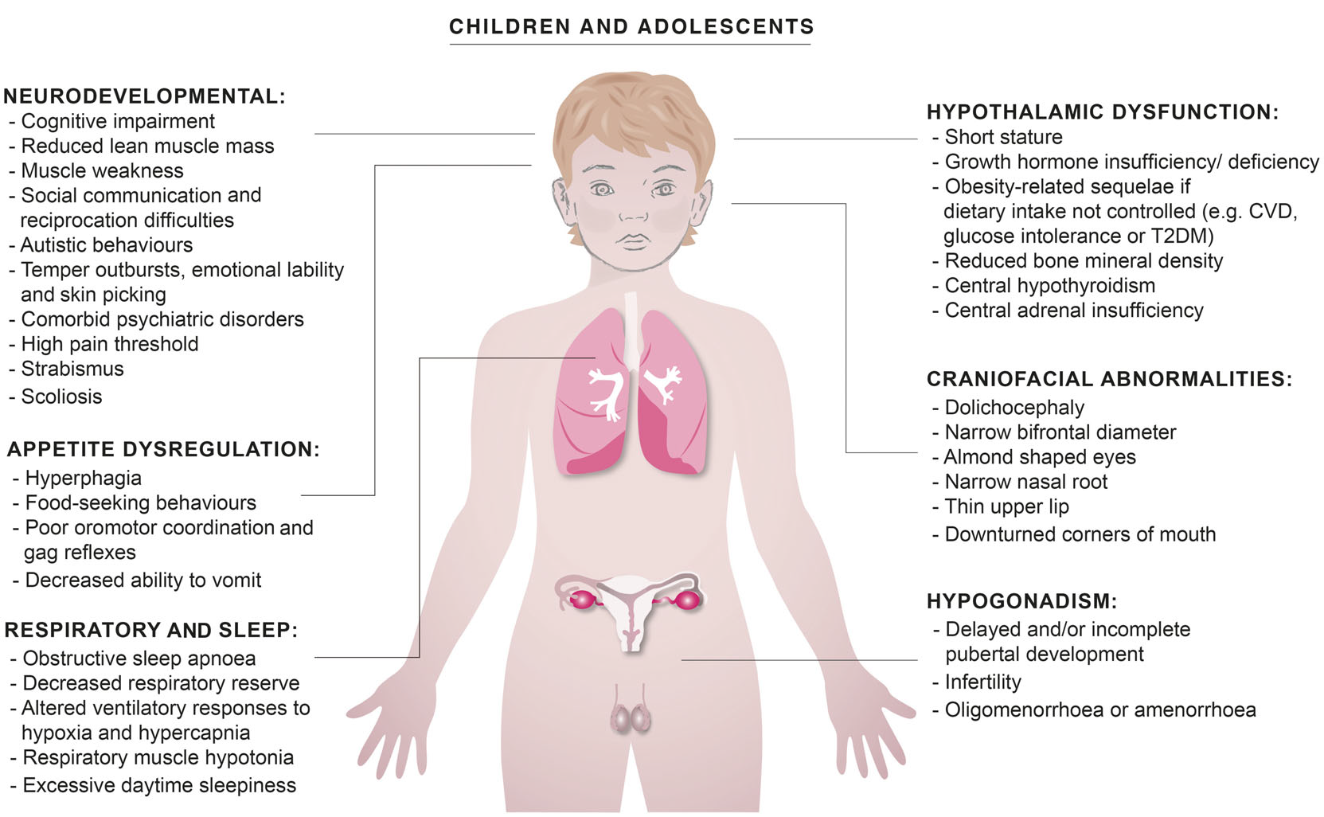
Signs of PWS—Children and Adolescents
(McKay et al., 2019)
Notes:
DIAGRAM Depicting how PWS continues to impact multiple system throughout life. For example, puberty may be delayed leading to need for hormone therapy.
Continuing with hypothalamic functioning from infants and toddlers - in children and adolescents this continues to result in short stature, central obesity, as well as low bone density and hypothyroidism

Slide 32
General Phases of Nutrition and Growth Patterns in PWS
Phase | Age Range | Description
0 | Prenatal | Decreased fetal movements and lower birth weight than siblings
1a | Birth | Hypotonia with difficulty feeding and decreased appetite
1b | 5-15 months | No difficulty feeding and growing appropriately on growth curve
2a | 18-36 months | Weight increasing without appetite increase or excess calories
2b | 3-6 years | Increased appetite and interest in food, but can feel full
3 | 6 years - teens | Hyperphagic; rarely feels full
4 | Adult | Appetite is no longer insatiable for some
(adapted from Mackay et al., 2019)

Slide 33
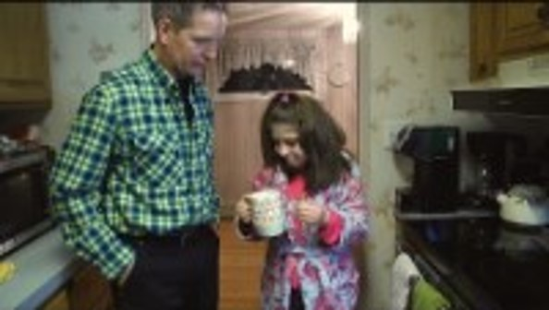
PWS Hyperphagia (excessive appetite)
Watch this video to see what it is like for a family taking daily precautions to prevent their child from excessive eating.
Thoughts?
Emotional reactions?
Link to video
Notes:
https://www.youtube.com/watch?v=yYebPiA0IjM

Slide 34
PWS - Co-Occuring Conditions/Complications
Lower than average metabolic rate
Obesity*
Type II Diabetes
Sleep Apnea
Scoliosis
Skin Picking
Osteoporosis
Obsessive Compulsive Disorder
Endocrine abnormalities
    Growth hormone deficiency is present in most cases.
    Hypothyroidism (thyroid does not release adequate thyroid hormone) is also common.
*PWS is the most common genetic cause of life-threatening childhood obesity
Notes:
A number of complications and co-occuring difficulties may be present among individuals with PWS
Obesity and low metabolic rate lead to Most common genetic cause of life-threatening childhood obesity and type II diabetes
Sleep apnea
Scoliosis
Scoliosis is where the spine curves abnormally and is present in 40-80% of individuals with Prader-Willi syndrome. The age of onset and severity of the curvature varies greatly; therefore it is important that it is regularly monitored in children and adults.
Skin Picking
Skin picking is common in individuals and found in around four out of five children. It can range from scratching, pulling at the skin or using tools such as tweezers to pierce it. This can result in sores, infection and scars.
Mental Health
Mental health problems are fairly common over the lifespan of people with Prader-Willi syndrome; major depression and ocd is common These conditions can be controlled by medication.

Slide 35
Activity 2
Now that you know some of the functional and behavioral characteristics as well as the co-occurring conditions of people with Prader-Willi syndrome, what types of specialists/professionals do you think would be beneficial to have on the intervention team for a child with this syndrome?
Come up with a list and justification for your team members.

Slide 36
PWS - Treatments and Supports
Physical Therapy
Motor training programs to address hypotonia assist in meeting developmental milestones (e.g., sitting & walking).
Reduce severity of associated conditions such as scoliosis.
Occupational Therapy
OTs can work on a variety of skills including sensory integration, fine motor, feeding, motor-planning, and self-care skills.
Notes:
PT- High prevalence of hypotonia requires physical therapy early in life to help child meet developmental milestones like sitting and walking
SLP- As a result of severe hypotonia many infants experience failure to thrive and slps with training in feeding disorders are commonly part of the team to help with sucking, swallowing, and eventually chewing. Although many individuals with PWS develop verbal speech it is important to continue with speech therapy as there is a high prevalence of speech disorders including apraxia, articulation difficulties, and general delays.
OTs- can also assist with feeding as well as helping the child with daily life activities such as dressing, feeding, and when in school writing

Slide 37
PWS - Treatments and Supports II
Speech and Language Therapy
Feeding issues in infancy may require assistance with sucking, swallowing, & chewing.
Therapy should continue throughout childhood to enhance language development as a large number of children have underlying speech and language difficulties such as developmental speech delay, childhood apraxia of speech, and/or articulation abnormalities.
Notes:
PT- High prevalence of hypotonia requires physical therapy early in life to help child meet developmental milestones like sitting and walking
SLP- As a result of severe hypotonia many infants experience failure to thrive and slps with training in feeding disorders are commonly part of the team to help with sucking, swallowing, and eventually chewing. Although many individuals with PWS develop verbal speech it is important to continue with speech therapy as there is a high prevalence of speech disorders including apraxia, articulation difficulties, and general delays.
OTs- can also assist with feeding as well as helping the child with daily life activities such as dressing, feeding, and when in school writing

Slide 38
PWS - Treatments and Supports III
Weight Management
To prevent obesity and related complications (e.g. diabetes) nutritional counseling should be sought and physical activity encouraged.
Behavior Support
Behavior management strategies including reinforcement of desirable behaviors, ensuring a predictable environment with clear behavior expectations, and functional communication training can help reduce challenging behaviors.
Notes:
Wt- Perhaps the most prominent characteristic of PWS is hyperphagia and obesity (low metabolic rate) and therefore, it is essential to consult with dietician with experience in working with individuals with PWS and their and families to maintain a healthy weight. In addition, given the high rate of osteoporosis a dietician can assist in making sure the child gets adequate calcium and vitamin d.
Behavior support can also be helpful in regards to food seeking behaviors as well as other common challenges experienced by individuals with PWS including stubbornness and anxiety and difficulties with transitions

Slide 39
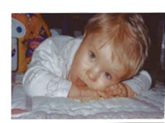
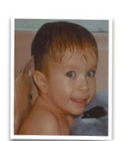
PWS - Treatments and Supports IV
Human growth hormone therapy
    Increases muscle mass while decreasing body weight/fat
    Increases responsivity
Address complications
    Sex hormone replacement for low sex hormones
    Regular bone screenings
    Vitamin D and calcium supplement
Food restriction
Top image: Toddler with extremely low muscle tone at 15 months.
Bottom image: Toddler shows an obvious increase in alertness and tone after three (3) months of growth hormone treatment.
Notes:
If started at a young age, growth hormone treatment, along with good dietary control, may retard obesity and the high proportion of fat mass. It may also prevent development of the typical facial appearance and improve motor milestones.

Slide 40
Angelman Syndrome (AS)

Slide 41
AS - History
1965: English physician Harry Angelman originally referred to as “Puppet Children.”
Patients with 7 characteristics:
Depressed occipital region of the skull
Primary optic atrophy
Abnormal air encephalograms
Paroxysmal laughter
Intellectual impairments
Ataxia/jerking movements
Protruding tongue

Slide 42
AS – History continued
1987: Ellen Magenis identified 2 patients with large chromosome 15 deletions.
1993: Robert Nicholls: Loss of the maternal part of the chromosome 15ql-13 region.
1994: Mitsuyoshi Nakao: UBE3A gene described as a “strong candidate” for AS.
Kishono and Matsuura ultimately credited.

Slide 43
AS - Prevalence
1:10,000 - 1:20,000 births
500,000 worldwide
Males and females
All ethnicities

Slide 44
AS - Diagnosis
Not routinely included in prenatal testing (rare).
Symptoms not evident at birth.
50% initially misdiagnosed.
Typicall diagnosed between the ages of 1 and 4.
1 in 10 that have all key symptoms but get negative results on every diagnostic test. May receive a “clinical” diagnosis.

Slide 45
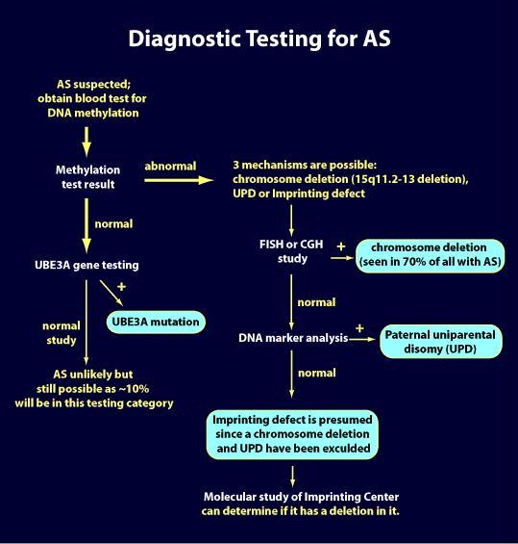
AS – Diagnosis II
Blood Sample
  Methylation test- positively identifies 80%
  DNA sequencing
  Fish test
  DNA marker analysis
Testing occurs in a sequence

Slide 46
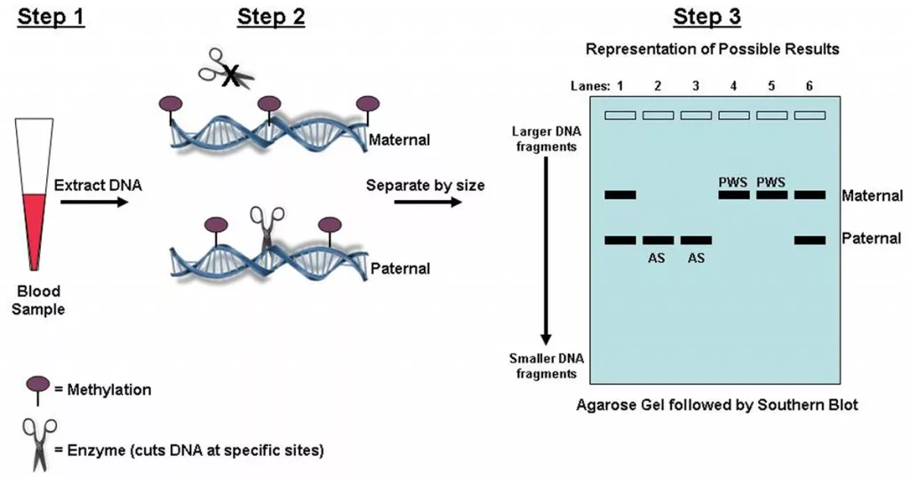
AS – Diagnosis III
“The most sensitive single approach to diagnosing PWS and AS is to study methylation patterns within 15q11-q13 using molecular genetic techniques. These will detect deletions, UPD and imprinting defects by establishing either a solely maternal methylated imprint (PWS) or paternal methylated imprint.”
- National Center for Biotechnology Information

Slide 47
AS - Genetics
Type of Error | Frequency
Deletion | 70%
UBEA3 Mutation | 11%
Unipaternal Disomy | 7%
Imprinting Defect | 3%
Notes:
AS arises from issues related to the maternal copy of chromosome 15 which results in only the father’s (inactive) copy being present .
about 70% of cases AS occur due to Deletion 15q11-13 of the maternal chromosome.
Mutation of UBEA3 causes AS in 11% - UBE3A has several functions including brain development involvement in protein turnover in the brain. loss of UBE3A function causes characteristic features of Angelman syndrome
7% of cases are due to uniparental disomy in which the active Maternal copy is missing leaving 2 inactivated paternal copies (7%)
Finally, AS can occur as the result of a defect in which mother’s copy not expressed as it should be and this happens in about 3% of cases

Slide 48
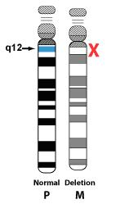
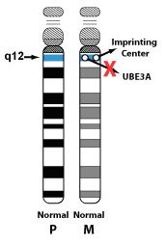
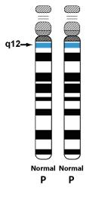
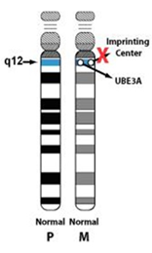
AS - Genetics II
Examples of Errors
Deletion
UBEA3 Mutation
Unipaternal Disomy
Imprinting Defect
Notes:
AS arises from issues related to the maternal copy of chromosome 15 which results in only the father’s (inactive) copy being present .
about 70% of cases AS occur due to Deletion 15q11-13 of the maternal chromosome.
Mutation of UBEA3 causes AS in 11% - UBE3A has several functions including brain development involvement in protein turnover in the brain. loss of UBE3A function causes characteristic features of Angelman syndrome
7% of cases are due to uniparental disomy in which the active Maternal copy is missing leaving 2 inactivated paternal copies (7%)
Finally, AS can occur as the result of a defect in which mother’s copy not expressed as it should be and this happens in about 3% of cases

Slide 49
AS - Early Signs
AS is not typically evident at birth, but difficulties sucking and swallowing are commonly reported retrospectively.
Delayed milestone achievement—Delays in meeting developmental milestones such as walking and talking are typically the first indicators that prompt professional consultation.
Notes:
In contrast to PWS, AS is not evident at birth. However, feeding problems and hypotonia may be present at birth. Developmental delays become apparent by 6 months of age and parents typically seek consultation when the infant does not meet common developmental milestones such as sitting independently and crawling

Slide 50
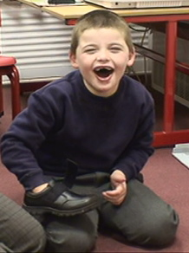
AS - Clinical Features
Frequency | Clinical features
Consistent (100%) | Developmental delay, speech impairment, hyperactivity, distinct behaviors (frequent smiling & laughter, excitable)
Frequent (>89%) | Microcephaly, seizures, characteristic EEG pattern
Associated (20-80%) | Sleep disturbances, constipation, facial features (wide mouth & teeth), hypopigmentation, scoliosis
Notes:
Hyperactivity
Characterized as hypermotoric - children with AS commonly appear to be in constant motion.
Limited attention span can impair social skills as child is not attending to social cues

Slide 51
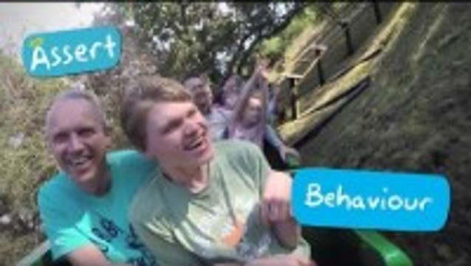
Behavior in Angelman Syndrome
Link to video
Notes:
https://www.angelmanuk.org/what-is-angelman-syndrome/

Slide 52
AS - Clinical Features II
Speech Impairments—Very common and often severe.
  Apraxia
  Dyspraxia
  Minimal to absent speech
  Receptive speech and non-verbal communication skills more advanced than verbal speech

Slide 53
AS - Clinical Features III
Movement difficulties
  Ataxia
Intellectual and developmental delays
  Limited attention span as well as communication delays and lack of motor control can make it difficult to obtain an accurate assessment of intellectual ability

Slide 54
Communication in Angelman Syndrome:
A Scoping Review (2019)
Pearson et al. (2019) conducted a comprehensive review of research examining communication in individuals with AS.
17 empirical research articles published between January 1960 and October 2018
  Inclusion criteria: Articles had to be written in English and peer-reviwed. Case studies were excluded.
Findings
While minimal or absent speech is nearly universal, communication profiles among individuals with AS are diverse.
Individuals with AS use multiple modes of communication including symbolic, non symbolic, and AAC.
AAC is used by the majority of children with AS (62-70%)
AAC = Augmentative and Alternative Communication

Slide 55
AS - Co-Occuring
Conditions/ Complications
Digestive Issues
  Gastroesophageal reflux
  Constipation
Ataxia—Poor control of voluntary movements
Scoliosis—Curvature of spine
Seizures
  Typically emerge before 3 years of age and persist throughout childhood.
  Severity improves over time but many adults with AS continue to show abnormal EEG activity.
Sleep disturbances
  Difficulties falling asleep
  Frequent night wakings

Slide 56
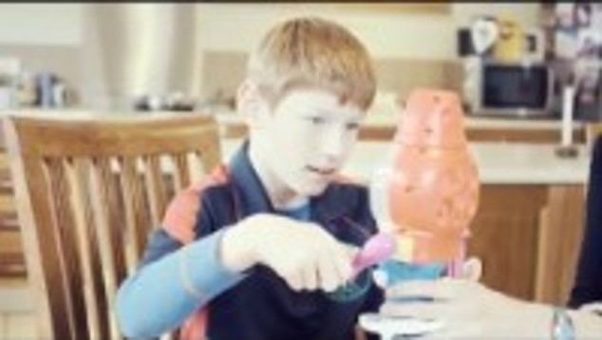
Diversity in AS
Link to video
Notes:
With the exception of the four characteristics of ataxia, functionally severe developmental delay, frequent laughter/smiling with hypermotor behavior, and speech impairment, there is a lot of variability between individuals that have the syndrome.
Watch this video and take note of the diversity that can be present.
https://www.youtube.com/watch?v=U5J0kvFSTtA

Slide 57
Activity 3
Now that you know the range of functional and behavioral characteristics of people with Angelman syndrome, what types of specialists/professionals do you think would be beneficial to have on the intervention team for a child with this syndrome?
Come up with a list and justification for your team members.
Is your list for PWS and AS the same or different? Why?

Slide 58
AS - Treatments and Supports
Physical Therapy
  Physical therapy can address difficulties with balance, posture, and strength.
  Orthotics or braces may assist in walking.
Occupational Therapy
  Functional skills of daily living with an emphasis on fine motor skills
  Sensory processing

Slide 59
AS - Treatments and Supports II
Speech and language therapy
Multimodal approach in which all forms of communication are encouraged is recommended to help increase success
Children with AS generally exhibit desire to interact (e.g., eye gaze, approach)

Slide 60
AS - Treatments and Supports III
Medications
Anti-epileptic medications are likely needed to control seizures (emerging evidence supporting Keto diet).
Melatonin or sedating medications may be helpful for some cases of severe sleep difficulties.
Behavioral Therapy
Behavioral strategies can help reduce sleeping difficulties and challenging behaviors as well as increase behaviors such as social interactions, functional communication, cognitive skills, etc.
Notes:
.

Slide 61


Activity 4
Complete this Venn diagram on the similarities and differences between PWS and AS. Keep in mind the information on chromosomes, history, prevalence, early signs, diagnosis, characteristics, and treatments that you have learned throughout this module.
Prader-Willi
Angelman

Slide 62
References
Angelman Syndrome Foundation. (2021). Testing and diagnosis of Angelman syndrome. https://www.angelman.org/what-is-as/testing-and-diagnosis/
Batshaw, M. L., Roizen, N. J., & Pellegrino, L. (2019). Children with disabilities (8th ed.). Paul H. Brookes.
Burdine, R. D., & Sheldin, E. (2021). Testing 101. FAST. https://cureangelman.org/testing-101
Buiting, K. (2010). Prader–Willi syndrome and Angelman syndrome. American Journal of Medical Genetics Part C: Seminars in Medical Genetics. 154C(3), 365-376. https://doi.org/10.1002/ajmg.c.30273
The Day . (2020, January 26). Cami Grundy, a life with Prader-Willi Syndrome [video] YouTube. https://www.youtube.com/watch?v=yYebPiA0IjM
Drakeygirl. (1970, January 1). Genetics. http://adrakesprogress.blogspot.com/2015/05/genetics.html
Foundation for Prader-Willi Research. (2020). A clear explanation of PWS symptoms, causes, diagnosis, genetics, treatments & research. About Prader-Willi Syndrome.
Mackay, J., McCallum, Z., Ambler, G. R., Vora, K., Nixon, G., Bergman, P., Shields, N., Milner, K., Kapur, N., Crock, P., Caudri, D., Curran, J., Verge, C., Seton, C., Tai, A., Tham, E., Musthaffa, Y., Laffterty, A. R., Belcher, G., Harper, J., ... & Downs, J. (2019). Requirements for improving health and well‐being of children with Prader‐Willi syndrome and their families. Journal of Paediatrics and Child Health, 55(9), 1029-1037. https://doi.org/10.1111/jpc.14546
Maranga, C., Fernandes, T. G., Bekman, E., & da Rocha, S. T. (2020). Angelman syndrome: A journey through the brain. The
FEBS Journal, 287(11), 2154–2175. https://doi.org/10.1111/febs.15258

Slide 63
References Continued
Mayo Clinic Staff. (2018, January 31). Prader-Willi syndrome. Patient care and health information. https://www.mayoclinic.org/diseases-conditions/prader-willi-syndrome/symptoms-causes/syc-20355997
Micheletti, S., Vivanti, G., Renzetti, S., Martelli, P., Calza, S., & Fazzi, E. (2020). Imitation in Angelman syndrome: The role of social engagement. Scientific Reports, 10(1), 1-11. https://doi.org/10.1038/s41598-020-72079-3
National Center for Biotechnology Information. (2020, March 6). Prader-Willi syndrome. Genetic testing tegistry. https://www.ncbi.nlm.nih.gov/gtr/tests/500313/overview/
PathwaysAwareness. (2013, August 21). 2 month old babies in horizontal suspension (held level in the air), typical and atypical [video]. YouTube. https://www.youtube.com/watch?v=BasXYtKOjSs
Pearson, E., Wilde, L., Heald, M., Royston, R., & Oliver, C. (2019). Communication in Angelman syndrome: A scoping review. Developmental Medicine & Child Neurology, 61(11), 1266-1274.
Vimeo. (2014). What is DNA? Institute for Creation Research. https://vimeo.com/108520146
Wallace, L. J. H. Bean, K. Stephens, & A. Amemiya (Eds.), Gene Reviews. https://www.ncbi.nlm.nih.gov/books/NBK1330/
What does Angelman Syndrome look like? (2016, February 12). Bing Videos. https://www.bing.com/videos/search?q=child+with+angelman+sydrome&ru=%2fvideos%2fsearch%3fq%3dchild%2bwith%2bangelman%2bsydrome%26FORM%3dH

Slide 64
Disclaimer
This is a product of the Early Childhood Intervention Doctoral Consortium (ECiDC), a project of the A.J. Pappanikou Center for Excellence in Developmental Disabilities at UConn Health. The Center is funded through cooperative agreement number H325H190004 from the Office of Special Education Programs, U.S. Department of Education. Materials and opinions expressed herein do not necessarily represent the Department of Education’s position or policy.

