Slide 1
Family-Professional Partnerships
Ethical, Policy, and Historical Foundations of Trusting Family-Professional Partnerships

Slide 2
Reading 1
The Core Concepts of Disability Policy Affecting Families Who Have Children with Disabilities

Slide 3
Core Concepts Most Related to Families
Family integrity and unity—intact families
Family centeredness—whole family
Autonomy—choice and consent
Cultural responsiveness—honoring diversity
Privacy & confidentiality—honor personal information
Empowerment & participatory decision-making—equal partners
Service coordination and collaboration—braided services
Protection from harm—family and agency duties

Slide 4
Ethics of Early Childhood Practices Regarding Families
Ethics—Concerns about right and wrong actions, especially about professionals’ actions in early childhood education
Ethical decision-making—A process of applying ethics in order to ensure right action and avoid wrong action by professionals and the people they serve
American policy core concepts—Guideposts for ethical decision-making

Slide 5
Key Ethical Principles
Family as Foundation
Family as core unit of society
Family as principal shaper & provider of physical, emotional, fiscal, & other support for children
Dignity
Dignity as an ascribed status, as a ‘regarded as’ standing within a community
Dignity as a state of being worthy, honored, & esteemed, not for what one can do (or cannot do) but simply as a person with inherent worth
Community
Community as more than a place or space
Membership & belonging to a greater societal whole
Family as source of life-long support
Having support in community programs

Slide 6
DEC Ethical Principles
Cultural responsiveness: We shall demonstrate our respect and appreciation for all families’ beliefs, values, customs, languages, and culture relative to their nurturance and support of their children toward achieving meaningful and relevant priorities and outcomes families’ desire for themselves and their children
Autonomy: We shall respect families’ rights to choose or refuse early childhood special education or related services

Slide 7
DEC Ethical Principles, continued
Participatory decision-making: We shall empower families with information and resources so that they are informed consumers of services for their children
Capacity and privacy: We shall demonstrate the highest standards of personal integrity, truthfulness, and honesty in all our professional activities in order to inspire the trust and confidence of the children and families and of those with whom we work
https://www.decdocs.org/member-code-of-ethics

Slide 8

DEC Recommended Practices:
Family Practices
F1: “Practitioners build trusting and respectful partnerships with the family through interactions that are sensitive and responsive to cultural, linguistic, and socioeconomic diversity.”
10 specific family practices:
  6 focusing on relationship indicators
  4 focusing on instructional indicators
17 family indicators embedded in other categories (e.g., Assessment, Environment, Transition)

Slide 9
DEC Recommended Practices
Practitioners build trusting partnerships with the family through interactions that are sensitive and responsive to cultural, linguistic, and socioeconomic diversity—cultural responsiveness
Practitioners provide the family with up-to-date, comprehensive and unbiased information in a way that the family can understand and use to make informed choices and decisions—autonomy

Slide 10
DEC Recommended Practices II
Practitioners are responsive to the family’s concerns, priorities, and changing life circumstances—empowerment
Practitioners and the family work together to create outcomes or goals, develop individualized plans, and implement practices that address the family’s priorities and concerns and the child’s strengths and needs—participatory decision-making

Slide 11
DEC Recommended Practices III
Practitioners support family functioning, promote family confidence and competence, and strengthen family-child relationships by acting in ways that recognize and build on family strengths and capacities—capacity
Practitioners engage the family in opportunities that support and strengthen parenting knowledge and skills and parenting competence and confidence in ways that are flexible, individualized, and tailored to the family’s preferences—individually appropriate

Slide 12
Reading 2
From Parent Involvement to Family Support: Evolution to Revolution

Slide 13
Chronology of Parent Roles
Parents as cause of problem—Bettleheim and autism
Parents as recipients of professionals’ decisions
Parents as organization members
Parents as service developers
Parents as program supporters
Parents as political advocates
Parents as partners

Slide 14
Key Points
Written in mid-80’s; Recommended practices were in 1993
Understanding among many families is that they weren’t getting much support from professionals
Emphasis on parent involvement with the program
  Advocating for more funding
  Support the program’s instruction at home in “formal” teaching —not in natural routines
Emphasis on mothers—primarily white, middle-class mothers

Slide 15

Parent (Mother) Involvement with the System (70’s-80’s)
Mothers
teach
Mothers
fundraise
System
Mothers attend trainings
Mothers
volunteer

Slide 16
Copernican Revolution:
System Support to Families
Educational System
Health System
Families
Social Service System
Recreation System

Slide 17
Ask Not
“Ask not what families can do for the service delivery system, but what the service delivery system can do for families.”

Slide 18
Reading 3
The Evolution of Family-Professional Partnership Models: Collective Empowerment as a Model for the Early 21st Century

Slide 19
Professionals Having Power Over Families
Professionals
Families

Slide 20
Shared Power
Power through Partnerships

Slide 21
Key Points:
Parent Counseling/Psychotherapy Model
Overview: Focus on mourning, grief, and psychological disturbance of mothers
Type of power: Power-over
Assumptions: Child with a disability creates family pathology, mother needs to be “fixed” in order to bond with the child

Slide 22
Key Points:
Parent Counseling/Psychotherapy Model II
Professional perspective: Medical model; psychiatrists, psychologists
Parent perspective: Traumatized, bewildered, frustrated by lack of help
Expected outcome: Mothers learning to accept their child; limited emphasis on child outcomes
Core Concepts: No alignment; seeking to protect the child from being harmed by the mother
Ethical reversal: Psychiatrists, psychologists, and pediatricians as foundation

Slide 23
Parent Training/Involvement Model
Overview: Focus on preparing mothers to be actively involved with their child’s early childhood program
Type of power: Power-over
Assumptions: Professionals know best; mothers have time and energy to support the success of the early childhood program; fathers are bread winners

Slide 24
Parent Training/Involvement Model II
Professional perspective: 4 key roles—parent assistance with program operation, parent training, parent participation in educational & therapeutic components, assistance with project dissemination
Parent perspective: Conflict between teaching and parenting roles
Expected outcome: Children advancing in skills with no attention to family outcomes
Core concepts: Limited alignment except for privacy & confidentiality
Ethical reversal: Early childhood professionals and program as foundation

Slide 25
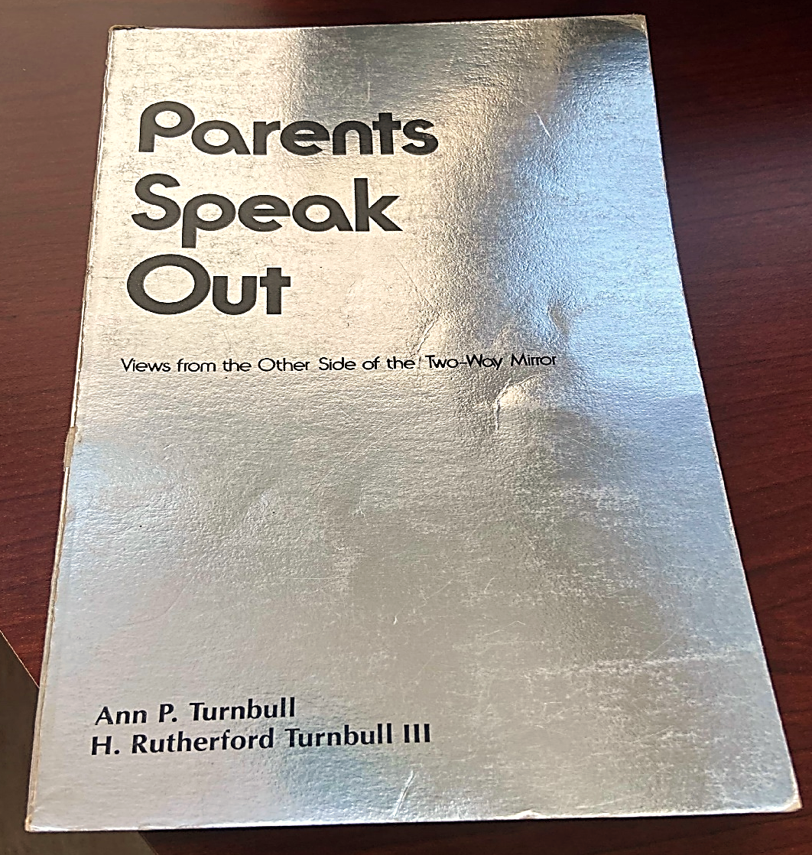
Parents Speak Out: Views from the Other Side of the Two-Way Mirror

Slide 26
Key Points: Family-Centered Model
Overview: Switch from parent (mother) to family; emphasis on family choice and family strengths; family as ultimate decision-maker (?)
Type of power: Power with
Assumptions: Beginning of Copernican Revolution; family is constant, beginning recognition of cultural responsiveness, parent-to-parent support (https://www.p2pusa.org/)

Slide 27
Key Points: Family-Centered Model II
Professional perspective: Need to expand expertise to family outcomes and to honoring family choices; professionals and families working together
Parent perspective: Welcomed sense of having family needs addressed
Expected outcome: Child and family outcomes, as prioritized by family
Core concepts: All
Ethical principle: Family as foundation

Slide 28
Key Points:
Collective Empowerment Model
Overview: Focus on professionals and families taking action to overcome challenges in getting what they want and need
Type of power: Power through synergy
Assumptions: Bringing in more family members, adding in friends, interaction with “door openers” in wider ecology

Slide 29
Key Points:
Collective Empowerment Model II
Professional perspective: Sense of empowerment
Parent perspective: Sense of empowerment, appreciation of real help
Expected outcome: Synergy, resource access and creation, enhanced quality of life
Core concepts: All—cultural responsiveness, family integrity, empowerment and participatory decision-making, service coordination and collaboration
Ethical principle: Family and community foundation

Slide 30
Reading 4
Evolution of the Parent Movement

Slide 31
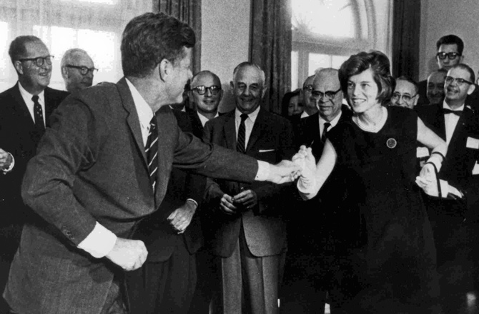
Key Points: Evolution of the Parent Movement
Pre-1970’s
National Association of Parents and Friends of Mentally Retarded Children, now The Arc of US
http://www.thearc.org/
Elizabeth Boggs—on whose shoulders we stand https://mn.gov/mnddc/dd-act/dd-act-50th-anniversary.html
Kennedy family—President’s Panel on Mental Retardation

Slide 32
Parent Movement II
Pre-1970’s: Early development and federal role
University Centers for Excellence in Developmental Disabilities
Developmental Disability Councils
Protection and Advocacy systems
Intellectual & Developmental Disabilities Research Centers
Groundwork for IDEA

Slide 33
Parent Movement III
1970’s: Fundamental reform
Confluence of parent/sibling and professional advocates
Synchrony of time, circumstance, and people
Due process regulations

Slide 34
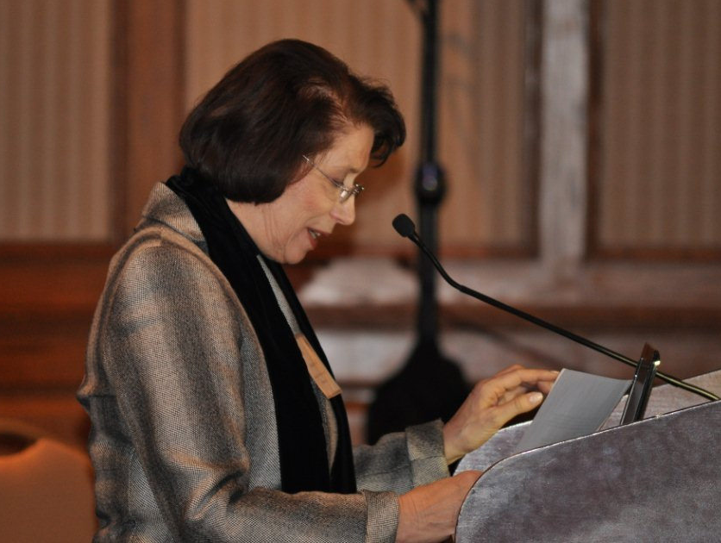
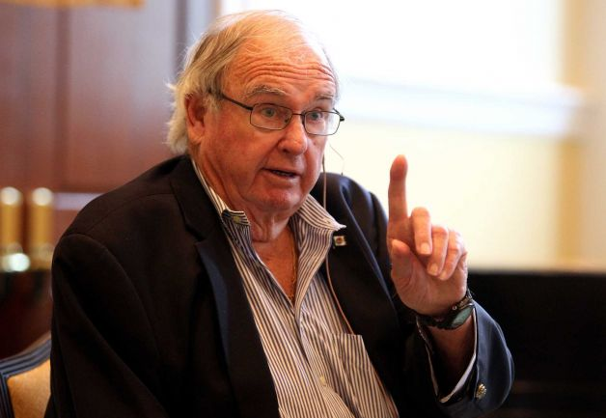
Parent Movement IV
1980’s: Expansion, retrenchment, and response
Part C—DEC conference envisioning early intervention, CEC, session being told “no way”, midnight gathering
“Surrender? Hell no, we have just begun to fight.”
Madeleine Will—Passionate insider for early childhood inclusion, and transition to adulthood
Lowell Weicker—Oversight hearings in Reagan era

Slide 35
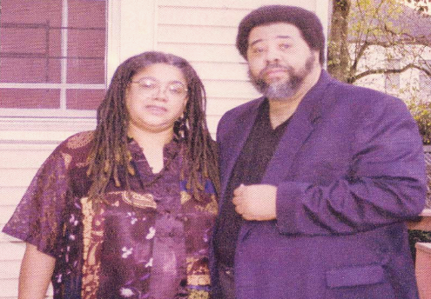
Parent Movement V
1990’s: Responding, renaming, expanding, confronting, and yielding
Added autism and TBI
Community Parent Resource Centers
2000-2009: Reauthorization
Most current reauthorization, 2004
Added positive behavior support
Added emphasis on research-based interventions

Slide 36
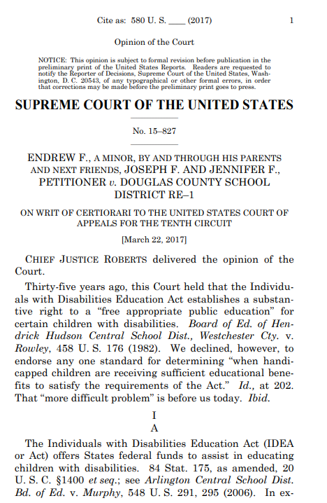

Parent Movement VI
2010-2019: Holding Ground with one exception
Endrew Decision (2017)

Slide 37
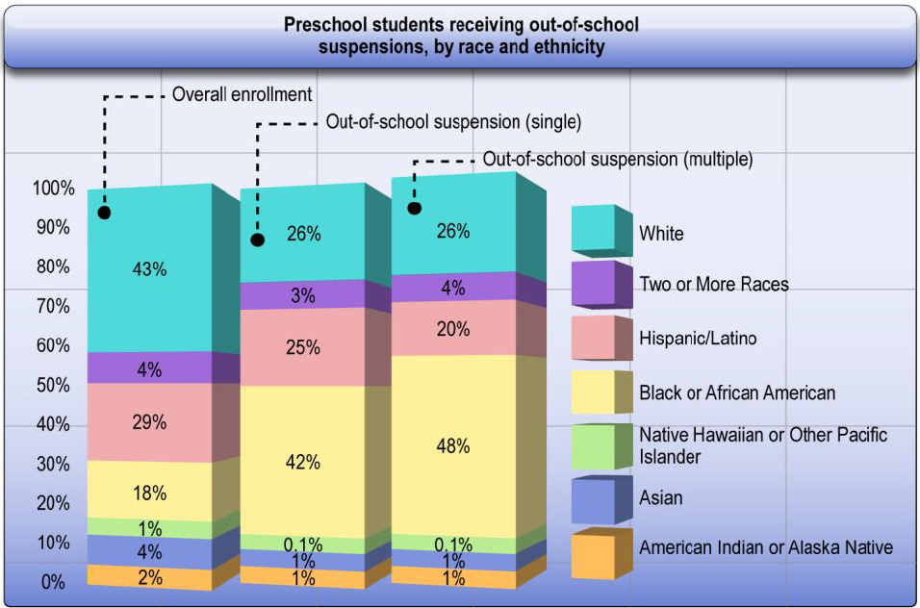
2020 and Beyond: Enhancing Equity
  Equity: Application of different levels of support calibrated to child and family strengths, needs, concerns, and resources in light of systemic barriers
Click to view source

Slide 38
The Bottom Line
Recognize we stand on the advocacy shoulders of families.
Trusting partnerships with families and community networks contribute to positive outcomes.
Enhancing equity for marginalized children and families is the priority of the decade.

Slide 39
Disclaimer
This is a product of the Early Childhood Intervention Doctoral Consortium (ECiDC), a project of the A.J. Pappanikou Center for Excellence in Developmental Disabilities at UConn Health. The Center is funded through cooperative agreement number H325H190004 from the Office of Special Education Programs, U.S. Department of Education. Materials and opinions expressed herein do not necessarily represent the Department of Education’s position or policy.

