Slide 1
Family-Professional Partnerships
Conceptualization, Measurement, and Application of Family Quality of Life

Slide 2
Follow Up from Reflections
Click to view video: Examining and Confronting Assumptions
A parent’s advice about sharing family information
Open-ended questions about best partnerships and worst disasters
Notes:
https://www.youtube.com/watch?v=lx3TO5icoV4

Slide 3
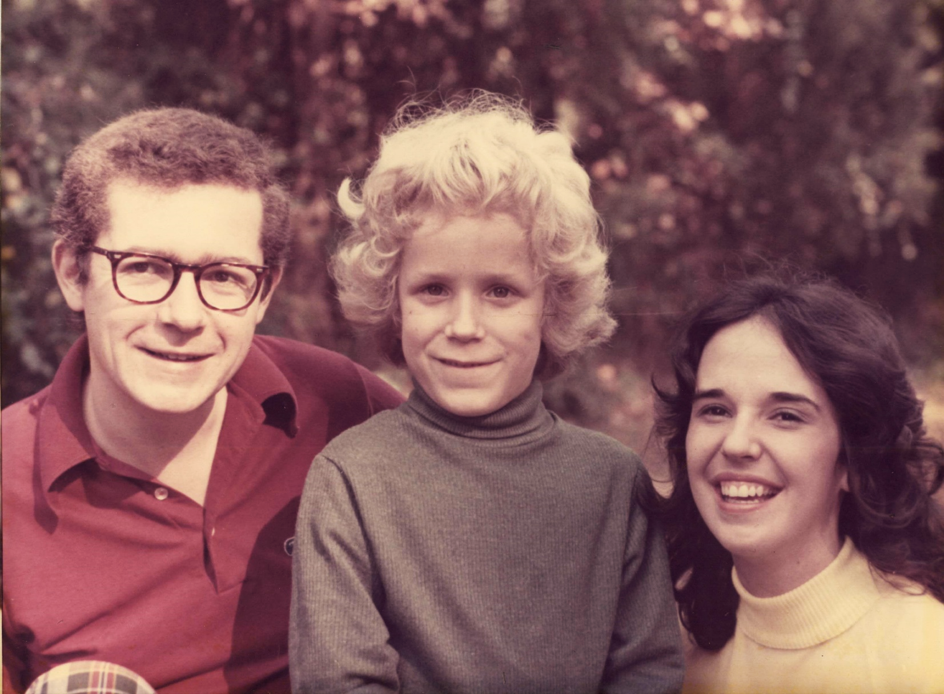
The Turnbull Family

Slide 4
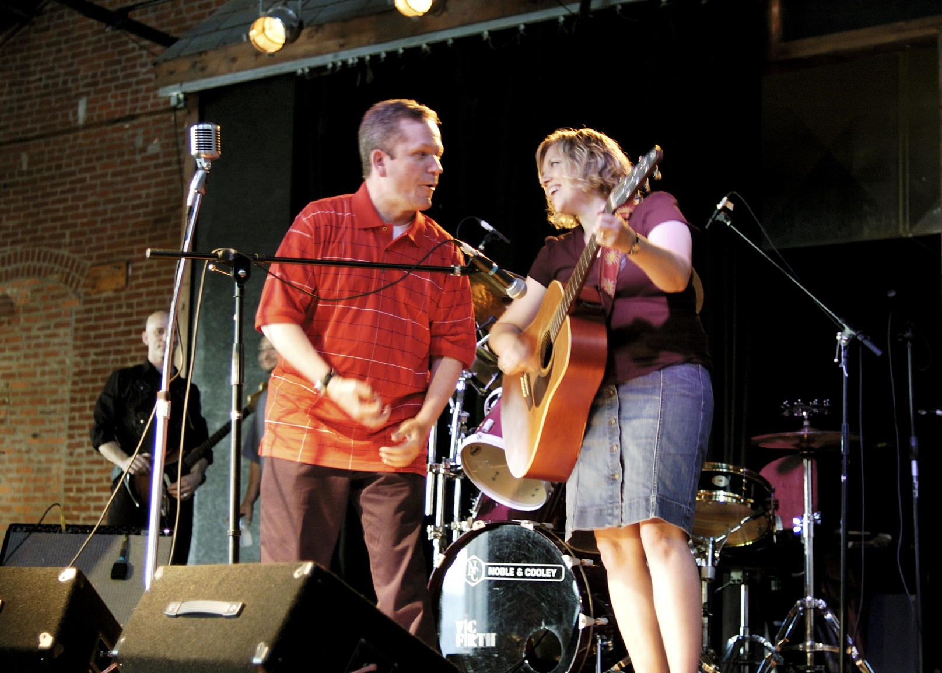
Jay

Slide 5
Ethical Principles and Core Concepts Aligned with Family Quality of Life (QoL)

Slide 6
Ethical Violation
QOL = NE + (H + S)
Quality of Life =
Natural Endowment
+
(Contribution of Home + Society)

Slide 7
Ethical Principles and Core Concepts Guiding FQOL Research
Family as foundation
Family integrity and unity
Family centeredness
Empowerment and participatory decision-making
Autonomy

Slide 8
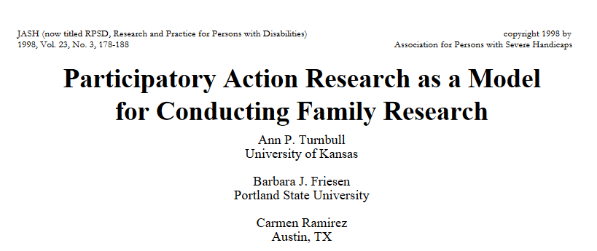
Participatory Action Research as a Model for Conducting Family Research (1998)Act for Conducting Family Research

Slide 9
Ethical Principles and Core Concepts Guiding FQOL Research II
Community
Individualized and appropriate services
Professional and system capacity building
Service coordination and collaboration
Dignity
Cultural responsiveness
Autonomy

Slide 10
Conceptualization and Measurement of Family Quality of Life

Slide 11
Steps in Conceptualizing and Measuring Family Quality of Life
Qualitative study
National field tests
Establishment of scale
Family Advisors
Literature Review
Use of Family Quality of Life Scale in research
Use of Family Quality of Life Scale/domains in professional development and family support services

Slide 12
Research on Family Quality of Life
Qualitative
33 focus groups comprised of families of children with and without disabilities; participatory action research
34 interviews of families who did not speak English
Quantitative
500 families of children with disabilities in 7 states

Slide 13
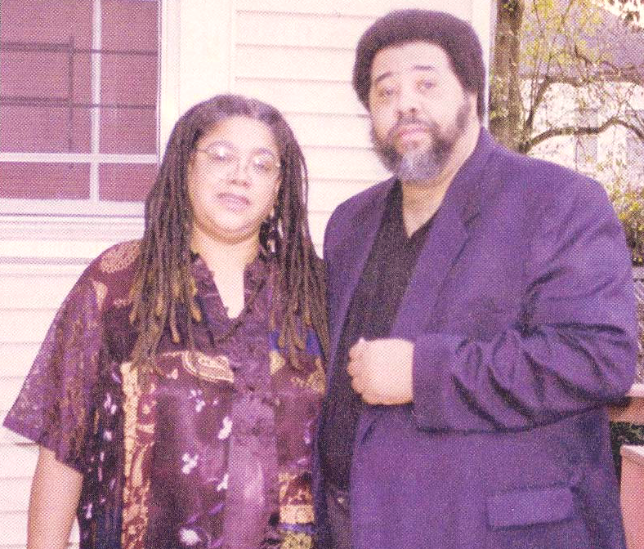
Ursula and DJ Marquis
Notes:
Ursula and DJ Marquis from New Orleans were research partners. They are parents of two children with disabilities, and amazing civil rights and disability advocates.

Slide 14
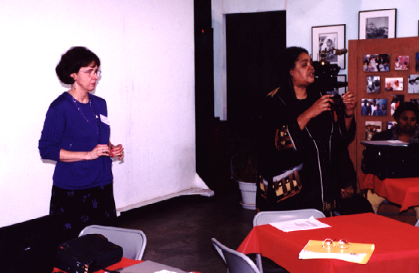
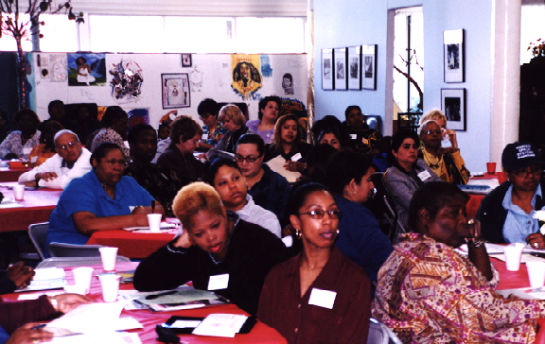
Ursula Speaks to a Focus Group
Notes:
The picture on the left is Ursula addressing a group of parents at a research focus group workshop.

Slide 15

Painting by Ursula
Notes:
This is a painting by Ursula representing Ann and Ursula being partners in learning about family quality of life. Note how their boots meet at the bottom and form a heart.

Slide 16
What Contributes to Family Quality of Life?
Tell us about the times when things have gone really well in your family. What helps things go well?
Tell us about the times that have been especially tough in your family. What are the things that usually create tough times?

Slide 17

What is the Definition of Family Quality of Life?
Family Quality of Life refers to the extent to which:
Family members’ needs are met
Family members enjoy their life together
Family members have a chance to do the things that are important to them.

Slide 18
Qualitative Study: Family Quality of Life Domains
Family Quality of Life
Family as a Whole
Individual
Family Members
Daily Family Life
Advocacy
Emotional
Well-Being
Family Interaction
Health
Physical
Environment
Financial Well-Being
Productivity
Social
Well-Being
Parenting

Slide 19
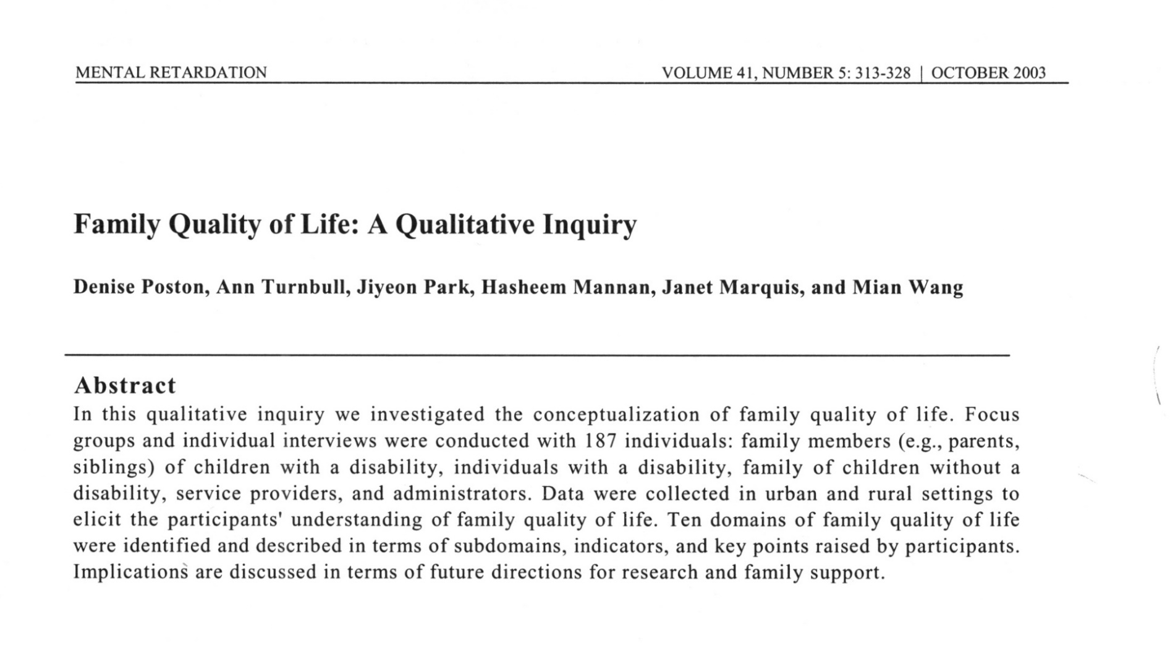
Qualitative Study

Slide 20
National Field Tests
Initially, involved two studies with approximately 500 families in seven states; PAR participation
Confirmed the factor structure with a five-factor solution and 25 items
Established validity in terms of the correlation with other well-being measures
Established test-retest reliability

Slide 21
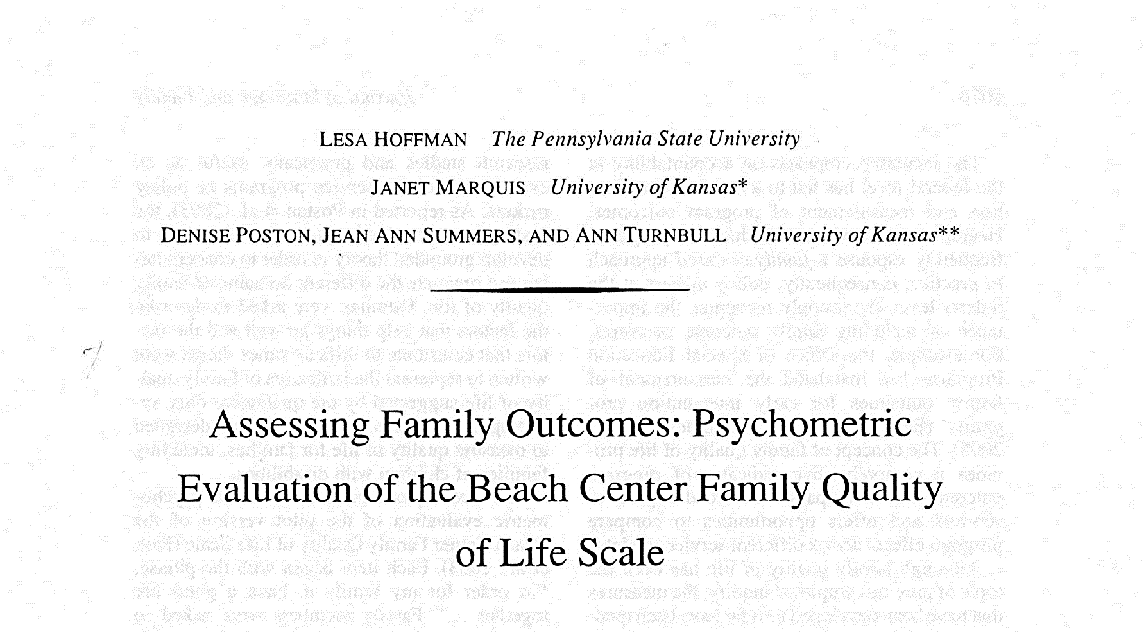
National Field Tests (continued)

Slide 22
Family Quality of Life Framework
Family Quality of Life
Emotional Well-Being
Physical/Material
Well-Being
Parenting
Family Interaction
Disability-Related
Support

Slide 23
Emotional Well-Being
Definition: Refers to the feeling or affective parts of family members and family life
Sample Indicators:
My family members have the support we need to relieve stress.
My family members have some time to pursue their own interests.
My family members have friends or others who provide support.

Slide 24
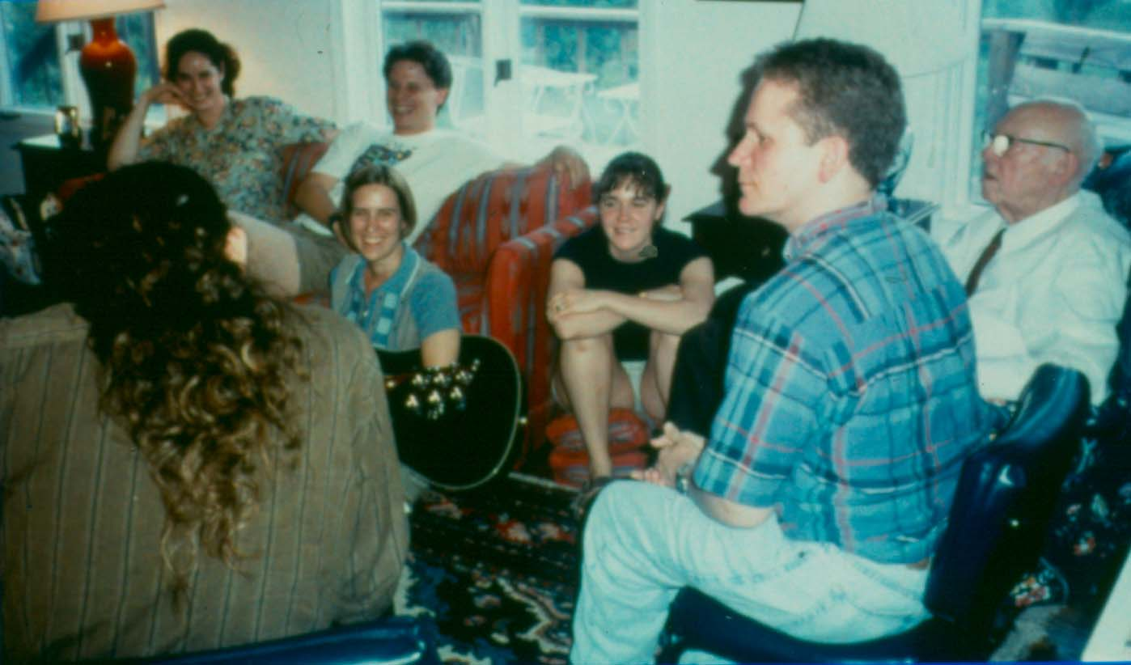
Friends or Others who Provide Support

Slide 25
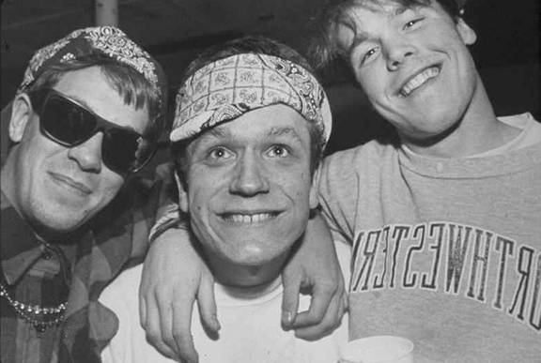
Jay and his college friends
Notes:
These were Jay’s college friends who were very supportive of him.

Slide 26
Jay’s Schedule
H – Housemate | Y – Yoga Teacher
F – Family | JC – Job Coach
ST – Speech Therapist | C1-C6 – Companions
MT – Music Therapist | FR – Fraternity
M – Masseuse | GF – Girlfriend
Y – Yoga Teacher | CW – Co-Worker
Notes:
This was Jay’s schedule and the network they built through Group Action Planning and Family Quality of Life. The Turnbulls had a great support system for Jay that made all the difference.

Slide 27
Group Action Planning
Inviting support
Creating Connections Click to view video
Sharing Great Expectations
Solving Problems Click to view video
Celebrating Success Click to view video
Notes:
Creating connections: http://www.youtube.com/watch?v=4h7cHv5Ulr0
Solving problems: https://youtu.be/_TZEEH85Q84
Celebrating success: http://www.youtube.com/watch?v=PHIlJXNeRc4

Slide 28
Physical/Material Well-Being
Definition: Refers to the resources available to the family to meet its members’ needs
Sample Indicators:
My family gets medical care when needed.
My family members have transportation to get to the places they need to be.
My family members feel safe at home, work, school, and in the neighborhood.

Slide 29
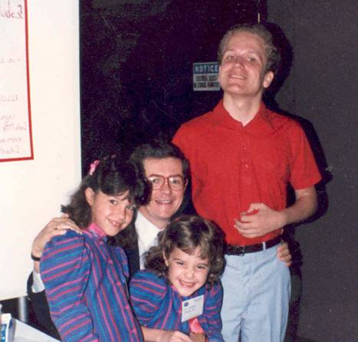
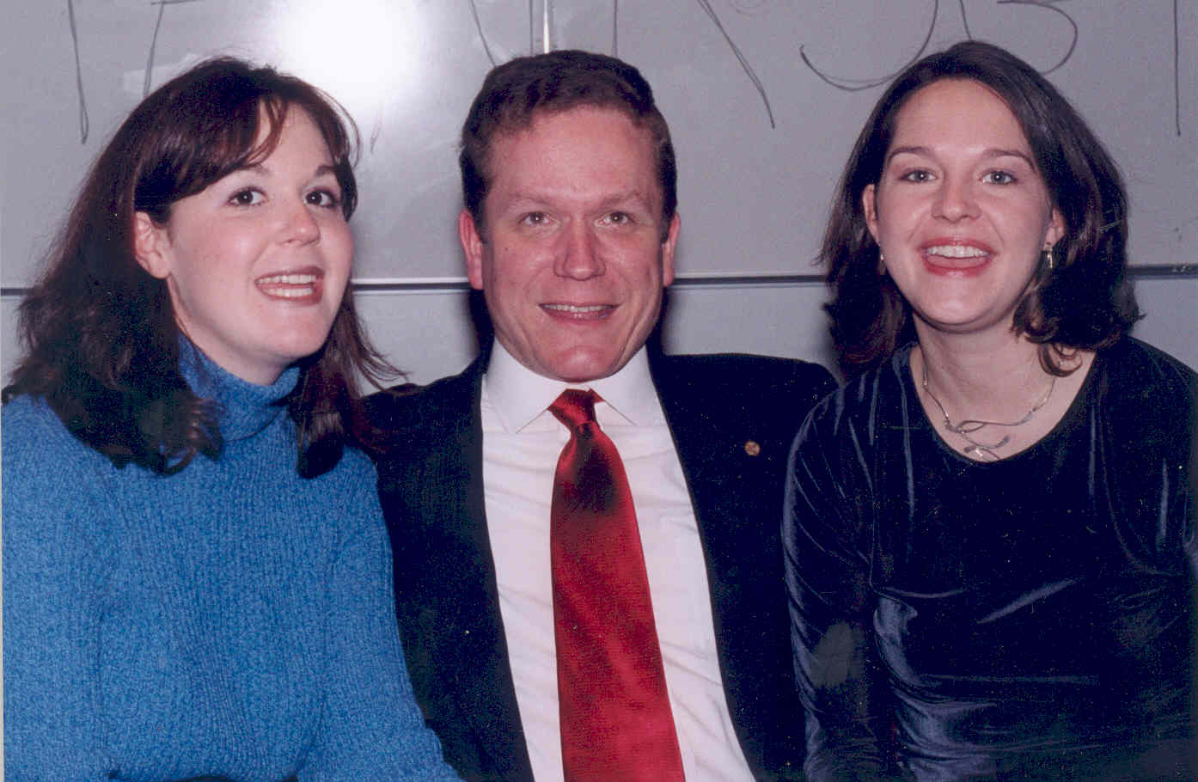
Feeling Safe at Home, Work, School, and in the Neighborhood

Slide 30
Family Interaction
Definition: Focuses on the relationships among family members
Sample Indicators:
My family members show that they love and care for each other.
My family members support each other to accomplish goals.
My family enjoys spending time together.

Slide 31

Where fun comes to die.
Notes:
A t-shirt worn by a University of Chicago student. The t-shirts represent the hazing that doctoral students encountered at the university, but it also can represent the homes of people caring for people with disabilities, as they are often overwhelmed and feel alone.

Slide 32
Parenting
Definition: Refers to activities that parents do to help their sons and daughters develop.
Sample Indicators:
Adults in our family teach their sons and daughters to make good decisions.
Parents help their sons and daughters learn to be independent.
Adults in my family have time to take care of the individual needs of each of their children.

Slide 33
Having Time to Take Care of the Individual Needs of Each of their Children
Rud
Amy
Ann
Jay

Slide 34
Having Time to Take Care of the Individual Needs of Each of their Children (continued)
Rud
Ann
Amy
Jay

Slide 35
Disability-Related Support
Definition: Focuses on support from family professionals, friends, and provided in order to benefit the family member with a disability
Sample Indicators:
My family member with a disability has support to accomplish goals at school or at a workplace.
My family member with special needs has support to accomplish goals at home.
My family has good relationships with the service providers who provide services and supports to our family member with a disability.

Slide 36
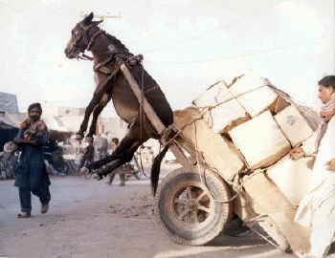
Having Support to Accomplish Child and Family Outcomes

Slide 37
Use of Family Quality of Life Scale in Research
Domains of least satisfaction
Emotional well-being
Disability-related support
Domains of greatest satisfaction
Parenting
Family interaction

Slide 38
Summary of Family Quality of Life Research
Four characteristics associated with higher family quality of life
Higher family income/income supplements
More support from family, friends, and community
More effective disability-related services
More trusting partnerships with professionals
Kyzar, K., Turnbull, A., & Turnbull, R. (2019). Enhancing quality of life for families of children with disabilities through trusting partnerships. American Academy of Pediatrics: Bioethics newsletter, Spring, 13-16.

Slide 39
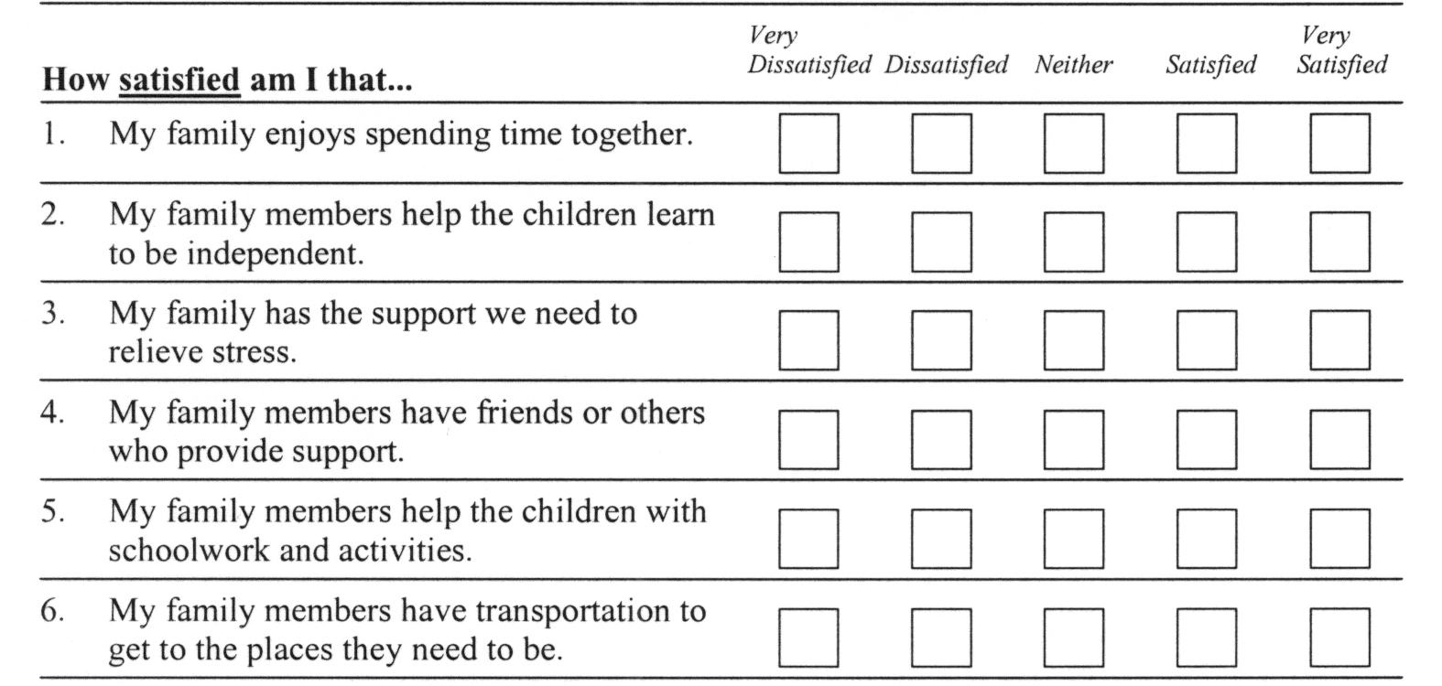
Sample Excerpt from Beach Center Family Quality of Life Scale
Click to view the Quality of Life Scale (PDF)
Notes:
Beach Center Family Quality of Life Scale: https://beachcenter.lsi.ku.edu/sites/default/files/2019-10/1.%20Beach%20Center%20Quality%20of%20Life%20Scale-With%20Update.pdf

Slide 40
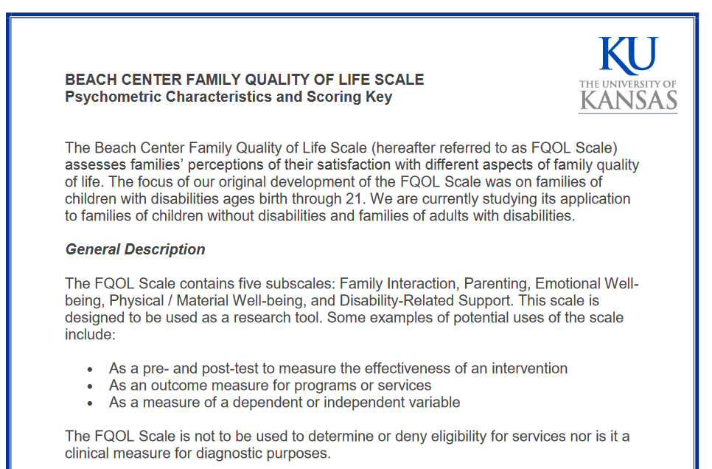
Beach Center Family Quality of Life Scoring Guide
Click to view the Scoring Guide
Notes:
Beach Center Family Quality of Life Scoring Guide

Slide 41
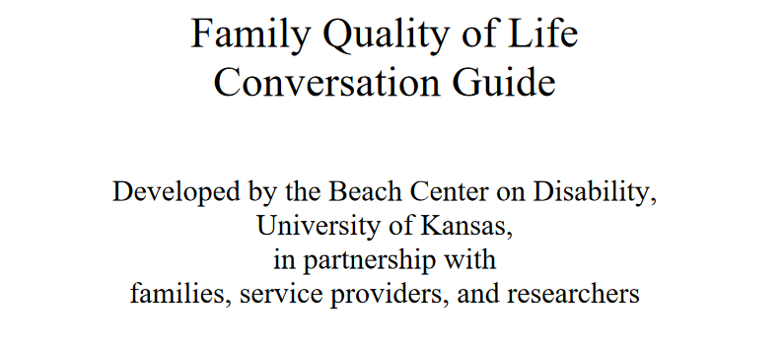
Beach Center Family Quality of Life Conversation Guide
Click to view the Conversation Guide
Notes:
Beach Center Family Quality of Life Conversation Guide: https://beachcenter.lsi.ku.edu/sites/default/files/inline-files/2. Beach Center Family Quality of Life Conversation Guide.pdf

Slide 42
References for Family Quality of Life
Blue-Banning, M., Summers, J.A., Frankland, H.C., Nelson, L.L., & Beegle, G. (2004). Dimensions of family and professional partnerships: Constructive guidelines for collaboration. Exceptional Children, 70(2), 167-184.
Chiu, C., Kyzar, K., Zuna, N., Turnbull, A. P., Summers, J.A., & Gomez, V.A. (2013). Family quality of life. In M.L. Wehmeyer (Ed.), The Oxford handbook of positive psychology and disability (pp. 365-392). Oxford University Press, Inc.
Eskow, K. G., Summers, J. A., Chasson, G. S., & Mitchell, R. (2018). The association between family-teacher partnership satisfaction and outcomes of academic progress and quality of life for children/youth with autism. Journal of Policy and Practice in Intellectual Disabilities, March, 16-25.
Hoffman, L., Marquis, J. G., Poston, D. J., Summers, J. A., & Turnbull, A. P. (2006). Assessing family outcomes: Psychometric evaluation of the family quality of life scale. Journal of Marriage and Family, 68, 1069-1083.
Kyzar, K. B., Brady, S. E., Summers, J. A., Haines, S. J., & Turnbull, A. P. (2016). Services and supports, partnership, and FQOL for families of children with deaf-blindness. Exceptional Children, 83(1), 77-91.
Kyzar, K. B., Brady, S. E., Summers, J. A., Haines, S. J., & Turnbull, A. P. (in press). Services and supports, partnership, and FQOL for families of children with deaf-blindness. Remedial and Special Education. Advance online publication. doi:10.1177/0741932518781946

Slide 43
References II
Mannan, H., Summers, J. A., Turnbull, A. P., & Poston, D. J. (2006). A review of outcome measures in early childhood programs. Journal of Policy and Practice in Intellectual Disabilities, 3(4), 219-228.
Park, J., Hoffman, L., Marquis, J., Turnbull, A. P., Poston, D., Mannan, H., Wang, M., & Nelson, L. (2003). Toward assessing family outcomes of service delivery: Validation of a family quality of life survey. Journal of Intellectual Disability Research, 47(4/5),367-384.
Park, J. Turnbull, A. P., & Turnbull, H. R. (2002). Impacts of poverty on quality of life in families of children with disabilities. Exceptional Children, 68(2), 151-170.
Poston, D., Turnbull, A. P., Park, J., Mannan, H., Marquis, J., & Wang, M. (2003). Family quality of life: A qualitative inquiry. Mental Retardation, 41(5), 313-328.
Poston, D. J., & Turnbull, A. P. (2004). Role of spirituality and religion in family quality of life for families of children with disabilities. Educational Training in Mental Retardation and Developmental Disabilities, 39(2), 95-108.
Saito, Y., & Turnbull, A. P. (2007). Augmentative and alternative communication practice in the pursuit of family quality of life: A review of the literature. Research & Practice for Persons with Severe Disabilities, 32(1), 50-65.
Summers, J. A., Hoffman., L., Marquis, J., & Turnbull, A. P., Poston, D., & Nelson, L. L. (2005a). Measuring the quality of family-professional partnerships in special education services. Exceptional Children, 72(1), 65-82.
Turnbull, A. P., Friesen, B. J., Ramirez, C. (1998). Participatory action research as a model of conducting family research. Journal of the Association for Persons with Severe Handicaps, 23(3), 178-188.

Slide 44
References III
Turnbull, A. P., Turnbull, H. R., Agosta, J., Erwin, E., Fujiura, G., Singer, G., & Soodak, L. (2005). Support of families and family life across the lifespan. In C. Lakin & A. P. Turnbull (Eds.), National goals and research for persons with intellectual disabilities.
Wang, M., Mannan, H., Poston, D., Turnbull, A. P., Summers, J. A. (2004). Parents’ perceptions of advocacy activities and their impact on family quality of life. Research and Practice for Persons with Severe Disabilities, 29(2), 144-155.
Wang, M., Summers, J. A., Turnbull, A. P., Little, T., Poston, D., & Mannan, H. (2006). Perspectives of fathers and mothers of children in early intervention programmes in assessing family quality of life. Journal of Intellectual Disability Research, 50(12), 977-988.
Wang, M., Turnbull, A. P., Summers, J. A., Little, T. D., Poston, D. J., Mannan, H., & Turnbull, H. R. (2004). Severity of disability and income as predictors of parents’ satisfaction with their family quality of life during early childhood years. Research & Practice for Persons with Severe Disabilities, 29(3), 82-94.
Zuna, N. I. (2007). Examination of family-professional partnerships, parent-teacher communication, and parent involvement in families of kindergarten children with and without disabilities (Doctoral dissertation). Retrieved from ProQuest Dissertations & Theses Global. (3266511).
Zuna, N., Selig, J. P., Summers, J. A., & Turnbull, A. P. (2009). A confirmatory factor analysis of a family quality of life scale for families of children without disabilities. Journal of Early Intervention, 31, 111-125.
Zuna, N., Turnbull, A. P., & Summers, J. A. (2009). Family quality of life: Moving from measurement to application. Journal of Policy and Practice in Intellectual Disabilities, 6, 25-31.

Slide 45
Disclaimer
This is a product of the Early Childhood Intervention Doctoral Consortium (ECiDC), a project of the A.J. Pappanikou Center for Excellence in Developmental Disabilities at UConn Health. The Center is funded through cooperative agreement number H325H190004 from the Office of Special Education Programs, U.S. Department of Education. Materials and opinions expressed herein do not necessarily represent the Department of Education’s position or policy.

