Slide 1
Family-Professional Partnerships
Group Action Planning: Enhancing Family and Individual Quality of Life Across the Life Span

Slide 2

IDEA Results
Opportunities in life similar to others without disabilities
Opportunities to be included in all aspects of the community and protected from attempts at segregation
Equality of
Opportunity
Full Participation
IDEA Results
Economic
Self-Sufficiency
Independent Living
Opportunities to engage in income producing work that contributes to household
Opportunities to fully participate in decision-making and to experience autonomy in making choices

Slide 3
Key Points: Family-Centered Model
Overview: Switch from parent (mother) to family; emphasis on family choice and family strengths; family as ultimate decision-maker (?)
Type of power: Power with
Assumptions: Beginning of Copernican Revolution; family is constant, beginning recognition of cultural responsiveness, parent-to-parent support (https://www.p2pusa.org/)

Slide 4
Key Points: Family-Centered Model II
Professional perspective: Need to expand expertise to family outcomes and to honoring family choices; professionals and families working together
Parent perspective: Welcomed sense of having family needs addressed
Expected outcome: Child and family outcomes, as prioritized by family
Core concepts: All
Ethical principle: Family as foundation

Slide 5
Key Points: Collective Empowerment Model
Overview: Focus on professionals and families taking action to overcome challenges in getting what they want and need
Type of power: Power through synergy
Assumptions: Bringing in more family members, adding in friends, interaction with “door openers” in wider ecology

Slide 6
Key Points: Collective Empowerment Model II
Professional perspective: Sense of empowerment
Parent perspective: Sense of empowerment, appreciation of real help;
Expected outcome: synergy, resource access and creation, enhanced quality of life
Core concepts: All—cultural responsiveness, family integrity, empowerment and participatory decision-making, service coordination and collaboration
Ethical principle: Family and community foundation

Slide 7
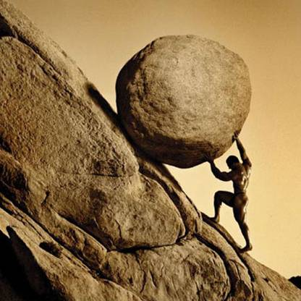
Strategies
Sisyphus from Greek mythology – has to continually start over
Notes:
Ask families to share some of their best and worst experiences in getting services and supports for their son or daughter
Seek to identify strengths of their past systems navigation that you can build on, as well as their particular challenges and how those might be overcome.
Identify each family’s preferred strategy for accessing information – online, workshops, reading material, etc.
Could we ask participants to share tips they have used that they have found to be helpful?

Slide 8
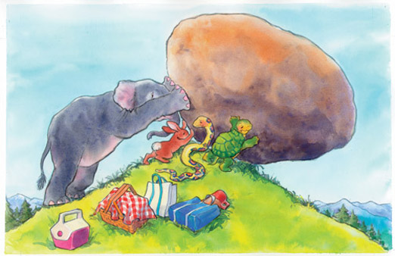
Reliable Partners
Sisyphus with reliable allies as partners.
Notes:
Ask families to share some of their best and worst experiences in getting services and supports for their son or daughter
Seek to identify strengths of their past systems navigation that you can build on, as well as their particular challenges and how those might be overcome.
Identify each family’s preferred strategy for accessing information – online, workshops, reading material, etc.
Could we ask participants to share tips they have used that they have found to be helpful?

Slide 9
Group Action Planning

Slide 10
Ethical Principles and Core Concepts Guiding Group Action Planning
Family as foundation
Family integrity & unity
Family centeredness
Empowerment and participatory decision-making
Autonomy

Slide 11
Ethical Principles and Core Concepts Guiding Group Action Planning II
Community
Individualized and appropriate services
Professional and system capacity building
Service coordination and collaboration
Dignity
Cultural responsiveness
Autonomy

Slide 12
Inviting Support
Strengths
Preferences
Community
School
Friends
Neighborhood
Job
Home

Slide 13
Creating Connections
Preferences
Strengths
Friends
Community
Neighborhood
School
Home
Job

Slide 14
Envisioning Great Expectations
NEIGHBORHOOD
HOME
FRIENDS
JOB
SCHOOL
COMMUNITY

Slide 15
Solving Problems
VISION
ACTION PLAN
Brainstorm Options
Weigh Options

Slide 16
Celebrating Success
Celebrate Progress
Acknowledge Group Members’ Contributions
Develop the “Joy Quotient”

Slide 17
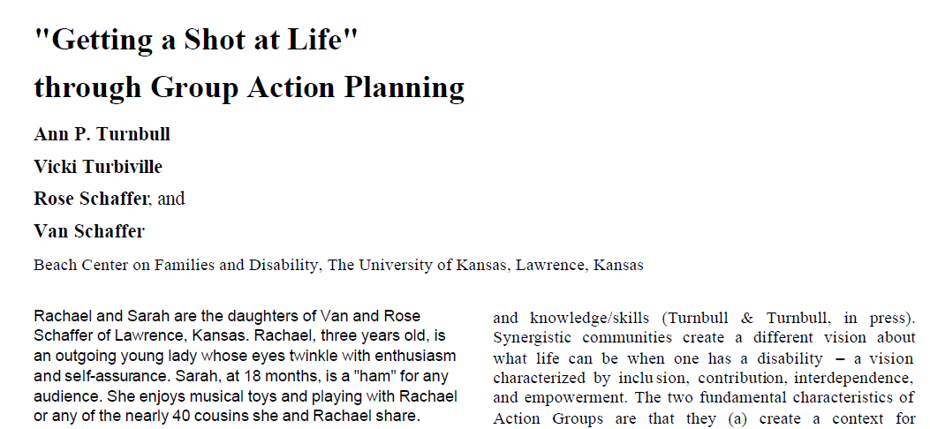
Getting a Shot at Life article
Click to view "Getting a Shot at Life" article - Beach Center
Notes:
http://www.beachcenter.org/Research/FullArticles/PDF/PCPF1A_Getting_a_Shot8_07.pdf

Slide 18
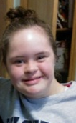
Let Me Introduce Myself
My name is Sarah Schaffer. I am 19 years old.
I love hanging out with my friends, music, sports, shopping, going out to eat, going to church, and being with my family.
I am in my 2nd year at Washburn University.
My goals are to finish college, get a job, move into an apartment with friends, and drive a car.
In other words, I want everything you want.

Slide 19
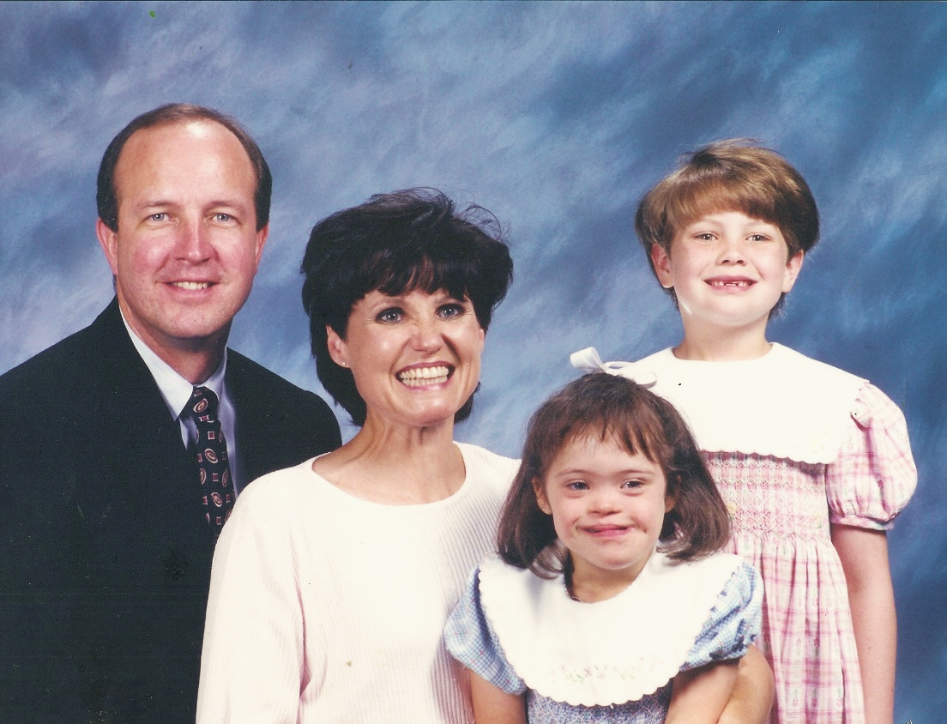
My Story
When I was born, my family was surprised to discover that I had Down syndrome.
They started searching for ways to help me over some of the challenges that I might face.

Slide 20

The Journey Begins
When I was 4 weeks old they took me to KU’s Schiefelbusch Speech and Language Hearing Clinic to meet Jane Wegner. That’s when I started working on talking and communicating.

Slide 21
My GAP
One day Jane asked my mom if we would be interested in something called GAP. It was to help me to grow in my childcare program and be ready for kindergarten.
My Mom said YES! Jane and my Mom will explain our first GAP to you. All I know is that we had meetings at my house with lots of people who were helping me talk, learn, make friends, and get ready for school.

Slide 22
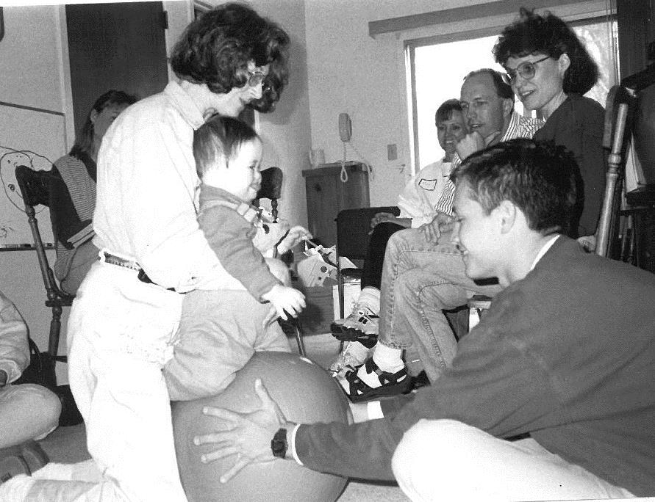
Group Action Planning (GAP)

Slide 23
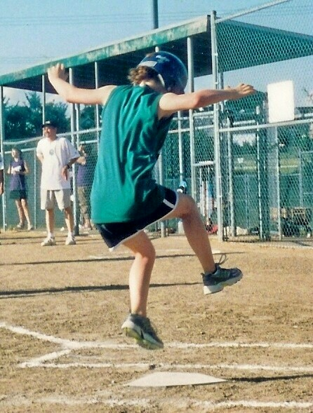
My Grade School Years
I made some friends, went to birthday parties, and was in brownies and girl scouts.
My favorite activities were soccer, gymnastics, softball, and being a server at church.

Slide 24
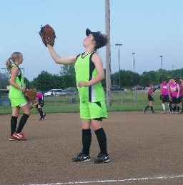
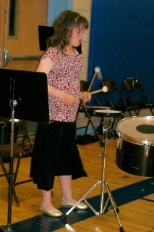
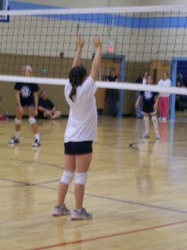
My Life as a Warhawk in Junior High
My classes were a bit challenging and overwhelming but I got through it.
I loved being in the percussion section of the band.
I played volleyball and softball. I ran the 100- and 200-meter dash in track.

Slide 25
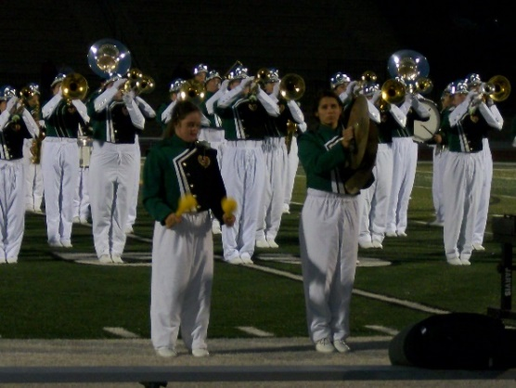
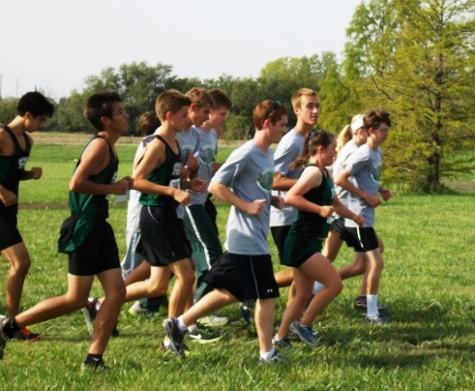
My Life as a Firebird in High School
My parents and sister made sure I attended regular classes. I had paras to help me with the work.
I played in the Marching Band, Pep Band, and Concert Band.
I ran cross country every year and finished every race.

Slide 26
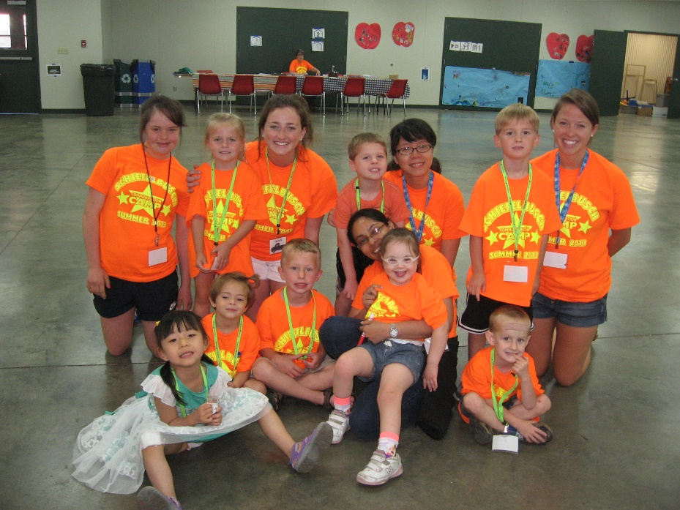
More High School Years
I really enjoy working at Jane’s Communication Camp in the summer.

Slide 27
My GAP (again)
When I told my parents my dream was to finish college, get a job, move into an apartment with friends, and drive a car, they said, “Let’s see what we can do.”
We asked Jane and Stephanie for their help. They said, “Let’s put another GAP together to plan for this new adventure.”
That is what we did.
We had lots of meetings at my house again. Everyone was full of ideas.

Slide 28
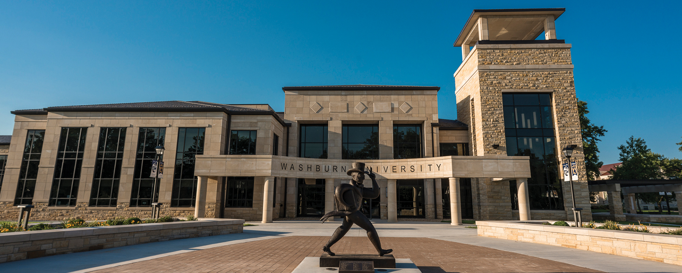
Looking at Colleges
I visited 2 colleges. Everyone at Washburn was so nice and friendly that I really wanted to go there.
Stephanie was so great because she had lots of connections at Washburn which helped.
I also received 2 scholarships to help with the cost of going to college. One from the National Down Syndrome Society and one from UPS for DOWNS.

Slide 29

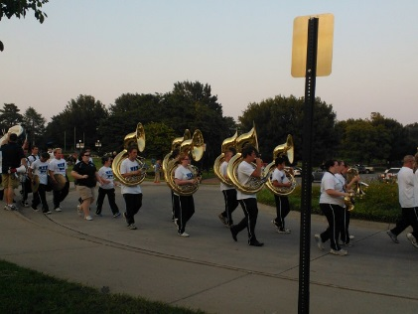
My Life as a Washburn Ichabod - Go Bods!
Right now, I am an Ichabod - thanks to everybody in my GAP.
Everybody at Washburn is so nice and friendly.
I am taking 7 hours of classes.
I get to be in the percussion section of the band and play at football games.

Slide 30
Review of IDEA Results
Opportunities in life similar to others without disabilities
Opportunities to be included in all aspects of the community and protected from attempts at segregation
Equality of
Opportunity
Full Participation
IDEA Results
Economic
Self-Sufficiency
Independent Living
Opportunities to engage in income producing work that contributes to household
Opportunities to fully participate in decision-making and to experience autonomy in making choices

Slide 31
Quotes
“ I think participating in the early GAP and taking the ‘long view’ from the start made a difference. This enabled me to be invested in the vision the Schaffers had for Sarah. The Schaffers made it easy to continue to be involved by bringing the GAP together when there were transitions on the horizon.
As Sarah became older, she made it easy by sharing her life and dreams with me. I am so rewarded by the life Sarah lives that I can’t imagine not being involved in her GAP! I intend to be in Sarah’s GAP as long as she has one.”
- Dr. Jane Wegner, Director, KU Speech-Language-Hearing Clinic

Slide 32
Quotes II
“For me, this behavior was modeled for me by Jane, my mentor. Her work, career, and role in her clients’ lives was one I sought (and still do) to emulate. It was normalized as part of the job. I don’t believe this work is best done in parts, siphoned off by professionals, or held in the boundary of a workday. When you agree to partner with someone, I think you agree to supporting them as a whole person, not just the parts for which you are licensed. Further, the longevity of such relationships allow for tangible progress because the person and their family are able to trust your advice, ideas, and opinions. That trust and commitment also makes it more likely that the family takes your schedule into account when planning and works hard to make it possible for you to be there. (continued on next slide)

Slide 33
Quotes III
Next, while there is no monetary compensation for the hours of time spent supporting a family in this way, I do benefit greatly. I am emotionally fulfilled by these relationships, I am challenged professionally, and I learn from the other members of the GAP or support team.”
“Most simply, I think it is about priorities. We all make time for what is important to us and ultimately choose how we spend our time. Supporting people with disabilities is much more than speech-language pathology or an IEP meeting, it is a social justice movement and it is required to develop a more just and accessible world.
(continued on next slide)

Slide 34
Quotes IV
Educators, SLPs, and the alike shouldn’t be afraid to deepen and broaden their level of support for their students and clients. The time and work load will ebb and flow over time, so if it feels particularly overwhelming and one point in time it won’t be like that all the time.
Jane and I have talked at length about the difference between professionals who ‘get it’ and those that don’t despite receiving the same education from the same professionals.”
- Dr. Stephanie Meehan

Slide 35

Your Reflections?
Alignment of GAP with collective empowerment.
Pros and cons of GAP.
Use of GAP to alleviate transition angst.
Professional time commitment.
Potential GAP benefits to members.

Slide 36
Disclaimer
This is a product of the Early Childhood Intervention Doctoral Consortium (ECiDC), a project of the A.J. Pappanikou Center for Excellence in Developmental Disabilities at UConn Health. The Center is funded through cooperative agreement number H325H190004 from the Office of Special Education Programs, U.S. Department of Education. Materials and opinions expressed herein do not necessarily represent the Department of Education’s position or policy.

