Slide 1
Family-Professional Partnerships
Trusting Family-Professional Partnerships in
Special and
General Education

Slide 2
Agenda
Analysis of Existing Frameworks
Research on Partnerships
Synthesis Partnership Framework
Applications

Slide 3
Analysis of Existing Frameworks
Analysis of Existing Frameworks
Research on Partnerships
Synthesis Partnership Framework
Applications

Slide 4

Parent (Mother) Involvement with the System (70’s-80’s)
Mothers
teach
Mothers
fundraise
System
Mothers attend trainings
Mothers
volunteer

Slide 5
Copernican Revolution:
System Support to Families
Educational System
Health System
Families
Social Service System
Recreation System

Slide 6

DEC Recommended Practices:
Family Practices
F1: “Practitioners build trusting and respectful partnerships with the family through interactions that are sensitive and responsive to cultural, linguistic, and socioeconomic diversity.”
10 specific family practices:
  6 focusing on relationship indicators
  4 focusing on instructional indicators
17 family indicators embedded in other categories (e.g., Assessment, Environment, Transition)
Click to view DEC Recommended Practices (PDF)
Notes:
ANN

Slide 7
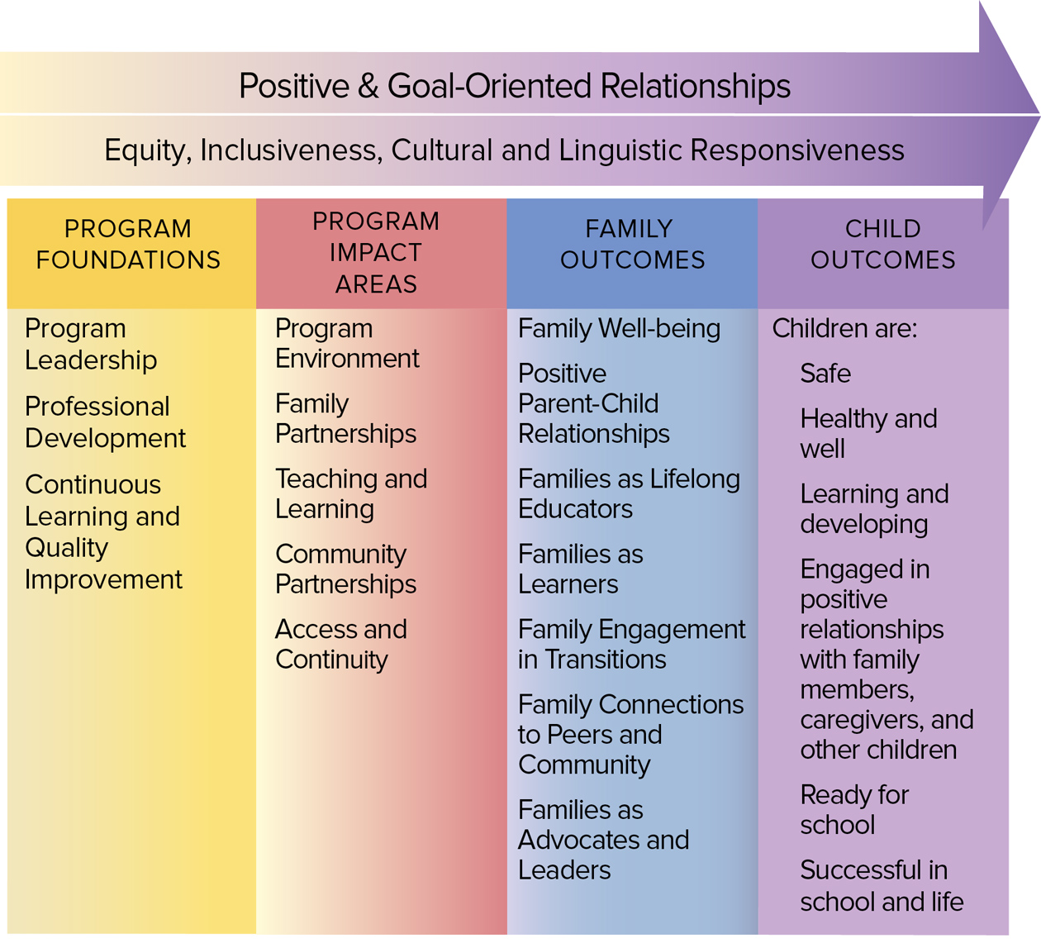
Head Start Family Framework

Slide 8
Head Start’s Parent, Family and
Community Engagement Framework
“Family engagement is an interactive process through which program staff and families, family members, and their children build positive and goal-oriented relationships. It is a shared responsibility of families and professionals that requires mutual respect for the roles and strengths each has to offer. Family engagement means doing with—not doing to or for—families.”
Click to read the Head Start School Readiness Article

Slide 9
Individuals with
Disabilities Education Act (IDEA)
The IEP meeting serves as a communication vehicle between parents and school personnel and enables them as equal participants to jointly decide what the child’s needs are, what services will be provided to meet those needs, and what the anticipated outcomes will be (Federal Register, 1981, p. 5462).
Notes:
ANN

Slide 10
Individuals with
Disabilities Education Act (IDEA) II
IDEA now provides that children’s education can be made “more effective by . . .strengthening the role and responsibility of parents and ensuring that families of such children have meaningful opportunities to participate in the education of their children at school and home.”
(20 U.S.C. Sec. 1400[c][5][C]).
Notes:
ANN

Slide 11
Epstein’s Framework on
Parent Involvement
Six Types
Parenting
Communicating
Volunteering
Learning at Home
Decision-making
Collaborating with Community

Slide 12
Epstein’s Framework on
Parent Involvement II
“The way schools care about children is reflected in the way schools care about the children’s families. If educators view children simply as students, they are likely to see the family as separate from the school. That is, the family is expected to do its job and leave the education of children to the schools. If educators view students as children, they are likely to see both the family and the community as partners with the school in children’s education and development. Partners recognize their shared interests in and responsibilities for children, and they work together to create better programs and opportunities for students.”
- Joyce Epstein, “School/Family/Community Partnerships,” Phi Delta Kappa
Click to visit the National Network of Partnership Schools website.

Slide 13


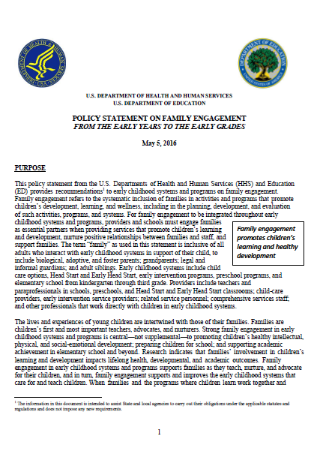
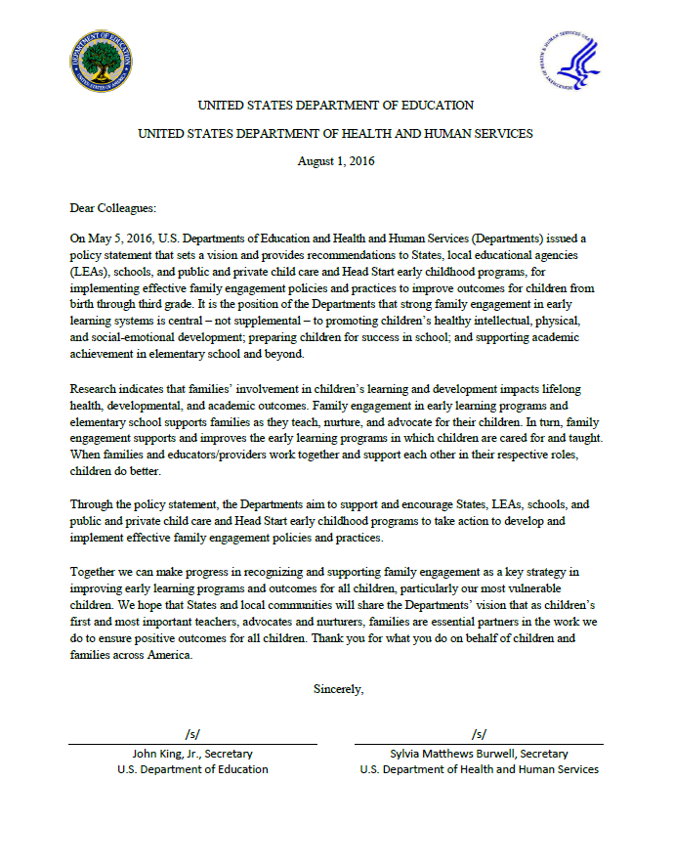
Federal Policy Statements
Family Engagement From the Early Years to the Early Grades
Click to visit the US Department of Education's Early Learning
Click to visit the Office of Early Childhood Development (DHHS)

Slide 14
HHS/ED Policy Statement on Family Engagement
“For family engagement to be integrated throughout early childhood systems and programs, providers and schools must engage families as essential partners when providing services that promote children’s learning and development, nurture positive relationships between families and staff, and support families” (p. 1).
“It is the goal of the Departments that all early childhood systems recognize and support families as essential partners in providing services that improve children’s development, learning, and wellness” (p. 2).
Notes:
ANN

Slide 15
Research on Partnerships
Analysis of Existing Frameworks
Research on Partnerships
Synthesis Partnership Framework
Applications

Slide 16
Beach Center Qualitative
Research on Partnerships
Qualitative research – 33 focus groups and 32 individual interviews
Participants included parents of children with and without disabilities, service providers, administrators
Broad representation of cultural diversity

Slide 17
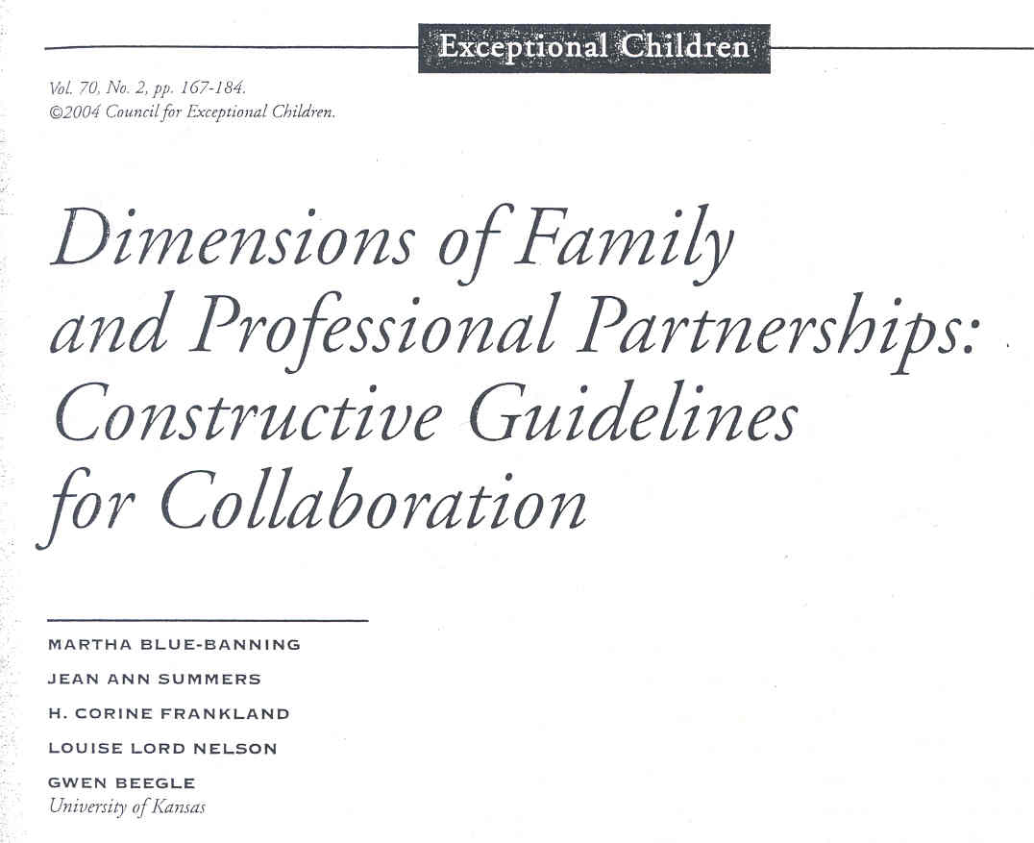
Dimensions of Family and Professional Partnerships

Slide 18
Trusting Partnership Dimensions
Communication
Competence
Respect
Commitment
Equality
Advocacy

Slide 19
Beach Center Quantitative
Research on Partnerships
Quantitative research (national field test and factor analysis)
  Approximately 500 families of children with disabilities ranging in age from 5 to early 20s
Participants included parents of children with and without disabilities
Broad representation of cultural diversity

Slide 20

Measuring the Quality of Family-Professional Partnerships in SE

Slide 21
Family-Professional Partnerships
Qualitative Dimensions
Quantitative Dimensions
Communication
Competence
Respect
Commitment
Equality
Trust
Family focus
Child focus

Slide 22
Two Factors
Family Focus
  Shows respect for your family’s values and beliefs.
  Uses words that you understand.
Child Focus
  Treats your child with dignity.
  Builds on your child’s strengths.
Summers, J. A., Hoffman., L., Marquis, J., & Turnbull, A. P., Poston, D., & Nelson, L. L. (2005). Measuring the quality of family-professional partnerships in special education services. Exceptional Children, 72(1), 65-82.

Slide 23
Two Factors II
Enhancing connection
  Shows respect for your family’s values and beliefs.
  Listens without judging you or your child.
Enhancing capacity
  Has skills to help your child succeed.
  Provides services that meet the individual needs
  of your child.
Kyzar, K., Brady, S., Summers, J. A., & Turnbull, A. P. (2018). Family quality of life and partnership for families of students with deaf-blindness. Remedial and Special Education, 41(1), 50-62.

Slide 24
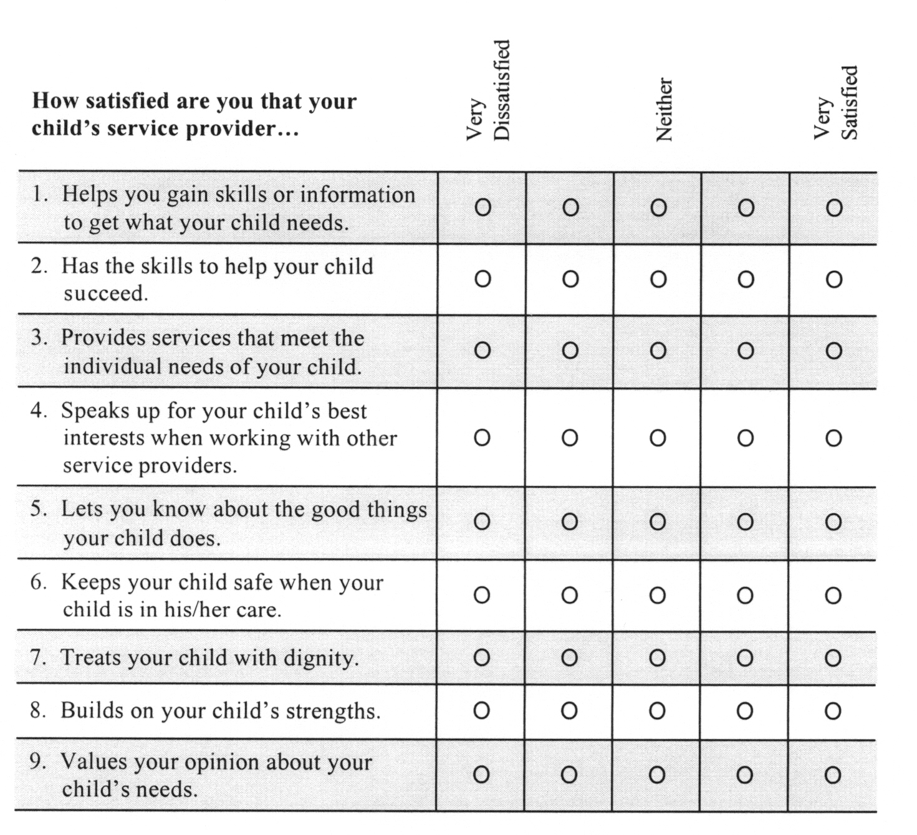
Sample Excerpt from Beach Center Partnership Scale
Click to view the Beach Center Family-Professional Partnership Scale.

Slide 25
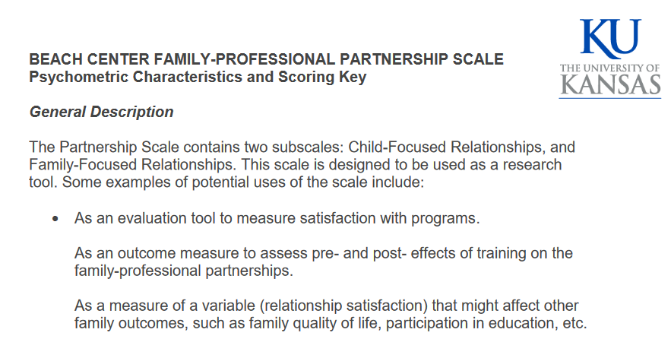
Beach Center Family-Professional Partnership Scoring Guide
Click here to view the article.

Slide 26
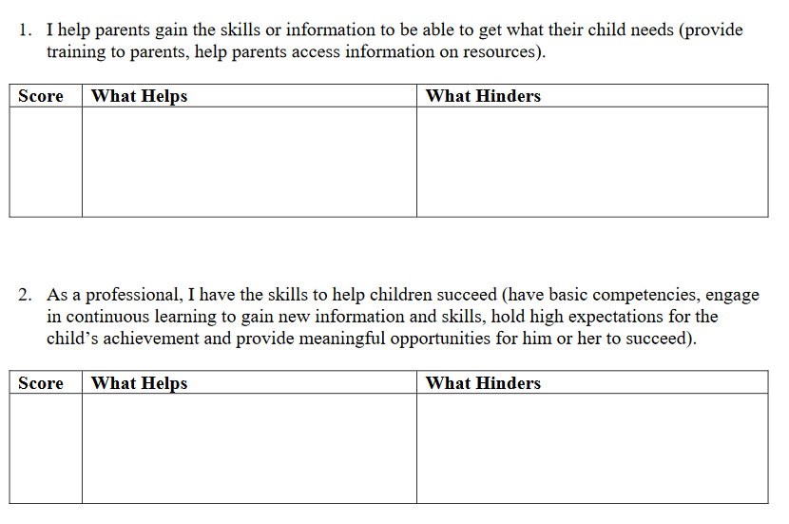
Beach Center Family-Professional Partnership Self-Assessment Guide
Click here to view the Self Assessment Form.

Slide 27
Use of Beach Center Partnership Scale
What we found about impact of partnerships on demographics:
  Families from three age groups of children (birth-3, 3-5, 6-12) place equal importance on partnerships, but their satisfaction decreases as their children get older.
  Families with low-income rate all the items related to partnership as equally important as compared to middle- and high-income families; but they are significantly less satisfied (Summers et al., 2005b).

Slide 28
Use of Beach Center Partnership Scale II
How it impacted the Sunshine Model:
  Demographic considerations have been a catalyst for increasing our emphasis on equity in addressing partnerships for students as they progress to higher grades and for families who are often marginalized due to low income.

Slide 29
Use of Beach Center Partnership Scale III
What we found about the impact of partnerships on service delivery:
  Parents’ satisfaction with partnerships significantly predicts parent involvement and parent-teacher communication for families of kindergarten children with and without disabilities (Zuna, 2007).
  Partnerships partially mediate the effect of families’ perceptions of service adequacy and their family quality of life suggesting that partnerships are a key element of appropriate services (Summers et al., 2007).

Slide 30
Use of Beach Center Partnership Scale IV
How it impacted the Sunshine Model:
  Impact of partnerships on service delivery has caused us to emphasize the necessity of trusting partnerships as an element of appropriate services and supports.

Slide 31
Use of Beach Center Partnership Scale V
What we found about the impact of partnerships on family well-being:
  As satisfaction with family-professional partnerships increases, family quality of life increases (Eskow, Summers, Chasson, & Mitchell, 2018; Summers et al., 2007; Kyzar, Brady, Summers, Haines, & Turnbull, 2016).
  As satisfaction with family-professional partnerships increases, family stress decreases (Burke & Hodapp, 2014).

Slide 32
Use of Beach Center Partnership Scale VI
How it impacted the Sunshine Model:
  Impact of partnerships on family well-being has created an awareness that educators can make a significant contribution to not only student success but family quality of life in how they work collaboratively with families as valued partners.

Slide 33
Synthesis Partnership Framework
Analysis of Existing Frameworks
Research on Partnerships
Synthesis Partnership Framework
Applications

Slide 34
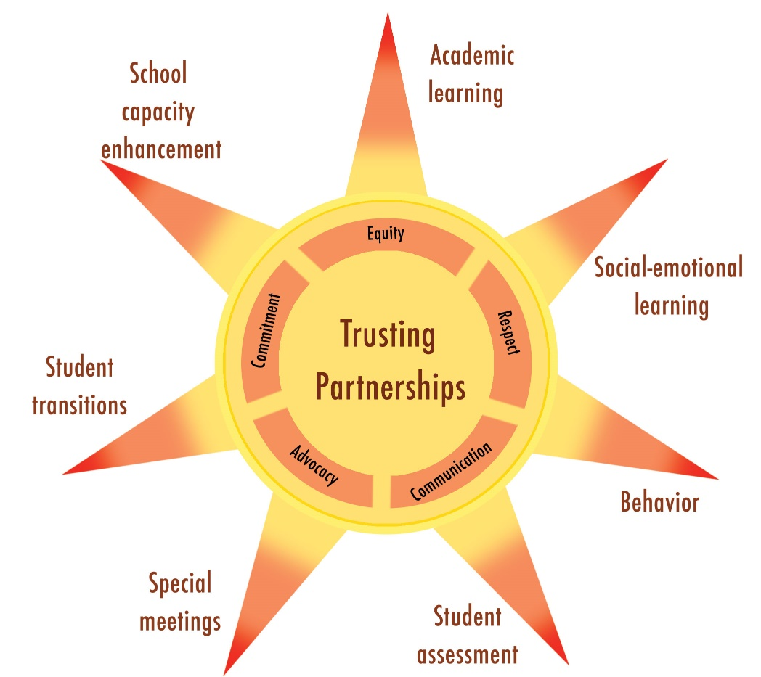
Modifications of Original Principles
Original dimensions
  Communication
  Competence
  Respect
  Commitment
  Equality
  Trust

Slide 35
Modifications of Original Dimensions
Advocacy—Elevated from indicator of commitment to a dimension
  Frequent words—fight, battle, bring out big guns, ammunition
  “But, you know, it is really unfortunate that you have to pull out those kinds of guns. I almost felt like I was threatening them to get what he needed. And I really didn’t like that feeling of having to do that.”

Slide 36
Modifications of Original Dimensions I
Trust—Elevated to core
  Based on a review of 51 studies, Henderson and Mapp (2002) concluded that building trusting relationships was the key factor that enabled family-professional relationships to result in positive student outcomes.
Competence—Pick up in the sunrays rather than as a dimensions

Slide 37
Applications
Analysis of Existing Frameworks
Research on Partnerships
Synthesis Partnership Framework
Applications

Slide 38
Sunshine Model of Trusting Partnerships: Part B

Slide 39
Table of Contents
Part 1: The “Why” of Partnerships
1. Trust, Partnerships, and Social Justice
2. Trusting Partnerships and Four Laws
Part 2: The “Who” of Partnerships
3. Family Systems—Family Characteristics
4. Family Systems—Family Interactions, Functions, and Life Span
5. School Systems

Slide 40
Table of Contents II
Part 3: The “How” of Partnerships
Equity
Respect
Communication
Advocacy
Commitment
Compendium—Partnership Opportunities

Slide 41
Social Justice Foundation
Fairness
Equality of opportunity
Dignity

Slide 42
Outline for Dimension Chapters
Definition and Rationale
Research on Relevance and Outcomes
Strategies

Slide 43
Compendium:
Seven Opportunities for Trusting Partnerships

Slide 44
Compendium
Academic Learning
    Academic priming
    Partnerships with RTI tiers
Social-Emotional learning
    Parent meeting to explain SEL curriculum
    Home activities for SEL curriculum
Behavior
    Partnerships within PBS tiers
    Identification of motivation sources
Student Assessment
    Assessment portfolios
    Special education eligibility

Slide 45
Compendium II
Special Meetings
    IEP meetings
    Manifestation determination meetings
Transitions
    Preparation for the next environment
    Transition planning
Program/School Capacity Enhancement
    Title 1 family policies and plans
    Families’ funds of cultural knowledge
General Strategies
    Families’ rights
    Newsletters

Slide 46
Compendium Format
Brief overview
Examples
Action steps
Linking to dimensions
Linking to partnership opportunities (for general strategies only)
References/resources

Slide 47
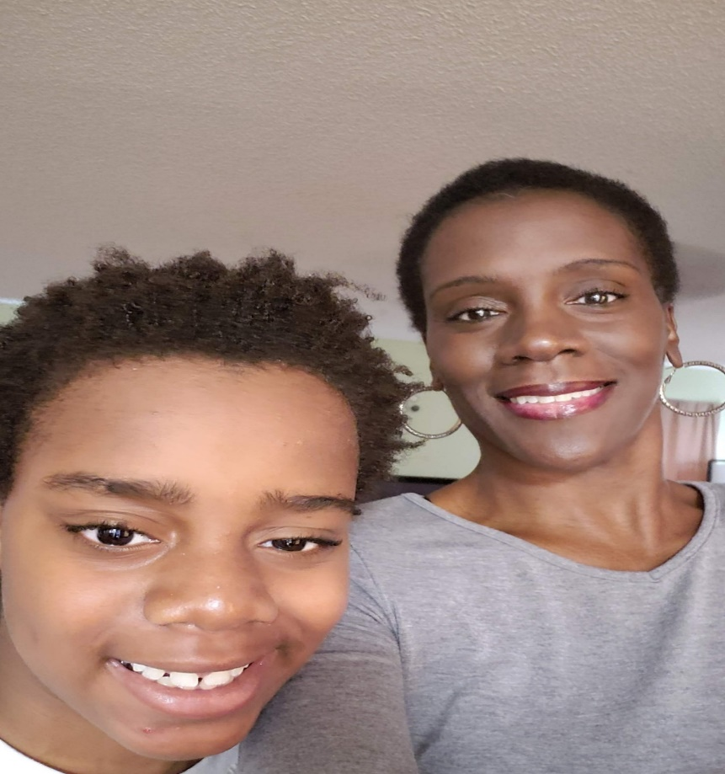
Conversation with Danyale Sturdivant

Slide 48
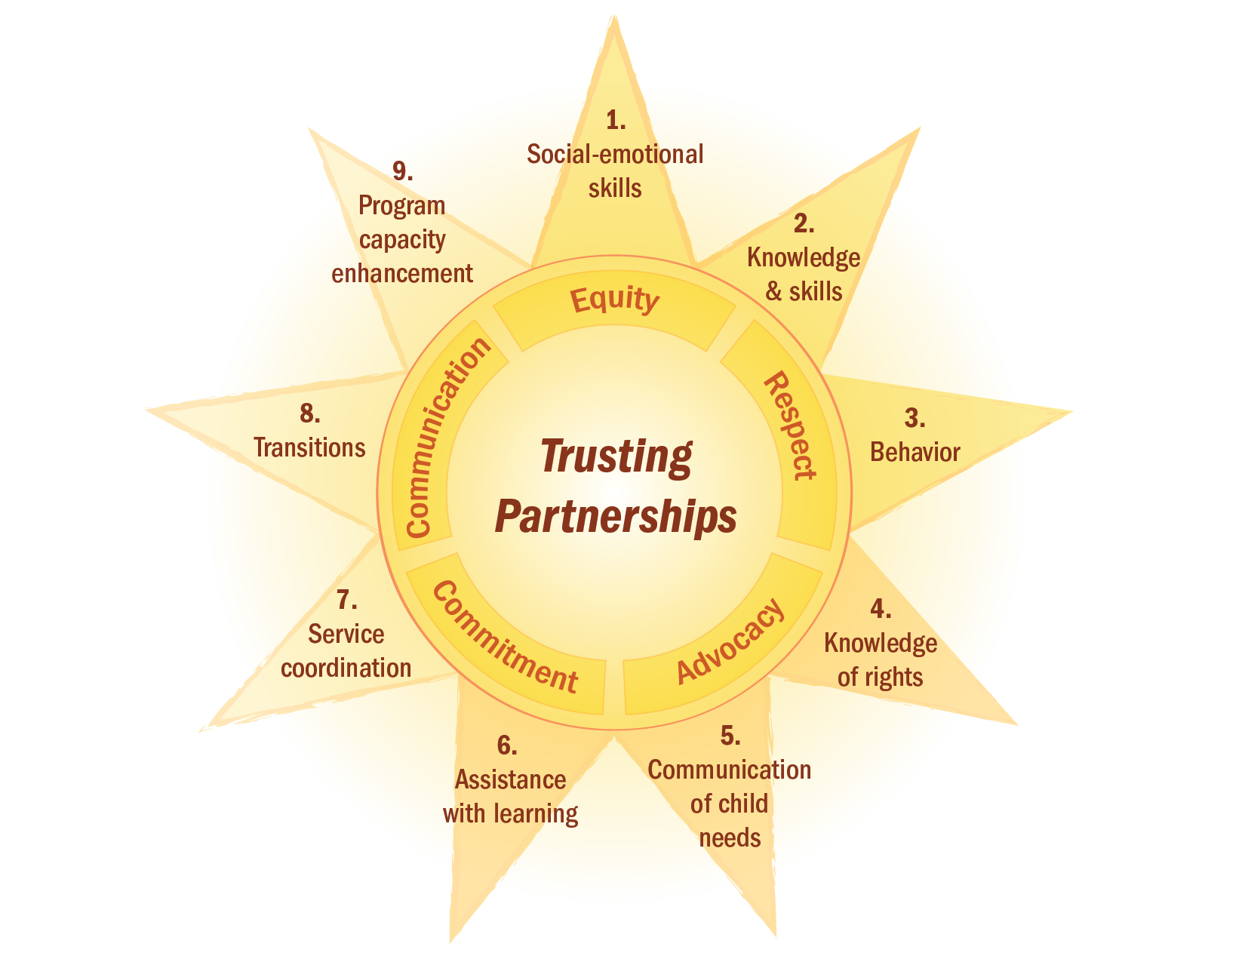
Sunshine Model of Trusting Partnerships: Part C

Slide 49
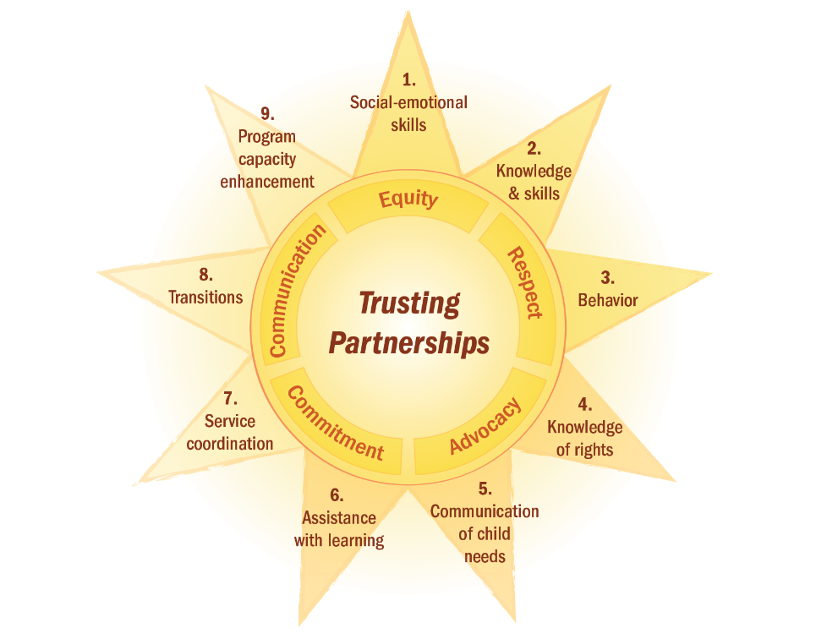
Three Families
Each family has a toddler, Marcus, who experiences significant intellectual disability.
    Anika—Strong marriage, both parents have college degrees and professional jobs, financial security.
    Beatrice—First-generation immigrant, Spanish speaking, single mother who lives with aunt, nail technician.
    Cadence—Single mother, experiences PTSD from childhood trauma, lost all belongings in recent hurricane, works part-time as care provider for an elderly person.

Slide 50
Foundational
Understanding of Equity
Equity: Application of different levels of support calibrated to family needs, strengths, resources, and priorities
    Customary support: providing usual strategies to families who generally do not face systemic barriers and/or extenuating circumstances.
    Adjusted support: accommodations in light of systemic barriers and/or extenuating circumstances.
    Substitute support: deviating substantially from customary & adjusted support by providing more intensive support due to significant systemic barriers and/or significant extenuating circumstances.

Slide 51
Infusing Equity: Families Knowing Their Rights
Equity: Application of different levels of support calibrated to family needs, concerns, and resources in light of systemic barriers.
Family’s knowledge of rights (Family Outcome, #4)
    Parent workshop on IDEA’s key principles
Fostering trusting partnership
    Anika—Anika & husband are eager learners and follow-up online with more in-depth information.
    Beatrice—needs Spanish translation; possibly 1:1 follow-up meeting.
    Cadence—does not attend; needs immediate assistance in learning FEMA rights and requirements to recover from hurricane losses.

Slide 52
Infusing Respect: Transitions
Respect: Conveys a sense of admiration for good or valuable qualities; also being concerned for their needs or feelings.
    Honoring families’ culture.
Transitions (#8)
    Consideration of preschool options.

Slide 53
Infusing Respect: Transitions II
Fostering trusting partnerships
    Anika—preference for Marcus to attend elite preschool (attended by older siblings) that has no experience with children with significant disabilities; willing to pay for a para-professional.
    Beatrice—needs a trusted Spanish-speaking person to accompany her to visit preschool options; hopes to find a preschool teacher who speaks Spanish.
    Cadence—needs maximum support and guidance; is exhausted from dealing with basic needs to make transition decisions.

Slide 54
Infusing Communication: Families Communicating about
Their Child’s Needs
Communication Listening, connecting, and expressing perspectives within two-way, frequent, and regular interactions.
    Listening empathetically.
Families communicating their child’s needs (Family Outcome, #5)
    Inquire about parents’ experiences and feelings in talking with others about their child’s needs.

Slide 55
Infusing Communication: Families Communicating about
Their Child’s Needs II
Fostering trusting partnerships
    Anika—Sobs as she describes her heartbreak about Marcus and her embarrassment, especially in answering questions from her in-laws and professional colleagues who she perceives is judging her.
    Beatrice—Believes Marcus is part of God’s plan for her life and is eager to share his needs with others.
    Cadence—Shares that seeing how her church community is eager to know more about Marcus and help him is what is giving her courage.

Slide 56
Infusing Advocacy:
Program Capacity Enhancement
Advocacy: Pleading one’s own or another’s case or cause for
improved outcomes.
    Presenting program needs to key decision-makers.
Program capacity enhancement (#9)
    Advocates to county commissioners for more funding.

Slide 57
Infusing Advocacy:
Program Capacity Enhancement II
Fostering trusting partnerships
    Anika—Contributes money to the program in lieu of presenting testimony.
    Beatrice—Consents to having a video snippet of a home visit shared with the commissioners in emphasizing the importance of bilingual staff.
    Cadence—Attends meeting and reads a statement about how the program staff have come to her rescue and kept her hope alive; she considers it her way to reciprocate.

Slide 58
Infusing Commitment:
Service Coordination
Commitment: Making a deliberate choice to prioritize and value partnerships, as well as to be dedicated to and assume responsibility for partnership outcomes.
    Broadening base of partners
Service Coordination (#7)
    Prepares community service providers to advance child outcomes.
Read the DEC New Service Coordination in Early Intervention Joint Position Statement.
Notes:
https://www.dec-sped.org/single-post/new-service-coordination-in-early-intervention-joint-position-statement

Slide 59
Infusing Commitment:
Service Coordination II
Fostering trusting partnerships
    Anika—Provides professional development for staff at Jewish Community Center on how they can foster inclusion for Marcus.
    Beatrice—Walks Beatrice through the process of applying for Section 8 Housing.
    Cadence—Develops a GAP team and includes professionals working in disaster relief to address family’s basic needs.

Slide 60
Infusing All Dimensions:
Child Behavior (#3)
Equity—Ensure that behavioral support offered to families
addresses different levels of child/family strengths and needs.
Respect—Seek information from families about their child-rearing beliefs, especially around discipline, and how their beliefs tie to their culture.
Communication– Provide handouts to families of resources about behavior at home and in the community that they can access on their phones.

Slide 61
Infusing All Dimensions:
Child Behavior (#3) II
Advocacy—Advocate with local behavioral specialists to provide pro bono/sliding scale services to families who need intensive behavioral support.
Commitment—For children with aggressive behavior, develop in partnership with families how to keep their other children safe during behavioral outbursts as well as to address their social/emotional needs in dealing with violence at home.

Slide 62
Suspensions and Expulsions
National rate for 3 and 4 years old in Pre-K programs is 3 times higher than for students K-12 combined.
  In MA, rate is 13 times higher.
Rate is higher for children in child-care centers than in pre-K.
Annual rate of preschoolers who are suspended may be more than 300,000.
  Gilliam (W. S.). (2016). Early childhood expulsions and suspensions undermine our nation’s most promising agent of opportunity and social justice. New Haven, CT: Yale University Child Study Center.
  Gilliam, W.S. et al. (2016). Do early educators’ implicit biases regarding sex and race related to behavior expectations and recommendations of preschool expulsions and suspensions? New Haven, CT: Yale University Child Study Center.

Slide 63
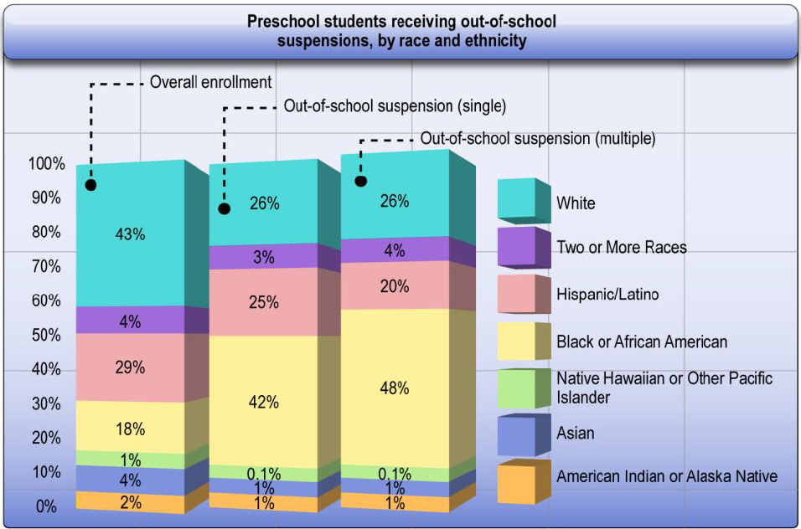
2020 and Beyond: Enhancing Equity
  Equity: Application of different levels of support calibrated to child and family strengths, needs, concerns, and resources in light of systemic barriers
Click to view source
Notes:
https://www2.ed.gov/about/offices/list/ocr/docs/crdc-early-learning-snapshot.pdf

Slide 64
Preschool to Prison Pipeline: Jesse
ACE score of 7 when starting preschool– physical neglect/abuse; emotional neglect/abuse; household member with substance abuse, mental illness, and incarceration.
Father died when he was 5; never had birthday party or Christmas gifts; can’t recall any kindness in his life.
Frequently suspended for aggression; characterized as having a temper and anger management issues; no intervention.

Slide 65
Preschool to Prison Pipeline: Jesse II
IDEA evaluation in 4th grade; identified as having ADHD; recommendation for counseling to deal with anger & depression and pediatric appointment for meds.
Mother attended most IEP meetings, 4th-8th grade; given rights manual; could not read it; no record of any suggestions; no record of professional equity or advocacy.
Seclusion used as primary method of punishment; anger escalated; frequent suspensions - most of 8th grade; joined gang; frequent drug use.

Slide 66
Preschool to Prison Pipeline: Jesse III
Dropped out of school at beginning of 9th grade; random short-term jobs; frequent altercations with others.
While high on drugs, shot and killed gang member; awaiting trial
after 3 years in jail.
In court papers, mother indicated no knowledge of special education history.
COLOSSAL system failure; no consequences for professionals.
Critical need for having a village of trusted partners.

Slide 67
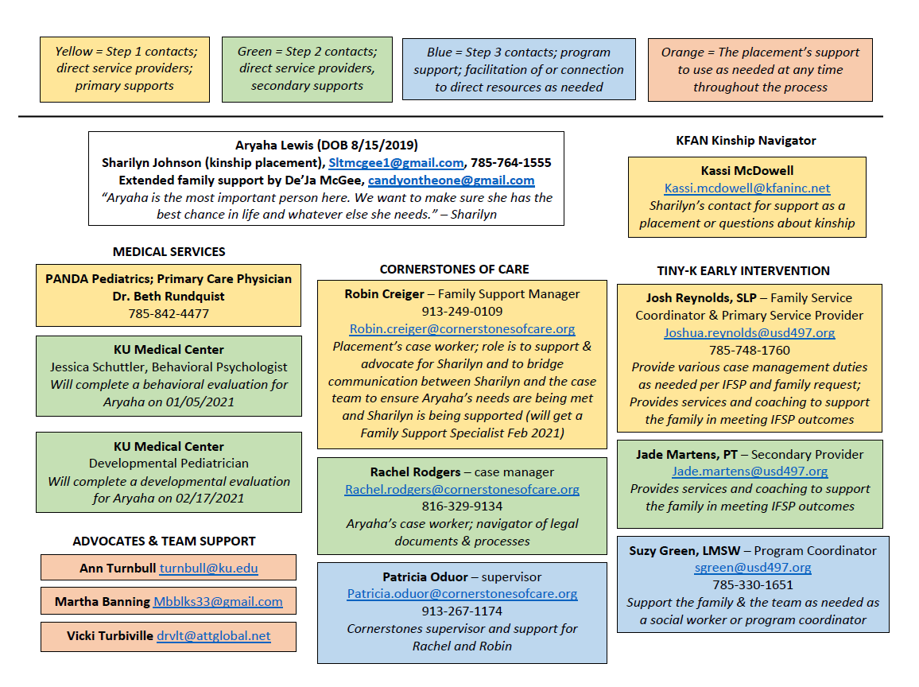
Example

Slide 68

Vision for Trusting Partnerships
Infuse the five dimensions into all opportunities for family-professional partnerships
Infuse the five dimensions into all relationships—personal and professional

Slide 69
References
Bezdek, J., Summers, J. A., & Turnbull, A. P. (2010). Professionals’ attitudes on partnering with families of children and youth with disabilities. Education and Training in Autism and Developmental Disabilities, 45(3), 356-365.
Blue-Banning, M., Summers, J. A., Frankland, H. C., Nelson, L. L., & Beegle, G. (2004). Dimensions of family and professional partnerships: Constructive guidelines for collaboration. Exceptional Children, 70(2), 167-184.
Burke, M. M., & Hodapp, R. M. (2014). Relating stress of mothers of children with developmental disabilities to family-school partnerships. Intellectual and Developmental Disabilities, 52(1), 13-23.
Epley, P. H., Summers, J. A., & Turnbull, A. P. (2011). Family outcomes of early intervention: Families’ perceptions of need, services, and outcomes. Journal of Early Intervention, 33(3), 01-219.
Eskow, K. G., Summers, J. A., Chasson, G. S., & Mitchell, R. (2018). The association between family–teacher partnership satisfaction and outcomes of academic progress and quality of life for children/youth with autism. Journal of Policy and Practice in Intellectual Disabilities, 15(1), 16-25.
Henderson, A., & Mapp, K. L. (2002). A new wave of evidence: The impact of school, family, and community connections on student achievement. Southeast Educational Development Laboratory.
Hoffman, L., Marquis, J., Poston, D., Summers, J. A., & Turnbull, A. P. (2006). Assessing family outcomes: Psychometric evaluation of the Beach Center Family Quality of Life Scale. Journal of Marriage and Family, 68, 1069-1083.

Slide 70
References II
Kyzar, K. B., Brady, S., Summers, J. A., Haines, S. J., & Turnbull, A. P. (2016). Services and supports, partnership, and family quality of life: Focus on deaf-blindness. Exceptional Children 83(1), 77-91.
Kyzar, K., Brady, S., Summers, J. A., & Turnbull, A. P. (2018). Family quality of life and partnership for families of students with deaf-blindness. Remedial and Special Education, 41(1), 50-62.
Kyzar, K., Haines, S. J., Turnbull, A. P., & Summers, J. A. (2017). Research-based practices for fostering trusting partnerships with families in educating students with intellectual disability. In M.L. Wehmeyer & K.A. Shogren (Eds.), Research-based practices for educating students with intellectual disability (pp. 296-319). Taylor & Francis.
Summers, J. A., Hoffman, L., Marquis, J., & Turnbull, A. P., Poston, D., & Nelson, L. L. (2005). Measuring the quality of family-professional partnerships in special education services. Exceptional Children, 72(1), 65-82.
Summers, J. A., Hoffman, L., Marquis, J., Turnbull, A. P., & Poston, D. (2005). Relationship between parent satisfaction regarding partnerships with professionals and age of child. Early Childhood Special Education, 25(1), 48-58.
Summers, J. A., Marquis, J., Mannan, H., Turnbull, A. P., Fleming, K., Poston, D. J., ... & Kupzyk, K. (2007). Relationship of perceived adequacy of services, family–professional partnerships, and family quality of life in early childhood service programmes. International Journal of Disability, Development and Education, 54(3), 319-338.
Zuna, N. I. (2007). Examination of family-professional partnerships, parent-teacher communication, and parent involvement in families of kindergarten children with and without disabilities (Doctoral dissertation). Retrieved from ProQuest Dissertations & Theses Global. (3266511).

Slide 71
Disclaimer
This is a product of the Early Childhood Intervention Doctoral Consortium (ECiDC), a project of the A.J. Pappanikou Center for Excellence in Developmental Disabilities at UConn Health. The Center is funded through cooperative agreement number H325H190004 from the Office of Special Education Programs, U.S. Department of Education. Materials and opinions expressed herein do not necessarily represent the Department of Education’s position or policy.

