Slide 1
Characteristics and Etiology of Infants and Young Children with Disabilities
Evidence-Based Practices for Young Children with Autism Spectrum Disorder

Slide 2
Notes About this Presentation
This presentation is not meant to be taught as a single lesson.
Facilitators should choose which EBPs to they would like to teach and delete the unused slides.
Slides 4, 5 and 6 provide a general overview of EBPs.
The EBP slides provide a definition, a link to the learning module and domains for which the EBP is applicable for the 0-5 population. A learning activity is also provided for each EBP.
If you are not well-versed in the EBP to which you are instructing, please review the learning module prior to teaching the following lessons.
The final slide provides a list of resources.
Notes:
This slide is for reference only and should not be displayed to participants

Slide 3
Evidence Based Practices (EBPs)
“An evidence-based practice is an instructional/intervention procedure or set of procedures for which researchers have provided an acceptable level of research that shows the practice produces positive outcomes for children, youth, and/or adults with ASD.”
- The National Professional Development Center on Autism Spectrum Disorder
https://autismpdc.fpg.unc.edu/evidence-based-practices

Slide 4
EBP and Autism Spectrum Disorder
EBPs are identified by each age group and each learning domain
28 identified evidence-based practices
27 identified for infants and children ages 0-5
https://autismpdc.fpg.unc.edu/evidence-based-practices

Slide 5
Current EBP in ASD
The next slide is a table from:
Sam, A., Waters, V., Dees, R., & AFIRM Team. (2022). Selecting an evidence-based practice. The University of North Carolina at Chapel Hill, Frank Porter Graham Child Development Institute, Autism Focused Intervention Modules and Resources. https://afirm.fpg.unc.edu/selecting-evidence-based-practice

Slide 6
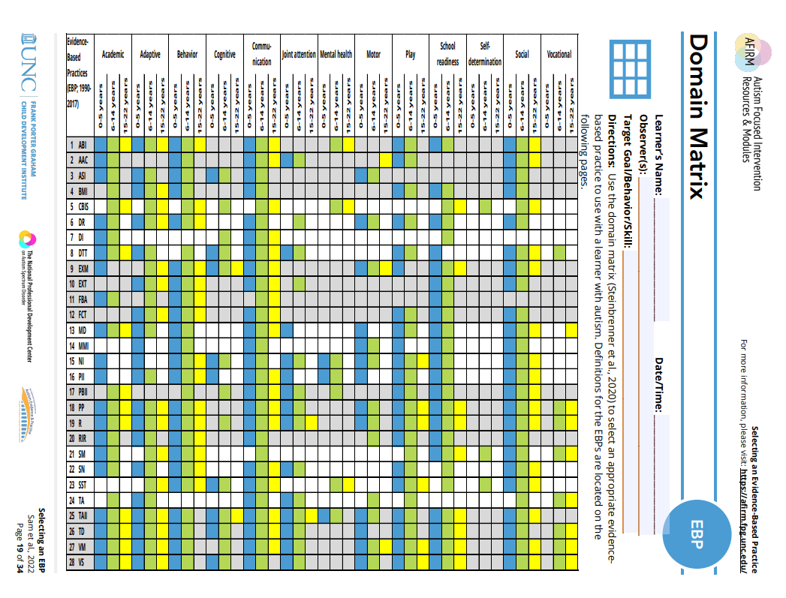
Current EBPs for working with individuals on the autism spectrum.
AFIRM Selecting an Evidence-Based Practice Packet (unc.edu)
AFIRM Selecting an Evidence-Based Practice Packet (unc.edu)
Notes:
This chart lists the current Evidenced Based Practices (EBPs) for use for working with individuals on the autism spectrum. The chart identifies the age group and domain for which the EBP is established.
Left column is abbreviated EBP. A definition of the EBP can be found here: https://ncaep.fpg.unc.edu/sites/ncaep.fpg.unc.edu/files/imce/documents/NCAEP%20Report%20-%20Table%203.1%20-%20EBP%20list.pdf
Top row is each learning domain. A colored box indicates that the EBP is evidenced based for the specified age range.
Yellow: 0-5 years
Blue: 6-14 years
Green: 15-22 years

Slide 7
AFIRM Modules
The National Professional Development Center on Autism Spectrum Disorder (NPDC) created online modules for 28 of the evidence-based practices (EBPs). The modules are called Autism Focused Intervention Resources and Modules (AFIRM).
AFIRM Modules are designed to help practitioners learn the step-by-step process of planning for using and monitoring an EBP with learners with ASD from birth through age 22.
Supplemental materials and handouts are available for download:
Free learning modules
CE Units available
http://afirm.fpg.unc.edu/
Notes:
Registration is required to access the modules. Registration is free. It is recommended for participants to complete the online module for the EBP for which they will be trained prior to presenting the activities presented here. It is also possible to complete the module as a group using projection of the screen.

Slide 8
Antecedent-Based Intervention (ABI)
ABI: Arrangement of events or circumstances that precede an activity or demand in order to increase the occurrence of a behavior or lead to the reduction of the challenging/interfering behaviors.
EBP in the following domains/instructional outcomes:
  Academic/Pre-Academic
  Adaptive/Self-Help
  Challenging/Interfering Behavior
  Communication
  Play
  School Readiness
  Social
https://afirm.fpg.unc.edu/antecedent-based-intervention
Notes:
Learning Activity 1

Slide 9
Activity
Facilitator prepares an activity/visual that is meant to engage, offer choices and/or set the expectation for the activity. The following are sample items or activities:
  Facilitator provides written agendas on tables for participants to follow.
  Facilitator provides a large visual schedule that includes pictures and words for the schedule of the day/meeting/etc. A large arrow points to the current activity and is moved at transition points.
  Facilitator conducts a brief interactive game to engage the participants prior to introducing a new topic.
  Facilitator offers the choice of a 30 minute or 1 hour lunch break.

Slide 10
Activity
Another approach is to set up the environment in the opposite manner in which the activity will occur so as to teach the importance of using the environment to set the expectations. The following are samples of such activities:
  When participants arrive, have all chairs facing the back of the room. Note how either everyone was confused or simply sat in the chairs as placed.
  Start the meeting without engaging the participants, such as not giving a greeting, simply start lecturing on a topic or don’t give the topic of the meeting or agenda.

Slide 11
Augmentative and Alternative Communication (AAC)
AAC: Interventions using and/or teaching the use of a system of communication that is not verbal/vocal which can be aided (e.g., device, communication book) or unaided (e.g., sign language).
EBP in the following domains/instructional outcomes:
  Academic/Pre-Academic
  Challenging/Interfering Behavior
  Communication
  Joint Attention
  Play
  Social
Augmentative & Alternative Communication | AFIRM (unc.edu)
Notes:
Learning Activity 2

Slide 12
Ayers Sensory Integration (ASI)
Ayres Sensory Integration® (ASI) can be used to increase learner communication, socialization, cognitive, and adaptive skills while reducing challenging behaviors in learners with identified challenges in sensory processing.
EBP in the following domains/instructional outcomes:
  Academic/Pre-Academic
  Adaptive
  Challenging/Interfering Behavior
  Cognitive
  Communication
  Motor
  Social
Ayres Sensory Integration | AFIRM (unc.edu)
Notes:
Learning Activity 19

Slide 13
Behavioral Momentum Intervention (BMI)
BMI: The organization of behavior expectations in a sequence in which low probability, or more difficult, responses are embedded in a series of high probability, or less effortful, responses to increase persistence and the occurrence of the low probability responses.
EBP in the following domains/instructional outcomes:
  Adaptive/Self-Help
  Challenging/Interfering Behavior
  Communication
  Play
  School Readiness
  Social
https://afirm.fpg.unc.edu/behavioral-momentum-intervention
Notes:
Learning Activity 3

Slide 14
Differential Reinforcement (DR)
DR: A systematic process that increases desirable behavior or the absence of an undesirable behavior by providing positive consequences for demonstration/non-demonstration of such behavior.
These consequences may be provided when the learner is:
engaging in a specific desired behavior other than the undesirable behavior (DRA),
engaging in a behavior that is physically impossible to do while exhibiting the undesirable behavior (DRI), or
not engaging in the undesirable behavior (DRO).
https://afirm.fpg.unc.edu/differential-reinforcement
Notes:
Learning Activity 4

Slide 15
Differential Reinforcement (DR) II
EBP in the following domains/instructional outcomes:
  Academic/Pre-Academic
  Adaptive/Self-Help
  Challenging/Interfering Behavior
  Communication
  Motor
  Play
  School Readiness
  Social
https://afirm.fpg.unc.edu/differential-reinforcement
Notes:
Learning Activity 4

Slide 16
Direct Instruction (DI)
DI: A systematic approach to teaching using a sequenced instructional package with scripted protocols or lessons. It emphasizes teacher and student dialogue through choral and independent student responses and employs systematic and explicit error corrections to promote mastery and generalization.
EBP in the following domains/instructional outcomes:
  Academic/Pre-Academic
  Communication
https://afirm.fpg.unc.edu/direct-instruction
Notes:
Learning Activity 5

Slide 17
Discrete Trial Training (DTT)
DTT: Instructional approach with massed or repeated trials with each trial consisting of the teacher’s instruction/presentation, the child’s response, a carefully planned consequence, and a pause prior to presenting the next instruction.
EBP in the following domains/instructional outcomes:
  Academic/Pre-Academic
  Adaptive/Self-help
  Cognitive
  Communication
  Joint Attention
  Play
  School Readiness
  Social
https://afirm.fpg.unc.edu/discrete-trial-training
Notes:
Learning Activity 6

Slide 18
Exercise (ECE)
ECE: Interventions that use physical exertion, specific motor skills/ techniques, or mindful movement to target a variety of skills and behaviors.
EBP in the following domains/instructional outcomes:
  Academic/Pre-Academic
  Challenging/Interfering Behavior
  Cognitive
  Communication
  Motor
  School Readiness
  Social
Exercise | AFIRM (unc.edu)
Notes:
Learning Activity 7

Slide 19
Extinction (EXT)
EXT: Interventions that use physical exertion, specific motor skills/ techniques, or mindful movement to target a variety of skills and behaviors.
EBP in the following domains/instructional outcomes:
  Academic/Pre-Academic
  Challenging/Interfering Behavior
  Cognitive
  Communication
  Motor
  School Readiness
  Social
https://afirm.fpg.unc.edu/extinction
Notes:
Learning Activity 8

Slide 20
Functional Behavioral Assessment (FBA)
FBA: A systematic way of determining the underlying function or purpose of a behavior so that an effective intervention plan can be developed.
EBP in the following domains/instructional outcomes:
  Academic/Pre-Academic
  Challenging/Interfering Behavior
  School Readiness
https://afirm.fpg.unc.edu/functional-behavior-assessment
Notes:
Learning Activity 9

Slide 21
Functional Communication Training (FCT)
FCT: A set of practices that replace a challenging behavior that has a communication function with more appropriate and effective communication behaviors or skills.
EBP in the following domains/instructional outcomes:
  Adaptive/Self-help
  Challenging/Interfering Behavior
  Communication
  Play
  School Readiness
  Social
https://afirm.fpg.unc.edu/functional-communication-training
Notes:
Learning Activity 10

Slide 22
Modeling (MD)
MD: Demonstration of a desired target behavior that results in use of the behavior by the learner and that leads to the acquisition of the target behavior.
EBP in the following domains/instructional outcomes:
  Academic/Pre-Academic
  Adaptive/Self-help
  Challenging/Interfering Behavior
  Communication
  Joint Attention
  Motor
  Play
  School Readiness
  Social
https://afirm.fpg.unc.edu/modeling
Notes:
Learning Activity 11

Slide 23
Music-Mediated Intervention (MMI)
MMI: Intervention that incorporates songs, melodic intonation, and/or rhythm to support learning or performance of skills/behaviors. It includes music therapy, as well as other interventions that incorporate music to address target skills.
EBP in the following domains/instructional outcomes:
  Adaptive/Self-help
  Challenging/Interfering Behavior
  Communication
  Motor
  Play
  School Readiness
  Social
https://afirm.fpg.unc.edu/music-mediated-intervention
Notes:
Learning Activity 12

Slide 24
Naturalistic Intervention (NI)
NI: A collection of techniques and strategies that are embedded in typical activities and/or routines in which the learner participates to naturally promote, support, and encourage target skills/behaviors.
EBP in the following domains/instructional outcomes:
  Academic/Pre-Academic
  Adaptive/Self-help
  Challenging/Interfering Behavior
  Cognitive
  Communication
  Joint Attention
  Mental Health
  Motor
  Play
  School Readiness
  Social
https://afirm.fpg.unc.edu/naturalistic-intervention
Notes:
Learning Activity 13

Slide 25
Parent-Implemented Intervention (PII)
PII: Parent delivery of an intervention to their child that promotes their social communication or other skills or decreases their challenging behavior.
EBP in the following domains/instructional outcomes:
  Academic/Pre-Academic
  Adaptive/Self-help
  Challenging/Interfering Behavior
  Cognitive
  Communication
  Joint Attention
  Mental Health
  Motor
  Play
  School Readiness
  Social
https://afirm.fpg.unc.edu/parent-implemented-interventions
Notes:
Learning Activity 14

Slide 26
Peer-Mediated Instruction and Intervention (PMII)
PMII: Intervention in which peers directly promote autistic children’s social interactions and/or other individual learning goals, or the teacher/other adult organizes the social context (e.g., play groups, social network groups, recess) and when necessary, provides support (e.g., Prompts, Reinforcement) to the autistic children and their peer to engage in social interactions.
EBP in the following domains/instructional outcomes:
  Communication
  Joint Attention
  School Readiness
  Social
https://afirm.fpg.unc.edu/https://afirm.fpg.unc.edu/peer-mediated-instruction-and-intervention
Notes:
Learning Activity 15

Slide 27
Prompting (PP)
PP: Verbal, gestural, or physical assistance given to learners to support them in acquiring or engaging in a targeted behavior or skill.
EBP in the following domains/instructional outcomes:
  Academic/Pre-Academic
  Adaptive
  Challenging/Interfering Behavior
  Communication
  Joint Attention
  Motor
  Play
  School Readiness
  Social
/https://afirm.fpg.unc.edu/prompting
Notes:
Learning Activity 16

Slide 28
Reinforcement (R+)
R: The application of a consequence following a learner’s use of a response or skills that increases the likelihood that the learner will use the response/skills in the future.
EBP in the following domains/instructional outcomes:
  Academic/Pre-Academic
  Adaptive
  Challenging/Interfering Behavior
  Communication
  Joint Attention
  Motor
  Play
  School Readiness
  Social
/https://afirm.fpg.unc.edu/reinforcement
Notes:
Learning Activity 17

Slide 29
Response Interruption & Redirection (RIR)
RIR: The introduction of a prompt, comment, or other distractors when an interfering behavior is occurring that is designed to divert the learner’s attention away from the interfering behavior and results in its reduction.
EBP in the following domains/instructional outcomes:
  Academic/Pre-Academic
  Adaptive
  Challenging/Interfering Behavior
  Communication
  Joint Attention
  Motor
  Play
  School Readiness
  Social
https://afirm.fpg.unc.edu/response-interruption-and-redirection
Notes:
Learning Activity 18

Slide 30
Social Narratives (SN)
SN: Interventions that describe social situations in order to highlight relevant features of a target behavior or skill and offer examples of appropriate responding.
EBP in the following domains/instructional outcomes:
  Academic/Pre-Academic
  Adaptive
  Challenging/Interfering Behavior
  Cognitive
  Communication
  Motor
  Social
https://afirm.fpg.unc.edu/social-narratives
Notes:
Learning Activity 20

Slide 31
Social Skills Training (SST)
SST: Group or individual instruction designed to teach learners ways to appropriately and successfully participate in their interactions with others.
EBP in the following domains/instructional outcomes:
  Challenging/Interfering Behavior
  Cognitive
  Communication
  Play
  Social
https://afirm.fpg.unc.edu/social-skills-training
Notes:
Learning Activity 21

Slide 32
Self Management (SM)
SM: Self-management teaches learners with ASD to discriminate between appropriate and inappropriate behavior, accurately monitor and record their own behaviors, and reward themselves for appropriate behavior or use of skill.
EBP in the following domains/instructional outcomes:
  Academic/Pre-Academic
  School Readiness
  Social
https://afirm.fpg.unc.edu/self-management

Slide 33
Task Analysis (TA)
TA: A process in which an activity or behavior is divided into small, manageable steps in order to assess and teach the skill. Other practices, such as reinforcement, video modeling, or time delay, are often used to facilitate acquisition of the smaller steps.
EBP in the following domains/instructional outcomes:
  Academic/Pre-Academic
  Challenging/Interfering Behavior
  Communication
  Joint Attention
  Play
  Social
https://afirm.fpg.unc.edu/task-analysis
Notes:
Learning Activity 22

Slide 34
Technology-Aided Intervention & Instruction (TAII)
TAII: Instruction or intervention in which technology is the central feature and the technology is specifically designed or employed to support the learning or performance of a behavior or skill for the learner.
EBP in the following domains/instructional outcomes:
  Academic/Pre-Academic
  Adaptive
  Challenging/Interfering Behavior
  Cognitive
  Communication
  Joint Attention
  Motor
  Play
  School Readiness
  Social
https://afirm.fpg.unc.edu/technology-aided-instruction-and-intervention
Notes:
Learning Activity 23

Slide 35
Time Delay (TD)
TD: A practice used to systematically fade the use of prompts during instructional activities by using a brief delay between the initial instruction and any additional instructions or prompts.
EBP in the following domains/instructional outcomes:
  Academic/Pre-Academic
  Adaptive
  Challenging/Interfering Behavior
  Cognitive
  Communication
  Joint Attention
  Motor
  Play
  School Readiness
  Social
https://afirm.fpg.unc.edu/time-delay
Notes:
Learning Activity 24

Slide 36
Video Modeling (VM)
VM: A video-recorded demonstration of the targeted behavior or skill shown to the learner to assist learning in or engaging in a desired behavior or skill.
EBP in the following domains/instructional outcomes:
  Academic/Pre-Academic
  Adaptive
  Challenging/Interfering Behavior
  Communication
  Motor
  Play
  School Readiness
  Social
https://afirm.fpg.unc.edu/video-modeling
Notes:
Learning Activity 25

Slide 37
Visual Supports (VS)
VS: A visual display that supports the learner engaging in a desired behavior or skills independent of additional prompts.
EBP in the following domains/instructional outcomes:
  Academic/Pre-Academic
  Adaptive
  Challenging/Interfering Behavior
  Cognitive
  Communication
  Joint Attention
  Motor
  Play
  School Readiness
  Social
https://afirm.fpg.unc.edu/visual-supports
Notes:
Learning Activity 26

Slide 38
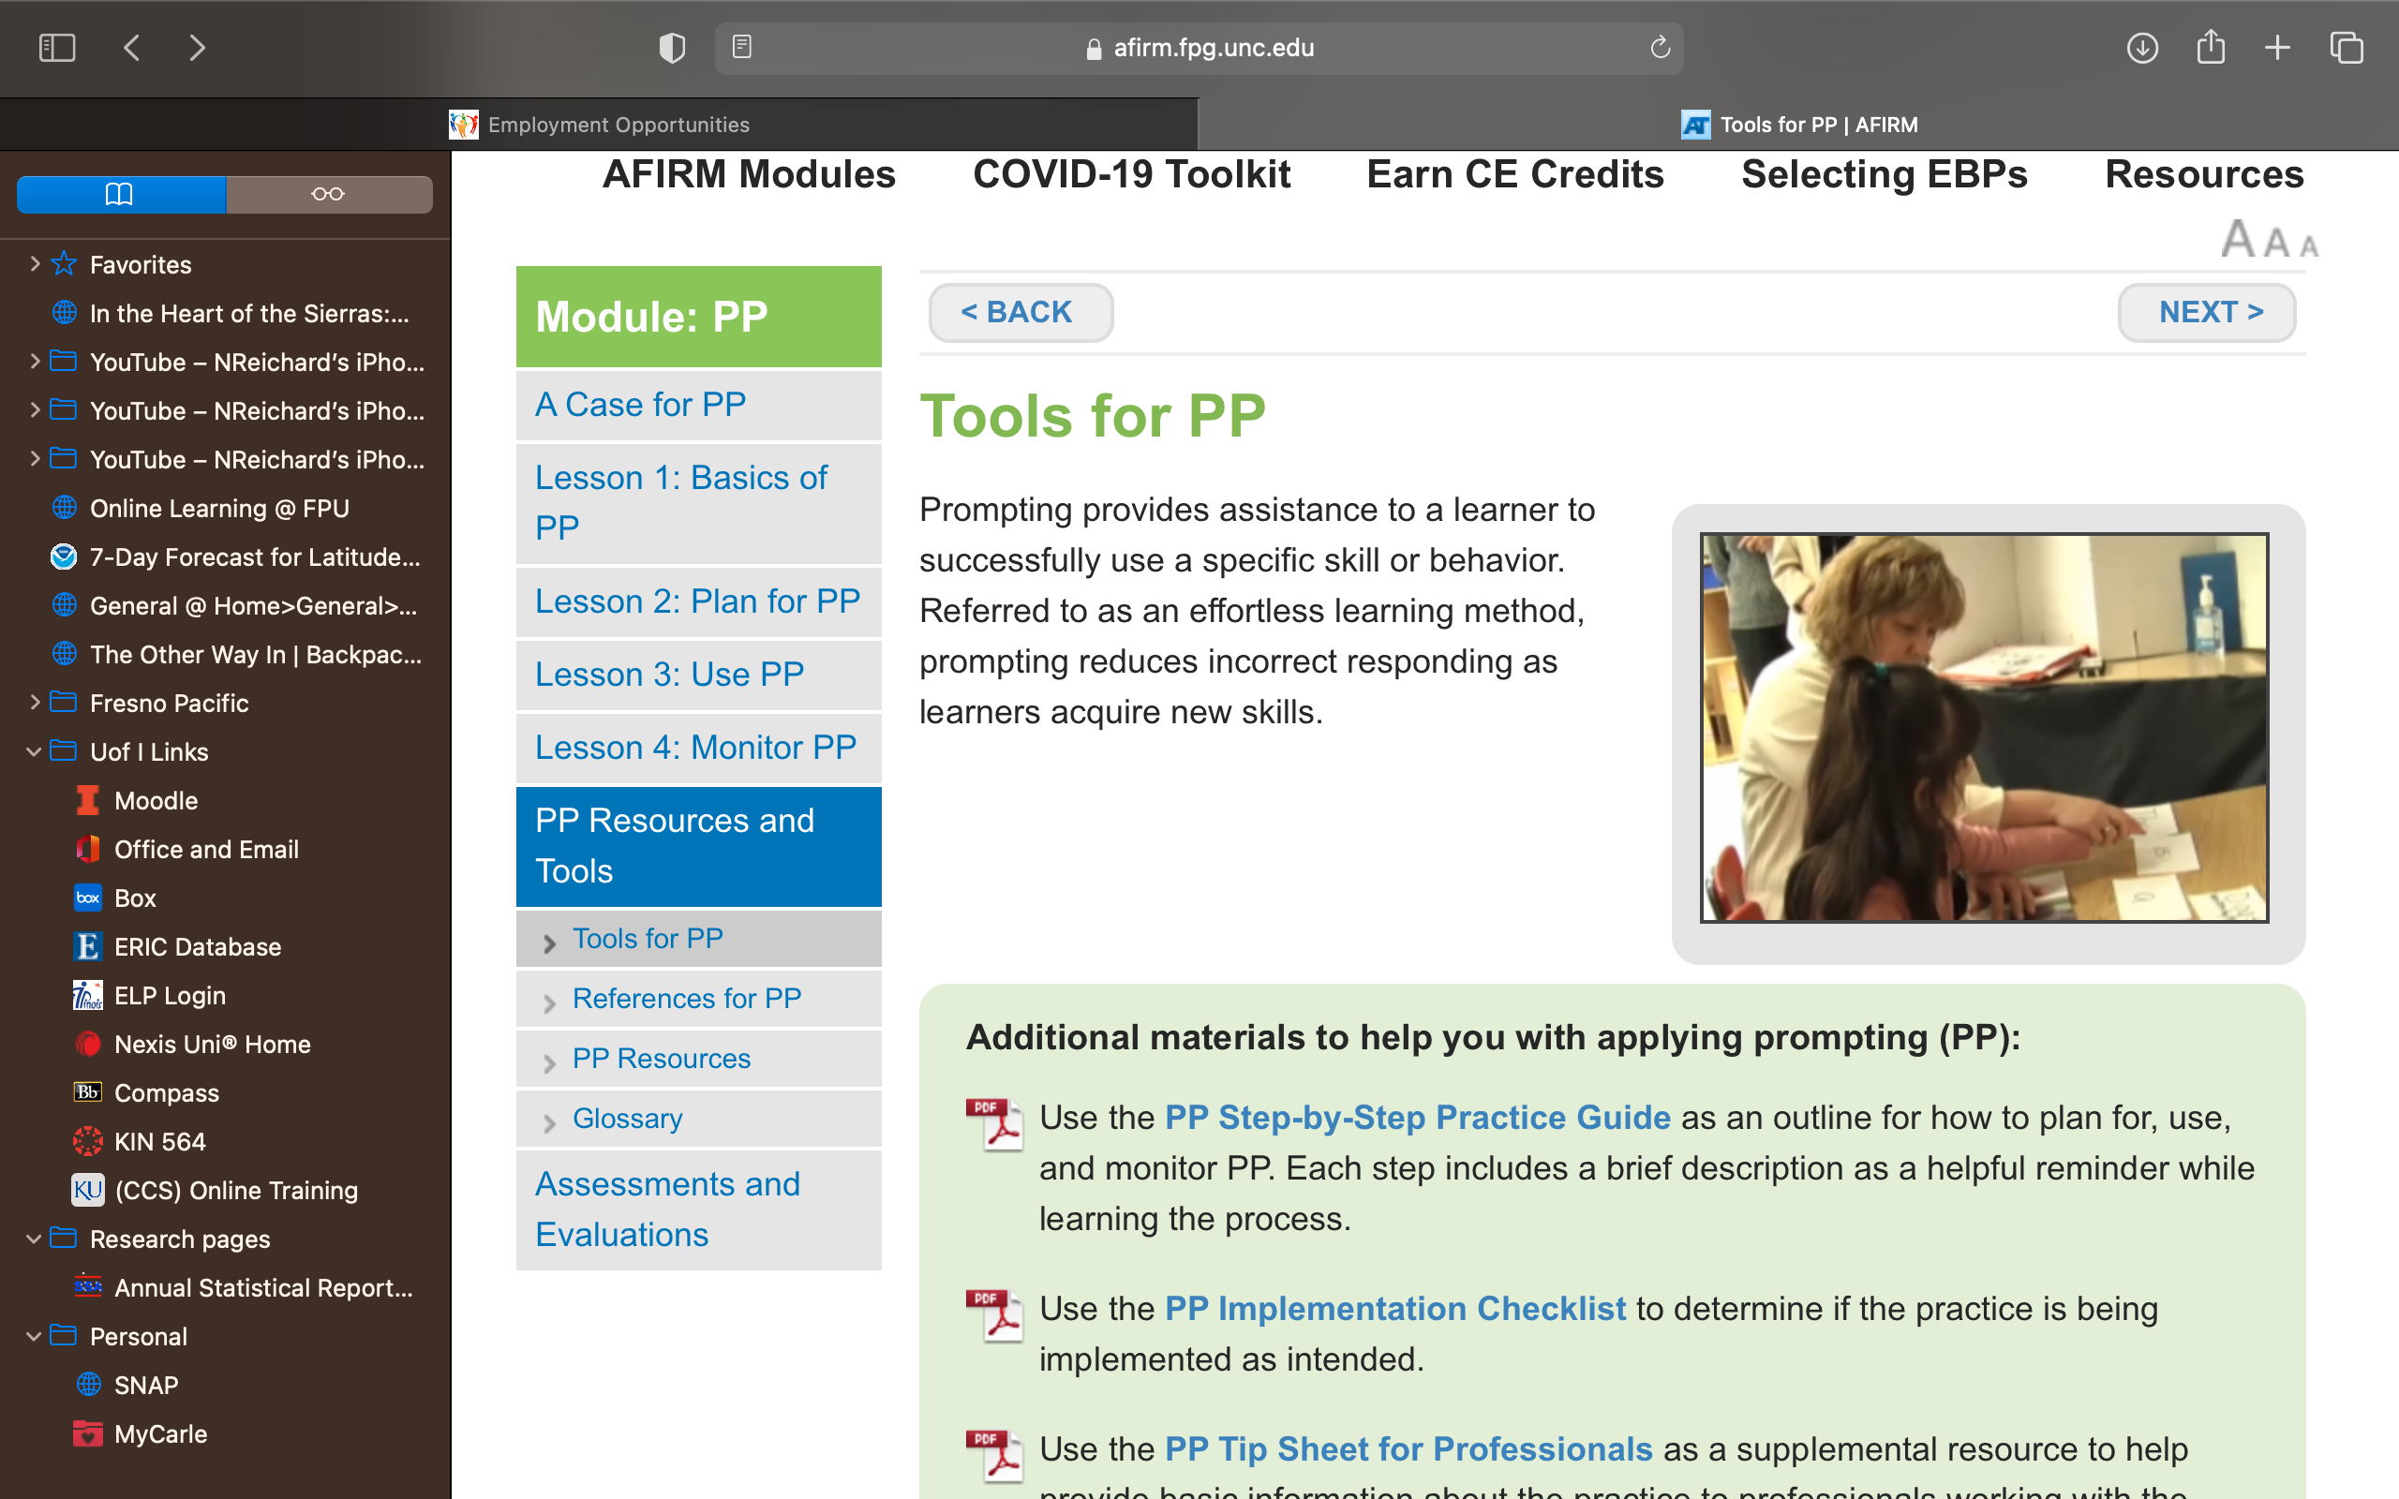
Additional Resources for Each EBP
Additional resources for each EBP can be
found within the AFIRM modules.
https://ncaep.fpg.unc.edu/sites/ncaep.fpg.unc.edu/files/imce/documents/NCAEP%20Report%20-%20Table%203.1%20-%20EBP%20list.pdf

Slide 39
Additional EBP Resources
AFIRM Modules
National Professional Development Center on Autism Spectrum Disorder (NPDC)
IRIS Module on EBPs
Council on Exceptional Children: Division on Autism and Developmental Disabilities: Teacher’s Corner

Slide 40
Disclaimer
This is a product of the Early Childhood Intervention Doctoral Consortium (ECiDC), a project of the A.J. Pappanikou Center for Excellence in Developmental Disabilities at UConn Health. The Center is funded through cooperative agreement number H325H190004 from the Office of Special Education Programs, U.S. Department of Education. Materials and opinions expressed herein do not necessarily represent the Department of Education’s position or policy.

