Slide 1
Characteristics and Etiology of Infants and Young Children with Disabilities
Rett Syndrome

Slide 2
Learning Objectives
By the end of this module, participants will be able to:
Recognize diagnostic characteristics of Rett syndrome.
Discuss various bodily systems which are affected by Rett syndrome.
Identify potential therapeutic interventions, including mobility, activities of daily living, and communication outcomes.
Discuss parent perceptions and support resources.

Slide 3
Outline
Background and Etiology
Diagnostic Process
Early Intervention
Co-Occurring Conditions
Body Systems
Communication
Case Study
Family Support

Slide 4
Background and Etiology

Slide 5
Features of Rett Syndrome (RTT)
Classification: Neurodevelopmental disorder
Can be caused by a single gene (MECP2) mutation that leads to an underproduction of an important brain protein.
Classic RTT
Atypical RTT

Slide 6
Features of Rett Syndrome (RTT) II
Incidence
1: 10,000
Predominantly in females

Slide 7
Features of Rett Syndrome (RTT) III
Observable Features
Individuals are born “typical”, but begin to lose gross motor, fine motor, and/or speech skills between ages 6-18 months
Most cannot speak, use their hands, or walk independently

Slide 8
RTT – Early Signs
Typical development followed by period of regression (occurring between 6-18 months)
Reduced hand control
Decreasing ability to walk or crawl
Loss of communication skills
Development of unusual hand, eye movements
Increasing difficulty with breathing
Increasing irritability
Notes:
https://www.mayoclinic.org/diseases-conditions/rett-syndrome/symptoms-causes/syc-20377227

Slide 9
2 Types of Rett Syndrome
Typical or
Classic RTT
Atypical or
Variant RTT

Slide 10
Diagnostic Process

Slide 11
Diagnosis
Diagnostic criteria revised in 2010
  Main criteria
  Requirements for typical or classic RTT
      Exclusion criteria for typical RTT
  Requirements for atypical or variant RTT

Slide 12
Genetics and RTT
MECP2 gene on the X chromosome linked is to Rett syndrome.
MECP2 gene has 1013 known distinct mutations.
Females with RTT may have any of them, but 8 mutations are most commonly found.
More severe mutations are associated with more severe phenotypes in classic and atypical RTT.
Mothers of females with RTT can also have the genetic mutation.
However, 3-5% of females with classic RTT and 30-50% with atypical RTT do not have MECP2 mutation.
(Amir & Zoghbi, 2000)

Slide 13
Rett Syndrome as a Staged Disorder*
Stage 1: Typical Development
Between 6-18 months of age
Babies may show less eye contact, delays in crawling or sitting upright
* There is some disagreement about whether or not RTT is a staged disorder.
RTT is not a degenerative disease.

Slide 14
Rett Syndrome as a Staged Disorder* II
Stage 2: Regression
Between 5-10 years of age, may last 1 year or more
Symptoms of RTT emerge
    Slowed head growth
    Abnormal hand movements
    Hyperventilating
    Screaming/crying for no apparent reason
    Problems with movement and coordination
    Loss of social interaction and communication
* There is some disagreement about whether or not RTT is a staged disorder.
RTT is not a degenerative disease.

Slide 15
Rett Syndrome as a Staged Disorder* III
Stage 3: Pseudo-stationary
May last until adulthood for some females
Observe less crying and irritability
Some improvement in hand use
Some improvement in communication
Seizures may begin in this stage
* There is some disagreement about whether or not RTT is a staged disorder.
RTT is not a degenerative disease.

Slide 16
Rett Syndrome as a Staged Disorder*IV
Stage 4: Non-ambulant
Seizures may occur less often
Reduced mobility
Muscle weakness
Joint contractures and scoliosis
Seizures may occur less often
Understanding, communication and hand skills generally remain stable or improve slightly
Not every female will enter this stage
* There is some disagreement about whether or not RTT is a staged disorder.
RTT is not a degenerative disease.

Slide 17
Early Intervention

Slide 18
Importance of Early Intervention
Early start with AAC (Augmentative and Alternative Communication)
Sensory, behavioral strategies training for family
Constipation management and GI interventions
Feeding therapy and sensory exposure
Prevention of upper extremity injury
Orthoses and mobility interventions

Slide 19
Importance of School Therapists
Use of AAC during the school day
Participation in activities, social opportunities
Integrating choice during routine care
Consistency with medical, physical interventions

Slide 20
Co-Occurring Conditions
(Co-Existing Conditions or Comorbidities)

Slide 21
Co-Occurring or Co-Existing conditions
Features of RTT and Co-Existing Conditions that may impact communication:
Altered muscle tone
Dyspraxia/apraxia
Hand stereotypes
Impaired oral motor skills
Breathing/respiratory problems
Impaired sleep pattern
Scoliosis/kyphosis
Loss of fine & gross motor function
Visual impairments
Hearing loss/auditory processing difficulties
Gastrointestinal issues
Difficulties with sensory regulation
Fatigue/reduced alertness
Heightened anxiety
Seizures
Figure 3. Rett Syndrome Communication Guidelines, 2019

Slide 22
Check for Understanding
List the two (2) types of Rett syndrome.
Name five (5) co-occurring conditions of Rett syndrome.
Give two (2) reasons why Early Intervention is important for a child with Rett syndrome.

Slide 23
Body Systems

Slide 24
Cognition
  Previously thought that individuals with Rett syndrome had severe cognitive deficits
  Study by Ahonniska-Assa et al. (2018) aimed to measure the cognitive abilities of girls with Rett syndrome
  Adapted the Peabody Picture Vocabulary Test so that the participants could answer using eye gaze to the preferred picture

Slide 25
Cognition II
  32% of the participants had low-average to mild cognitive impairments.
  68% had moderate-severe cognitive impairments
  Significance:
    If individuals with Rett syndrome are functioning at mild impairment to even “within normal limits” (WNL), then education and communication support is crucial
    Eye gaze is the KEY to unlocking their potential
    Early training using eye gaze is paramount
Ahonniska-Assa et al., 2018

Slide 26
Apraxia/Dyspraxia
The inability/difficulty to carry out a cognitive intent. The individual intends to move a particular way, but the neurological signal does not reliably get to the correct muscles to move them in the way they should.
Affects the muscles that control:
Speech
Non-verbal signals
Sustained eye contact
The intent to move in general, which can cause delayed processing

Slide 27
Apraxia/Dyspraxia II
In Rett syndrome, it looks like:
  a long wait time
  regulation issues
  Anxiety
  frustration leading to the inability to answer
  can be misinterpreted as stubbornness

Slide 28
More on Apraxia/Dyspraxia
The individual may need to move away (or look away) before moving toward (or looking at) what he/she intends
Waiting for a response is critical!
Failure on the communication partner’s part to wait for the individual to finish the intent may appear to be rejection or lack of response
The individual will learn which people will take the time to wait and decide if the effort is worthwhile

Slide 29
Hand Movements
Diagnostic
Complete or partial loss of acquired purposeful hand movement
Hand movements can also include flapping, squeezing, mouthing, tapping, and others
These hand movements tend to be seen at midline, continuous, and complex, though there is a wide range of presentations
Notes:
https://www.ncbi.nlm.nih.gov/pmc/articles/PMC5624791/
From the book

Slide 30
Hand Movements II
Impact
Access to communication devices can be impacted by hand movements
Completion of self-care or developmental tasks will need to be adapted to suit the individual's needs
Individuals may have difficulty with pointing, picking up items, pushing buttons, or exchanging items between hands
Notes:
https://www.ncbi.nlm.nih.gov/pmc/articles/PMC5624791/
From the book

Slide 31
Mobility
Most individuals with RTT present with a distinct gait pattern, including a preference to favor one leg and difficulty with anterior propulsion
Ataxia
    Difficulty with motor coordination
Apraxia
    Difficulty to perform, even when the individual has a goal in mind
Spasticity
  Increased muscle tone
Of individuals who are able to walk, up to 80% lose their mobility
Notes:
https://www.ncbi.nlm.nih.gov/pmc/articles/PMC3990480/

Slide 32
Mobility II
Since many individuals will rely on others to help them explore their environment, some developmental opportunities maybe impacted:
  Play skills: May rely on others to bring toys to them, make toys "go", move a toy in a specific place, etc.
  Sensory experiences: Individuals may have limited or controlled sensory experiences due to lack of access to a variety of interactions.
  Communication opportunities: May reduce opportunities for initiation. Communication partners may need to be the ones entering the individual's space to begin conversation.

Slide 33
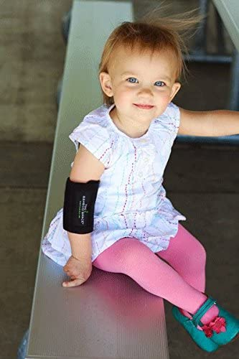
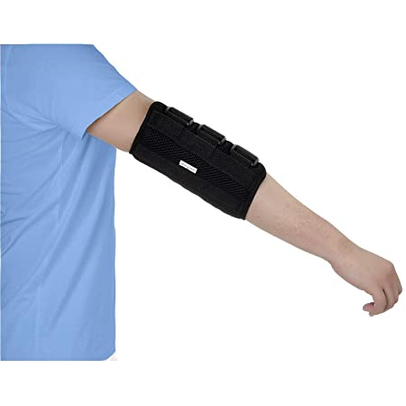
Splinting
Individuals with Rett syndrome are at a higher risk for injuries associated with stereotypical hand movements.
  Hand biting
  Mouthing
  Infections
Elbow Immobilization Splints
  Restricts range of motion, independent daily living tasks
  Minimally effective for increasing self-care skills
Gloves, mittens
  Allows for self-soothing, can lead to facial rashes/ injury
Notes:
https://pubmed.ncbi.nlm.nih.gov/23869872/

Slide 34
Alternative Injury Prevention
Consider environmental modifications
  Sensory strategies to promote regulation, reduce anxiety
  Contextual cues to help convey time of day, expectations
Communication supports
  Use of AAC to increase independence
  Responsive, attentive communication partner
Appropriate therapeutic and educational engagement
  "Just right challenge" to increase skill development while reducing frustration

Slide 35
Sensory
Sensory arousal exists on a continuum, and individuals with RTT may require supports from caregivers or others to help maintain an optimal level of regulation depending on different activities.
Sensory Overload | Overstimulated | Regulated
Needs a break or sensory input May be shutting down, overwhelmed, frustrated | Needs some assistance to return to a regulated state May be excited, anxious, fidgety | Calm and ready to engage

Slide 36
Mental Health Considerations
There is a growing body of research which describes mental health concerns in individuals with Rett syndrome, including:
  Anxiety
  Low mood
  Mood changes
  Fear
Recognizing and addressing mental health concerns is equally as important as helping individuals maintain state regulation.
Notes:
https://jneurodevdisorders.biomedcentral.com/articles/10.1186/s11689-015-9127-4

Slide 37
Feeding
Goals: Maintain health, decrease sensory sensitivities, improve participation
Feeding difficulties are complex and may involve multiple systems, including oral, motor, sensory, neurologic, gastrointestinal, and respiratory.
Oral motor and swallowing difficulties can impact health outcomes and participation in family meals.

Slide 38
Feeding II
Some individuals will utilize alternate methods of feeding (such as tube feeding) to help meet their nutritional needs.
Feeding challenges require a full medical team approach which includes the individual and family.

Slide 39
Feeding Implications
Feeding challenges can impact an individual's state regulation, emotions, and health, which can then impact the ability to engage in learning and communication opportunities.
Sensory
Behavioral
Oral motor
Nutrition
Mental health

Slide 40
Check for Understanding II
What are some of the hand movements associated with Rett syndrome?
What are some possible mobility-related outcomes?
How does RTT affect sensory systems?

Slide 41
Communication

Slide 42

The Communication Bill of Rights
From the National Joint Committee for the Communication
Needs of Persons with Severe Disabilities (NJC) (2016)
https://www.asha.org/njc/communication-bill-of-rights/

Slide 43
Ways of Communicating
Eye gaze
Gestures and Body Movements
Vocalizations & Preserved Speech
Augmentative and Alternative Communication Systems

Slide 44
Augmentative and Alternative Communication
(AAC)

Slide 45
Augmentative & Alternative Communication
Unaided
Aided
Not using external aids to communicate
Relying on one's body to convey the message
  Gestures
  Signs
  Vocalizations
Using an external tool to communicate
Can be high-tech or low-tech
A range of communication methods
Small number of pictures/objects for choice making
Robust language systems with large number of symbols

Slide 46
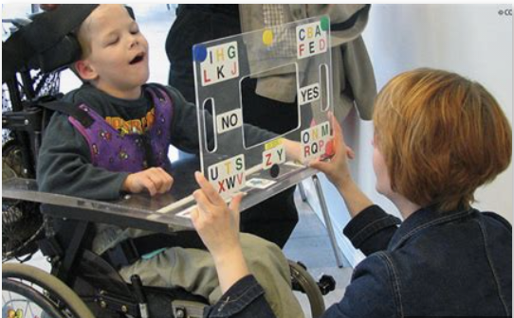
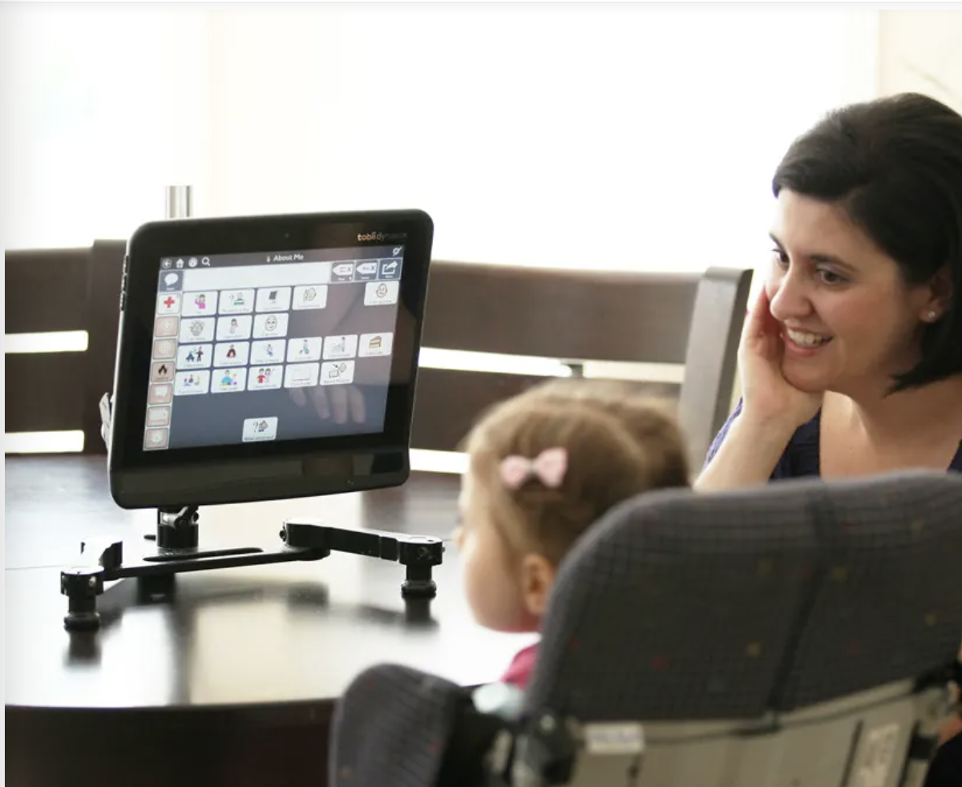
AAC: Technology
Low Tech
High Tech

Slide 47
Low Tech AAC
Gesturing
Eye-gaze
Body movement
Alphabet board
Symbol-based communication book

Slide 48
High Tech AAC
Speech generating devices
Eye-gaze technology
Access to robust language system

Slide 49
Communication Characteristics
Study of parents and professionals on communication among females with RTT
  Eye-gaze is the most common modality.
  Increased response time is often needed.
  Anxiety/apraxia/cognitive load make expressive language more challenging.
  Receptive language can be average, mildly impaired, to moderate-severely impaired.
  Some females with RTT have no form of communication.
(Bartolotta et al., 2012)

Slide 50
Assessment for Use of AAC
General Principles
Should be a team process.
Should be informed, comprehensive, and holistic.
Should consider the opportunities and barriers to communication that may be present in various environments (e.g., home, school, playground).
Should be completed in naturalistic environments.
"Interview family and school-based professionals to learn how [an] individual communicates, what strategies have been tried, been successful, not successful.“
- Professional
(Townend et al., 2019)

Slide 51
Assessment for Use of AAC II
Procedures
Interviews with communication partners
Questionnaires can be helpful
Complete observations of individual in naturalistic environments
Videotaping
Informal assessments
Modified formal (standardized) assessments and dynamic assessments
  Assessments over multiple time points
  Interactive
  Test-Intervene-Retest method
(Townend et al., 2019)

Slide 52
Assessment for Use of AAC III
"Assessments should be functional and incorporate all methods of communication. Rather than using standardized assessments, assessments looking at functional performance..."
- Professional
(Townend et al., 2019)

Slide 53
Assessment for Use of AAC IV
Considerations
Consider a range of symbols
Layout (size and number of options on the screen/board)
Complexity of vocabulary being offered
Alternative access (e.g., eye gaze, touchscreen, or switch control)
Positioning of the individual and the device/AAC system
"Try as much software as possible and then begin with the most suitable one."
- Caregiver of an individual with RTT
(Townend et al., 2019)

Slide 54
Assessment for Use of AAC V
Reminders
No prerequisite skills must be demonstrated
Trial periods are essential
Feature matching is best practice
Communication should be multi-modal
"Parents need to know that the child has potential to learn and to grow into using AAC strategies.“
– Expert Panel
(Townend et al., 2019)

Slide 55
Language and Literacy Intervention
Language intervention should be focused on increasing functional communication.
Communication should be developed across multiple modalities.
Goals for intervention should aim to increase in frequency, complexity and variety.
Team should use a holistic approach and consider the needs and preferences of the individual.

Slide 56
Language and Literacy Intervention II
Literacy intervention should start at a young age.
Developing vocabulary giving the individual access to a robust language system is crucial.
Shared book reading has been shown to promote receptive and expressive language skills at the same time as emergent literacy skills (Koppenhaver et al., 2001).

Slide 57
Case Study
Notes:
Need to update

Slide 58
Activity: Role Play
Assign students to play the following team members:
  Early Intervention Provider (EI)
  Preschool Teacher
  Speech-Language Pathologist (SLP)
  Occupational Therapist (OT)
  Family Member (Parent or Guardian)
  Program Administrator or Inclusion Specialist
The team is meeting for <Case Study>’s Individualized Family Service Plan (IFSP) transition meeting as she prepares to enter a preschool classroom. The goal is to:
  Review current needs and strengths
  Discuss seizure management and communication strategies
  Plan inclusive classroom supports
  Ensure family voice is central in decision-making

Slide 59
Family Support

Slide 60
RTT-Specific Resources
International Rett Syndrome Foundation (IRSF)
Rett UK
Rett University
Rett Syndrome Research Trust

Slide 61



Family Support Resources
Finding a Clinic: https://www.rettsyndrome.org/for-families/rett-syndrome-clinics/
Education: https://www.rettsyndrome.org/for-families/education/
New Diagnosis: https://www.rettsyndrome.org/wp-content/uploads/100-Day-Pathway.pdf

Slide 62
Family and Community Engagement
Family and Community Engagement - IRSF Resource
Educational Coloring Book about Rett Syndrome
Cure Rett Communities
Look for inclusive playgroups in your area

Slide 63
References
Ahonniska-Assa, J., Polak, O., Saraf, E., Wine, J., Silberg, T., Nissenkorn, A., & Ben-Zeev, B. (2018). Assessing cognitive function in females with Rett syndrome by eye-tracking methodology. European Journal of Pediatric Neurology, 22(1), 39-45. https://doi.org/10.1016/j.ejpn.2017.09.010
Amir, R. E., & Zoghbi, H. Y. (2000). Rett syndrome: Methyl- CpG-binding protein 2 mutations and phenotype-genotype correlations. American Journal of Medical Genetics, 97, 147–152. https://doi.org/10.1002/1096-8628(200022)97:2%3C147::aid-ajmg6%3E3.0.co;2-o
Barnes, K. V., Coughlin, F. R., O’Leary, H. M., Bruck, N., Bazin, G. A., Beinecke, E. B., Walco, A. C., Cantwell, N. G., & Kaufmann, W. E. (2015). Anxiety-like behavior in Rett syndrome: Characteristics and assessment by anxiety scales. Journal of Neurodevelopmental Disorders, 7. Epub. https://doi.org/10.1186/s11689-015-9127-4
Bartolotta, T. E., Zipp, G. P., Simpkins, S. D., & Glazewski, B. (2011). Communication skills in girls with Rett syndrome. Focus on Autism and Other Developmental Disabilities, 26(1), 15–24. https://doi.org/10.1177/1088357610380042
Downs, J., Parkinson, S., Ranelli, S., Leonard, H., Diener, P., & Lotan, M. (2014). Perspectives on hand function in girls and women with Rett syndrome. Developmental Neurorehabilitation, 17(3), 210-217. https://doi.org/10.3109/17518423.2012.758183
Dy, M. E., Waugh, J. L., Sharma, N., O'Leary, H., Kapur, K., D'Gama, A. M., Sahin, M., Urion, D. K., & Kaufmann, W. E. (2017). Defining hand stereotypies in Rett syndrome: A movement disorders perspective. Pediatric Neurology, 75, 91–95. https://doi.org/10.1016/j.pediatrneurol.2017.05.025

Slide 64
References (continued)
Fu, C., Armstrong, D., Marsh, E., Lieberman, D., Motil, K., Witt, R., Standridge, S., Lane, J., Dinkel, T., Jones, M., Hale, K., Suter, B., Glaze, D., Neul, J., Percy, A., & Benke, T. (2020). Mulitsystem comorbidities in classic Rett syndrome: A scoping review. BMJ Paediatrics Open, 4, e000731. https://doi.org/10.1136/bmjpo-2020-000731
Koppenhaver, D. A., Erickson, K. A., & Skotko, B. G. (2001). Supporting communication of girls with Rett syndrome and their mothers in storybook reading. International Journal of Disability, Development and Education, 48(4), 395–410. https://doi.org/10.1080/10349120120094284
Isaias, I. U., Dipaola, M., Michi, M., Marzegan, A., Volkmann, J., Rodocanachi Roidi, M. L., Frigo, C. A., & Cavallari, P. (2014). Gait initiation in children with Rett syndrome. PloS One, 9(4), e92736. https://doi.org/10.1371/journal.pone.0092736
Mayo Clinic. (n.d.) Rett Syndrome - Symptoms and Causes. https://www.mayoclinic.org/diseases-conditions/rett-syndrome/symptoms-causes/syc-20377227
Neul, J. L., Kaufmann, W. E., Glaze, D. G., Christodoulou, J., Clarke, A. J., Bahi-Buisson, N., Leonard, H., Bailey, M. E. S., Schanen, N. C., Zappella, M., Renieri, A., Huppke, P., Percy, A. K., & RettSearch Consortium. (2010). Rett syndrome: Revised diagnostic criteria and nomenclature. Annals of Neurology, 68(6), 944–950. https://doi.org/10.1002/ana.22124
Reichow, B., George-Puskar, A., Lutz, T., Smith, I. C., & Volkmar, F. R. (2015). Brief report: Systematic review of Rett syndrome in males. Journal of Autism and Developmental Disorders, 45(10), 3377–3383. https://doi.org/10.1007/s10803-015-2519-1
Townend, G. S., Bartolotta, T. E., Urbanowicz, A., Wandin, H., & Curfs, L. M. G. (2020). Development of consensus-based guidelines for managing communication of individuals with Rett syndrome. Augmentative and Alternative Communication (Baltimore, Md.: 1985), 36(2), 71–81. https://doi.org/10.1080/07434618.2020.1785009

Slide 65
Disclaimer
This is a product of the Early Childhood Intervention Doctoral Consortium (ECiDC), a project of the A.J. Pappanikou Center for Excellence in Developmental Disabilities at UConn Health. The Center is funded through cooperative agreement number H325H190004 from the Office of Special Education Programs, U.S. Department of Education. Materials and opinions expressed herein do not necessarily represent the Department of Education’s position or policy.

