Slide 1
Characteristics and Etiology of Infants and Young Children with Disabilities
Introduction to Intellectual Disability

Slide 2
Outline
Characteristics, Classifications, and Prevalence
Process for Diagnosis, Clinical Manifestations, and Evaluations
Education, Leisure, and Behavior Needs
Treatment and Medication Options
Supporting the Family
Plan for Child
Plan for Family
Case Studies

Slide 3
Characteristics, Classifications, and Prevalence

Slide 4
Defining Intellectual Disability
2010 Rosa’s Law (Pub. L. 111-256) changed the term from mental retardation to intellectual disability
IDEA 2004: “significantly sub-average general intellectual functioning, existing concurrently with deficits in adaptive behavior and manifested during the developmental period that adversely affects a child’s educational performance.”

Slide 5
Defining Intellectual Disability, continued
APA and AAIDD: 3 criteria- sub-average intellectual functioning, adapted behavior deficits, and onset during developmental period.
WHO ICD-11: “a group of developmental conditions characterized by a significant impairment of cognitive functions which are limitations of learning, adapted behavior and skills.”

Slide 6
Adaptive Impairments
Impairments interfering with the ability to adapt or function in daily life when compared to peers of similar age and culture.
Limitations may include: communication, social participation, function at work or school, or personal independence.

Slide 7
Activity: Adaptive Behavior Scenarios
Instructions:
Present 2–3 short scenarios describing children with varying adaptive behavior challenges (e.g., difficulty with self-care, communication, or social participation).
Ask students to:
Identify which adaptive domains are impacted.
Suggest strategies or supports that could be implemented in early childhood settings.

Slide 8
Intellectual Functioning: Significantly sub-average
Controversies
5-point variance in most psychometric IQ tests
Measured IQ may not be stable over time
Flynn Effect: mean IQ has increased on every restandardization sample population for major IQ measures
Cognitive functioning is not consistent across neurodevelopmental domains
Intelligence may encompass wider abilities that IQ measures do not account for
Predictive and cultural limitations of current IQ measures

Slide 9
Classifications of Intellectual Disability
Degree of Intellectual Impairment
Mild (IQ 50-70)
Severe (IQ below 50)
Adapted Behavior
More accurate in adults than in children
Required Supports
Perspective shifts from deficits to abilities in an inclusive environment
Domains of Disability
Etiology
Pathophysiology
Functional Limitation
Impairment
Disability
Societal Limitation
Classification by cause
Focuses on genetics
Gives a more complete view of a person’s functioning

Slide 10
Prevalence
Population: 6.7 to 10.37 per 1,000 people.
Gender ratio 2 males for every 1 female.
Mild intellectual disability prevalence is variable due to numerous factors.
Severe intellectual disability prevalence is stable at 0.3% to 0.5% of the population.

Slide 11
Etiology
Mild Intellectual Disability
Severe Intellectual Disability
Etiology is unknown in half of cases.
5% have definite genetic origins.
Familial clustering is common.
47% have definite genetic origins.
Down Syndrome, Fragile X, and FAS account for 1/3 of cases.
Chromosomal disorders account for 2/3 of cases.
Substance abuse, infection, or other problems during 1st and 2nd trimester of pregnancy account for 10% of cases.

Slide 12
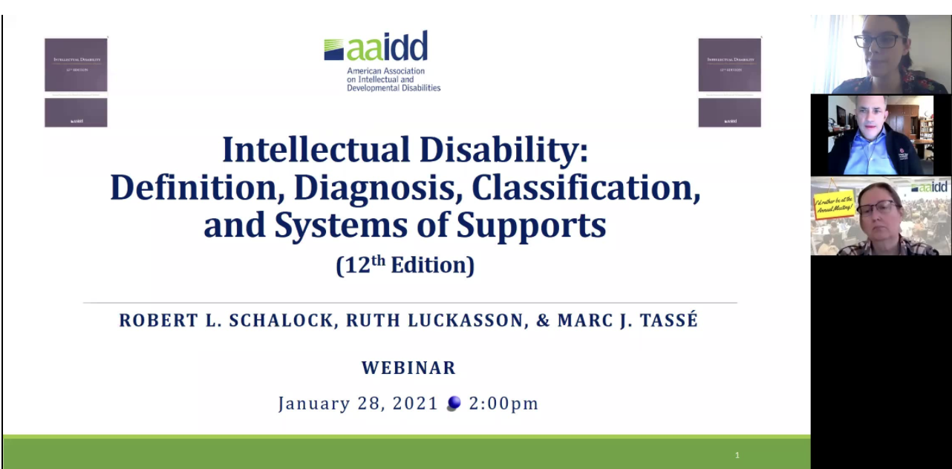
Video on Intellectual Disability
https://www.aaidd.org/education/events/2021/01/28/default-calendar/intellectual-disability-definition-diagnosis-classification-and-systems-of-supports-12th-edition

Slide 13
Process for Diagnosis, Clinical Manifestations, and Evaluations

Slide 14
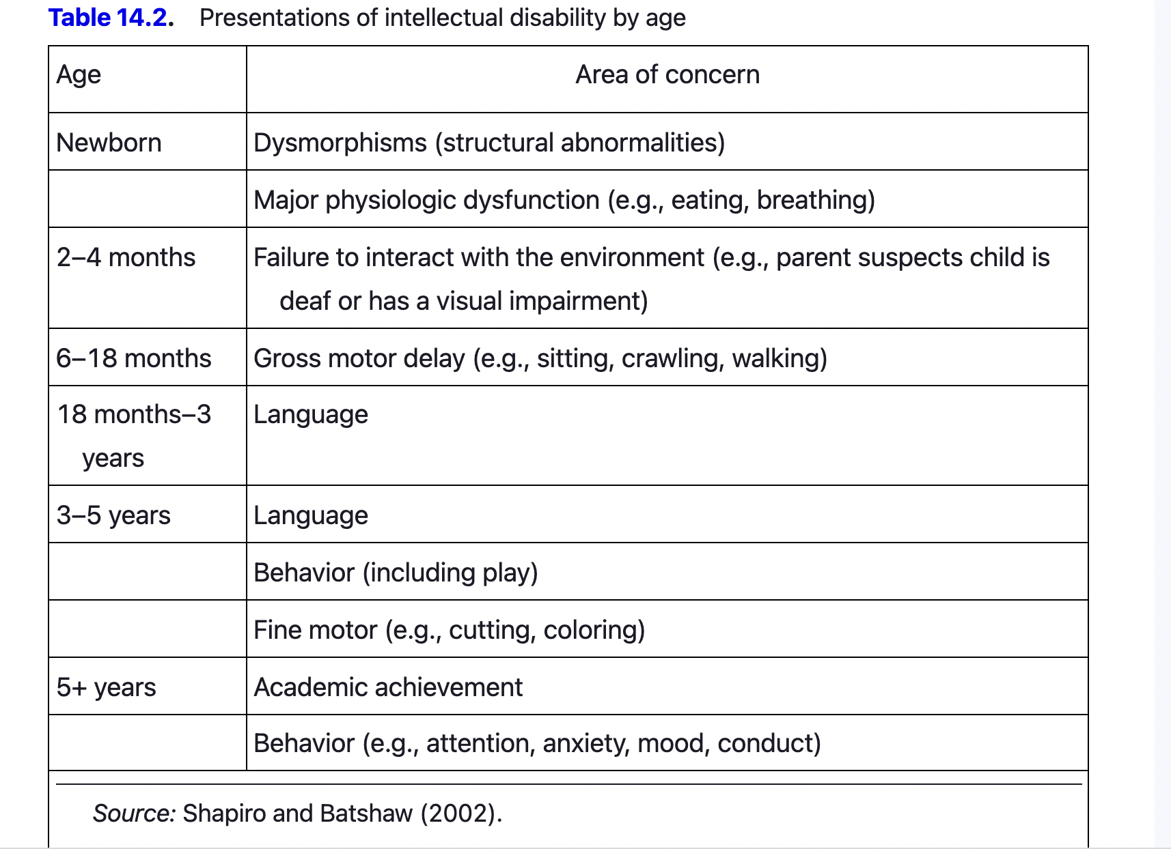
Clinical Manifestations: Areas of Concern by Age

Slide 15
Global Delay
Used for children under 5 years old showing significant delay in 2 or more neurodevelopmental milestones: communication, self-help, motor, and social-emotional skills.
When children continue to show significant delays across all developmental areas, intellectual disability is the most likely diagnosis.

Slide 16
Activity: Diagnosis Decision Tree
Instructions:
Create a simplified flowchart or decision tree based on the diagnostic considerations listed (e.g., severity, medical history, family planning).
In small groups, pulling from the case study and use the decision tree to determine:
Whether further testing is needed
What specialists should be involved
How to communicate findings to families

Slide 17
Evaluations: Medical Testing
No single test exist for intellectual disability; and therefore testing should be based on medical history and physical exam.
Considerations:
Is the disability mild or severe? (Mild intellectual disability is likely to have a biological cause)
Is there a specific diagnostic path?
Are parents considering having more children?
What are the parents’ wishes?

Slide 18
Evaluations: Psychological Testing
Intelligence Testing
Common Tests: BSID-III, SB5, and Wechsler Scales (WPPSI-IV; WISC-V)
Adaptive Behavior Testing
Common Tests: Vineland- 3, Scales of Independent Behavior- Revised, Adaptive Behavior Assessment System- Third edition

Slide 19
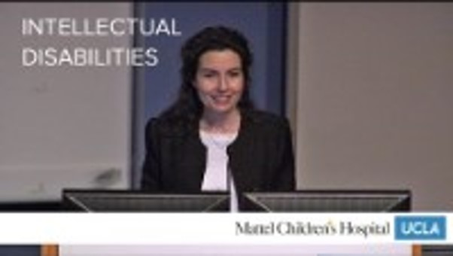
Intellectual Disabilities
Link to video
Notes:
Alicia Bazzano, MD, PhD, describes current guidelines and the future outlook for intellectual disabilities care.
http://www.youtube.com/watch?v=Yl2yCaGpkTY

Slide 20
Video Discussion
How does the updated definition of intellectual disability shift our understanding of the condition compared to older terminology and frameworks?
How can professionals build trusting partnerships with families to support children with intellectual disabilities?
The video emphasizes the importance of individualized supports. What does a “systems of supports” approach look like in early childhood education settings?

Slide 21
Identifying Education, Leisure, and Behavior Needs

Slide 22
Educational Services
Student—Teacher Relationship
Relevant to the child’s needs
Address the child’s individual strengths and challenges
Support independence
Early Intervention Programs
IEP in school programs

Slide 23
Importance of Special Education Teacher
Responsible for designing and carrying out the individualized family service plan (IFSP) or individual education program (IEP).
Works collaboratively with other disciplines.
Trained in both pedagogical techniques and behavior management for children with special education needs.
Assesses the progress of the child.
Revises the curriculum as needed to optimally serve the student.

Slide 24
Leisure and Recreational Needs
Peer socialization in play and recreational activities
Socialization competencies
Dealing with social conflict, managing anger-making needs known, and expressing affection or unhappiness
Age and skill-appropriate adaptive play equipment

Slide 25
Leisure and Recreational Needs II
Socially oriented play groups
Extracurricular sports and social activities
Social activities
Summer camps
School dances
School or family trips
Dating or socialization in youth groups or school clubs
Visits to movies and restaurants

Slide 26
Behavioral Needs
Behavior problems do occur with a greater frequency in this population
May result from associated neurodevelopmental disorders (e.g., ADHD or sensory disorders)
May result from primary or secondary psychiatric disorders (e.g., mood disorders)

Slide 27
Behavioral Needs II
May result from unrealistic parental expectations; family, financial, or social difficulties; and school-related adjustment difficulties
Many behavior problems result from a mismatch between the demands of the situation and the child’s abilities
Represent attempts by the child to communicate, gain attention, or avoid performing a task

Slide 28

How much do you know about intellectual disabilities?
Link to video
Notes:
How much do you know about intellectual disabilities? | Matthew Williams | TEDxVancouver
http://www.youtube.com/watch?v=BURbLmQL1BE

Slide 29
Identifying Treatment & Medication Options

Slide 30
Co-Occurring Conditions
Co-occurring conditions include:
Cerebral Palsy
Sensory Impairments
Seizure Disorders
Speech Disorders
ADHD
Anxiety Disorders
Depression
ASD
Other disorders of language, behavior, or perception

Slide 31
Treatment of Co-Occurring Conditions
Treatment of co-occurring conditions may require ongoing physical therapy, occupational therapy, speech-language therapy, behavioral therapy, adaptive equipment, eyeglasses, hearing aids, medication, and so forth
Failure to adequately identify and treat these problems may negatively influence functional outcomes and result in difficulties in the home, school, or neighborhood environment

Slide 32
Medication
Medication is not useful in treating the core symptoms of intellectual disability.
No drug has been found to improve cognitive function.
Medication may be helpful in treating comorbid behavioral and emotional disorders.
Generally directed at specific symptom complexes, including ADHD, self-injurious behavior or aggression, and mood or obsessive-compulsive disorders.

Slide 33
Supporting the Family of a Child with Intellectual Disability

Slide 34
Trusting Partnerships
Ecological Systems Theory
Defining Family Partnerships
Defining Trust

Slide 35
Family Quality of Life
Family Interaction
Parenting
Physical & Material Well-Being
Emotional Well-Being
Disability Related Supports

Slide 36

Parents of Children with Special Needs Have Needs, Too
Link to video
Notes:
Parents of Children with Special Needs Have Needs, Too | Debra Vines | TEDx Oak Park
http://www.youtube.com/watch?v=AC9Q3IJeH1w

Slide 37
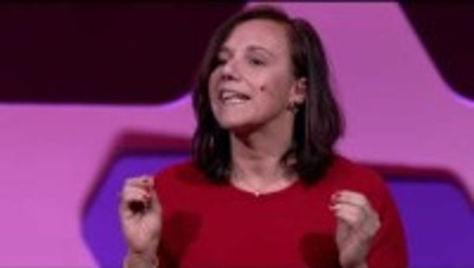
3 things I Learned from my Intellectually Disabled Son
Link to video
Notes:
3 things I learned from my intellectually disabled son | Emilie Weight | TED Institute
http://www.youtube.com/watch?v=4C1-8cXbwrU

Slide 38
Video Discussion
Emilie Weight shares personal insights from parenting her son with an intellectual disability. How can educators and professionals better understand and honor the lived experiences of families?
What role do families play in shaping inclusive practices and advocating for their children?

Slide 39
Developing a Plan of Support for a Child with Intellectual Disability

Slide 40
Areas of Focus
Abstract thinking
Executive function
Short-term memory
Functional academics
Communication
Conversation
Language
Social judgement
Risk
Adaptive abilities
Functional academics
Vocational skills
Personal care
Household tasks

Slide 41
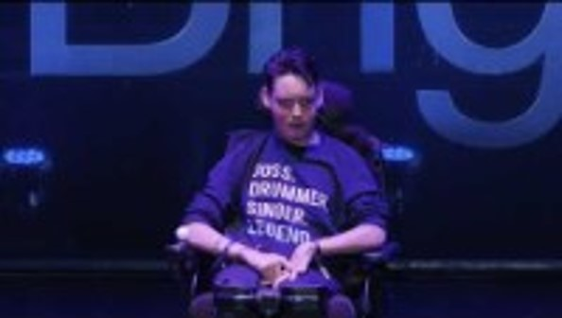
Finding Where You Belong: A Story of Disability and Education
Link to video
Notes:
Finding Where You Belong: A Story of Disability and Education | Joss Perring | TEDxBrighton
http://www.youtube.com/watch?v=FVS8bcPUjw8

Slide 42
Video Discussion
What barriers to inclusion did Joss experience, and how do these reflect broader systemic issues in education?
How does Joss’s story highlight the importance of self-advocacy and listening to the voices of individuals with disabilities?

Slide 43
Developing a Plan of Support for a Family of a Child with Intellectual Disability

Slide 44
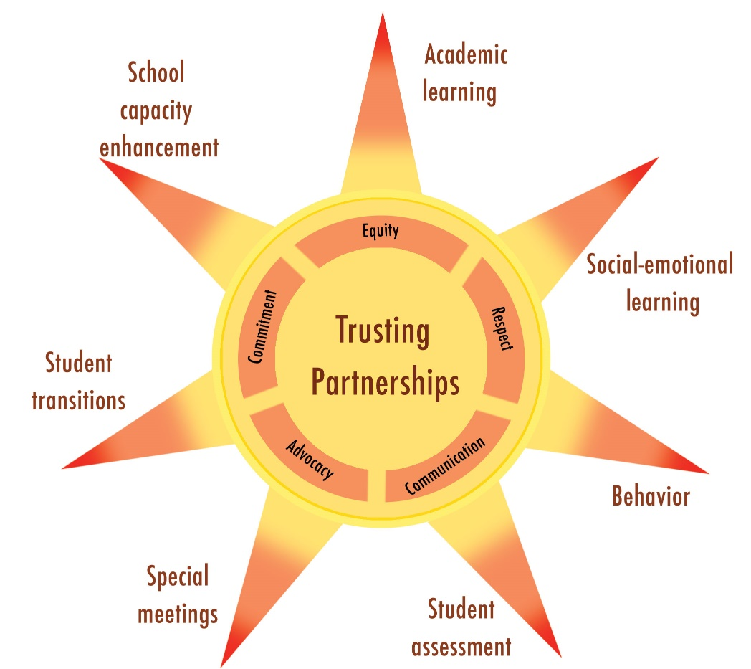
The Sunshine Model of Trusting Family-Professional Partnerships
Turnbull et al., 2021

Slide 45

“We cannot ignore and exclude those with special needs.”
Link to video
Notes:
We cannot ignore and exclude those with special needs | Drew Ann Long | TEDxBirmingham
http://www.youtube.com/watch?v=jY23YeWYDN8

Slide 46
Putting It All Together

Slide 47
Case Study - Home
In small groups, read the case study and accompanying materials.
Develop a plan of support for the child and family in their home environment.

Slide 48
Case Study - School
In small groups, read the case study and accompanying materials.
Develop a plan of support for the child in the school environment, and include a plan for family partnership.

Slide 49
Disclaimer
This is a product of the Early Childhood Intervention Doctoral Consortium (ECiDC), a project of the A.J. Pappanikou Center for Excellence in Developmental Disabilities at UConn Health. The Center is funded through cooperative agreement number H325H190004 from the Office of Special Education Programs, U.S. Department of Education. Materials and opinions expressed herein do not necessarily represent the Department of Education’s position or policy.

