Slide 1
Communication:
Strategies Across Contexts
Interdisciplinary Collaboration
Notes:
“Today we’re deepening our understanding of communication as a collaborative skill, not just an interpersonal one. In EI/ECSE, communication shapes how we share expertise, partner with families, and function as a team.”
Prompts to Ask
Opening warm-up:
“In one word, what does ‘communication’ mean to you in your professional role?”
Team lens:
“Think of a recent team interaction—what communication behaviors helped or hindered the conversation?”
Probing Questions
“What assumptions do we carry into team communication?”
“Who tends to talk the most in team settings? Why?”

Slide 2
Overview
Strategies for Communication
Listening
Providing Information
Conflict Resolution
Negotiation
Communication Contexts
Assessment
Intervention
Interagency
Consultation
Notes:
“These topics are not isolated skills—they are the foundational behaviors that shape teaming models, coaching practices, and equitable family-centered work.”
Prompts
“Which area feels most intuitive for you?”
“Which of these feel most challenging in real-world practice?”
Deeper Probes
“What makes negotiation hard in interdisciplinary teams?”
“Which communication contexts—assessment, intervention, interagency—present the most complexity, and why?”
Mini-Activity (Optional)
Ask students to move to four corners labeled: Listening / Conflict / Negotiation / Communication Contexts
Prompt: “Go to the corner that represents the hardest skill for you personally.”

Slide 3
Communication
The process of sending and receiving information and ideas between individuals using a common system of symbols, signs, or behavior.
Notes:
We communicate through tone, priorities, jargon, silence, and even expectations. Every member of a team brings unique communication norms shaped by discipline, training, and culture.”
Prompts
“What communication ‘systems’ do your disciplines rely on—terms, tools, documentation styles?”
“How might that create barriers or strengths in teaming?”
Probing Questions
“What happens when team members don’t share meaning even when they share words?”
“How does power influence whose meaning becomes the team’s meaning?”
Activity
Have students list “words we use that other disciplines misunderstand.”
Share in small groups.

Slide 4
Communication Strategies
Active listening
Nonverbal communication
Paraphrasing
Questioning
Notes:
“These strategies—active listening, paraphrasing, questioning—are the building blocks of the coaching model used in EI/ECSE. They help us avoid operating from an ‘expert stance.’”
Prompts
“Which of these strategies do you use most naturally in your role?”
“Which feels least natural—and why do you think that is?”
Probing Questions
“How does active listening help shift power toward families?”
“How might paraphrasing prevent misunderstandings among team members?”
Activity
Role-play:
Partner A states a concern from a family’s perspective; Partner B responds using paraphrasing + open-ended question.

Slide 5
Listening
Listening is the process of receiving, interpreting, and reacting/responding to a message from another person.
Notes:
“In interdisciplinary meetings, we often listen for what confirms our discipline’s viewpoint rather than for what expands it. Active listening requires curiosity.”
Prompts
“Think of a recent team meeting: Where did listening break down?”
“What tends to distract you most when you’re listening?”
Probing Questions
“How might listening be an equity practice?”
(Example: ensuring all voices—not just dominant ones—are included.)
Mini Activity
Ask students to share a time when they realized they had misheard something and the consequences it had.

Slide 6
Why Listen?
To obtain information
To understand
To learn
For enjoyment
Notes:
There are several purposes for listening. These include to obtain information. For example, on an EI team, you may need more information about when mealtime occurs in the family. It is also important to understand the message being conveyed. The preschool teacher may be focusing on how the PT recommends that a child be positioned during circle time. Listening also involves learning more about something. The OT may share why certain activities help promote eye-hand coordination. And listening can also be for pleasure (e.g., listening to music).
Listening supports understanding, learning, and relationship building during assessment, intervention, and teaming.
Prompts
“Which purpose of listening is most critical in family-centered work?”
“When you’re gathering information from a family, which mode of listening do you rely on most?”
Probing Questions
“How do you balance listening for details vs. listening for the ‘story’?”

Slide 7
Active Listening
A conscious effort to hear the words that another person says and more importantly, the complete message that person is attempting to communicate.
Notes:
Listening is one of the most important skills you can have. Being able to do it well has a positive impact on all aspects of your life, including how effective you are at work. Research suggests, however, that we only remember 25-50 percent of what we hear, meaning that we could be missing important messages.
Highlight the gap between hearing and understanding; connect to reflective practice and coaching.
Prompts
“Where have you observed active listening change the tone of a meeting?”
“Which parts of active listening feel most natural? Least?”
Probe
“Why do we tend to rehearse our responses instead of listening?”

Slide 8
Active Listening Techniques
Pay attention
Show that you are listening
Provide feedback
Defer judgment
Respond appropriately
Notes:
Active listening includes these five techniques. Watch the video to learn more about what each of these entail.
Anchor each technique in real EI scenarios.
Prompts
“Which technique most effectively communicates respect?”
“Which technique helps slow down fast-paced meetings?”
Mini-Activity
Pairs practice a short exchange and guess the technique used.

Slide 9
Improve Your Listening Skills with Active Listening
Improve Your Listening Skills with Active Listening (2:39)
Watch the video and:
Describe the five active listening techniques.
Reflect on which techniques you currently use.
Reflect on which technique(s) you want to practice improving.
Notes:
Support reflective self-assessment based on the video.
Prompts
“Which technique from the video stood out most?”
“What might be a barrier to implementing that consistently?”

Slide 10
Nonverbal Communication to Demonstrate Listening
Eye contact
Facial expressions
Head nods
Leaning forward
Arm movement
Body posture
Utterances such as, “yes”, “unhum”
Notes:
These nonverbal communication strategies are indicators that a person is paying attention and listening to the speaker.
Nonverbals differ across cultures, disciplines, and individuals.
Prompts
“How does your discipline train you to use nonverbals?”
“Where might a nonverbal cue be misinterpreted?”
Probing
“Whose nonverbal behavior gets read as ‘engaged’ and why?”

Slide 11
Paraphrasing
Why – to clarify or verify a point(s) the speaker made
How - summarize what the speaker said
How – ask the speaker if that is accurate or what they intended to communicate
Notes:
The primary purpose of paraphrasing is to clarify or verify what the speaker has said and if what you have paraphrased is not accurate, the speaker can correct that.
Emphasize paraphrasing as a tool for clarity and equity.
Prompts
“How can paraphrasing help reduce conflict?”
“What’s the risk of paraphrasing incorrectly?”

Slide 12
Asking Questions
Open-ended questions – require thought and more than one-word response; more comprehensive answer based on speaker’s knowledge.
Close-ended questions – require a one-word or short phrase response.
Notes:
Examples of open-ended questions – What is a typical day for Joshua? What are Lily’s favorite toys? What do you think will happen if….?
Examples of close-ended questions – What is Kanesha’s birthday? Do Terek and Liam play together?
Open-ended questions support understanding of routines, strengths, and family priorities.
Prompts
“How might a closed question unintentionally limit family voice?”
“What makes for a powerful open-ended question during assessment?”

Slide 13
Conversation with Examples of
Seeking and Verifying Information
Connect Video 3.4: Conversation with Examples of Seeking and Verifying Information (2:39)
Watch the video and identify:
Examples of the five active listening techniques.
Examples paraphrasing (i.e., clarifying, verifying).
Examples of open and close ended questions.
Notes:
Guide students to observe effective communication patterns.
Prompts
“Which techniques did you see modeled best?”
“How did the communicator check for accuracy?”

Slide 14
Barriers to Effective Listening
Environmental conditions
Distance from speaker
Attitude of the listener
Speed of speaking
Speaker’s nonverbal communication
Language of the speaker
Notes:
Environmental, linguistic, and relational factors influence communication.
Prompts
“Which barrier resonates most with your field experience?”
“How can teams plan ahead for these barriers?”
Environmental conditions – Factors such as the temperature, humidity, ventilation, acoustics, lighting, etc. of the space may impact attention and listening.
Distance from the speaker – The farther from the speaker, the more likely the listening process will be impacted and some words not heard or misunderstood. This may be exacerbated if the listener has a hearing loss.
Attitude of the listener – Some listeners may judge what the speaker is saying or what they think they will be saying. For example, the EI or preschool teacher may consider themselves the professional and the expert on child development and devalue what the parent is saying. Or, this is a family with whom the EI or teacher has been working with and thinks they can predict what is going to be said, so stop listening.
Speed of the speaker – Some individuals may speak very fast, making it difficult for some listeners to concentrate on what they are saying. Some may speak slowly and hesitantly, resulting in some listeners distracted by wanting them “to move on” with what they are saying.
Speaker’s nonverbal communication – Some speakers may use little or no verbal cues such as facial expressions, eye contact, gestures, etc. to help convey the meaning of their message or the feeling behind the message.
Language of the speaker - Some speakers may use a very quiet voice or monotone when talking, thus, making it difficult to maintain listening. Others may have a dialect or accent that requires extra attention. Still other speakers may need an interpreter (e.g., sign language, another verbal language), again, often requiring more intense concentration on the part of the listener.

Slide 15
Problem Solving
The process of identifying a problem, developing
possible solutions and taking a course of action.
Notes:
Highlight that problem solving is a collaborative, structured process.
Prompts
“What distinguishes collaborative problem solving from individual problem solving?”

Slide 16
Stages of Problem Solving
Identify the problem
Define the context of the problem
Explore possible solutions
Select the perceived “best” solution
Implement the selected solution
Monitor outcomes and seek feedback
Notes:
Emphasize shared data, collaborative brainstorming, and clear role division.
Prompts
“Where do you see teams skipping steps?”
“What makes teams reluctant to define the problem clearly?”
Identify the problem – State the problem specifically and identify what aspect of the team’s goal(s) is/are being impacted.
Define the context of the problem – Specify any underlying causes, gather any available data to clarify the problem, determine and collect any additional resources needed to clarify the problem.
Explore possible solutions - Involve the entire team in generating possible solutions, ensure that possible solutions align with the team’s and program’s goals, identify both short-term and long-term solutions.
Select the “best” solution – Evaluate possible solutions in relationship to the team’s goal(s) and desired outcome(s), consider all possible solutions without bias, state the selected solution explicitly.
Implement the selected solution – Plan for and implement.
Monitor outcomes and seek feedback – Develop measures for monitoring and collect data, gather feedback from all relevant consumers/stakeholders of the implementation, evaluate outcomes.

Slide 17
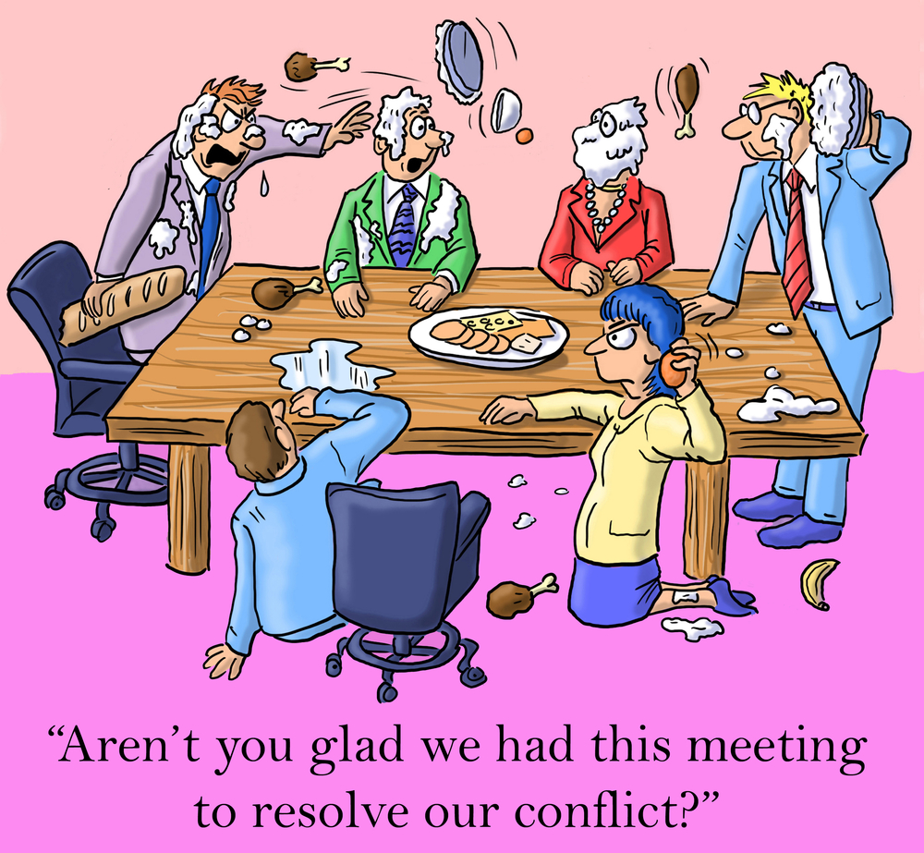
Conflict Resolution
Notes:
Use humor to normalize conflict and reduce defensiveness.
Prompts
“What emotions do you associate with conflict?”
“How does humor shift the conversation?”

Slide 18
Conflict: Definition
A serious disagreement between two or more individuals.
Notes:
Read the definitions of conflict and conflict resolution.
Some may think that conflict is negative and disruptive to a team’s performance and ability to achieve its goals. However, if resolved in a way to reach a solution to the conflict it can result in positive change and team growth and improved interactions.
However, unresolved conflicts will likely lead to dysfunctional team functioning. An impartial party will often be needed to “mediate” the conflict resolution. This could be someone within the team who takes the lead in doing this, or someone external to the team. The next slide will identify five steps in the conflict resolution process.
Conflict can be productive when resolved collaboratively.
Prompts
“What assumptions do people make about conflict?”
“How does unresolved conflict impact families?”

Slide 19
Conflict Resolution: Definition
The process by which two or more individuals
find a peaceful solution to their dispute.
Notes:
Highlight “peaceful solution” as an outcome where all voices are heard.
Prompts
“What does a peaceful solution look like on your team?”

Slide 20
Conflict Resolution: A Five Step Process
Clarify what the conflict is.
Establish a desired outcome for the conflict.
Discuss possible solutions for achieving the common outcome.
Decide on the best solution for resolving the conflict.
Agree on a solution and the responsibilities of each individual.
Notes:
Define the source of the conflict – Identify the specific point(s) of disagreement. Each party should agree on what the disagreement is. This may involve a discussion of what needs are not being met, what the “real” issue(s) are, and what the differing points of view are.
Establish a desired outcome for the conflict – Each individual agrees to an acceptable outcome for the conflict.
Discuss possible solutions for achieving the common outcome – This step involves brainstorming possible solutions/strategies for meeting the common outcome. It will involve each individual listening to the other(s) and working together to identify how the outcome can be met.
Decide on the best solution for resolving the conflict – All individuals involved agree on the best solution or the solution that all “can live with”. This step also includes discussing what led to the conflict and how that can be prevented in the future.
Agree on a solution and the responsibilities of each individual – Each individual involved in the conflict verbally states that they agree to the solution and what their responsibility is in maintaining the solution.
Walk through each step; provide a real example (e.g., disagreement on service frequency).
Prompts
“Which step requires the most emotional labor?”
“How do we ensure all voices are included?”
Probe
“How might power dynamics influence this process?”

Slide 21
Five Different Conflict Resolution Styles
Visual Example of the Five Different Conflict Resolution Styles (3:34)
Watch the video and identify:
The different conflict resolution styles that you observe in your current team.
The style that is most representative of you.
The style(s) that seem(s) most conducive to resolving conflicts in a team. Why?
Notes:
Each of us tends to approach conflict differently. This video identifies using media clips, five styles of approaching conflict: avoidance, competition, compromise, collaboration, and accommodation.
Identify patterns and reflect on personal tendencies.
Prompts
“Which style feels most familiar to you?”
“Which style do you think your discipline encourages?”

Slide 22
Communicating with Interpreters
Notes:
Language access is an equity and legal requirement.
Prompts
“What makes interpreted meetings more complex?”
“How can we prepare families beforehand?”

Slide 23
IDEA States That The Team Must:
(iv) Consider the communication needs of the child, and in the case of the child who is deaf or hard of hearing, consider the language and communication needs, opportunities for direct communication with peers and professionals in the child’s language and communication mode, academic level, and full range of needs including opportunities for direct instruction in the child’s language and communication mode, and (v) Consider whether the child requires assistive communication devices and services.” IDEA Sec. 1414 (d) (3) (B)
Notes:
Highlight the right to communication in the child’s mode/language.
Prompts
“How have you seen this implemented in practice?”

Slide 24
IDEA Also States:
Use of interpreters or other action, as appropriate. The public agency must take whatever action is necessary to ensure that the parent understands the proceedings of the IEP Team meeting, including arranging for an interpreter for parents with deafness or whose native language is other than English. Sec.300.322(e)
Notes:
Focus on legal mandates for language access for families.
Prompts
“How do teams ensure families fully understand meetings?”

Slide 25
Need for Sign Language Interpreters
Over 98% of U.S. newborns received a hearing screening.
About 6,500 U.S. infants were identified with a permanent hearing loss.
The prevalence of hearing loss in 2017 was 1.7 per 1,000 babies screened.
It is unclear as to how many of these children communicate with sign language.
(CDC, 2017)
Notes:
Discuss prevalence and communication challenges.
Prompts
“What might team communication look like with a signing family?”

Slide 26
Need for Foreign Language Interpreters
According to the most recent U.S. Census data:
One out of five children live in families where at least 1 parent was foreign born.
Of those children, 26% live in households where no one over 13 years old speaks English fluently.
Notes:
Emphasize cultural and linguistic diversity in early childhood settings.
Prompts
“What biases might show up in interpreted meetings?”

Slide 27
Roles of Interpreters
Conduit – acts as means for what is said by one individual to reach another individual.
Clarifier – checks for understanding of what is said and asks speaker to repeat or state/sign in a different way.
Cultural broker/mediator – detects cultural misunderstandings and provides cultural framework to clear up the misunderstanding.
Notes:
Conduit – This is the primary role of the interpreter who communicates everything exactly as it is said. The interpreter should reflect the tone, volume, and inflection of the speaker. The interpreter also manages the flow and speed of the conversation. First person language is used in this role.
Clarifier – If signs of confusion are evident, the interpreter must ask permission and have a signal to interrupt the communication process. The interpreter, using third person (e.g., Tanya would like to…), requests an unfamiliar word/phrase be simplified, or, if there is no equivalent word/phrase in either language use analogies/word pictures.
Cultural broker/mediator – This role is based on the interpreter having knowledge of the culture represented.
Advocate – This role is sometimes included as a 4th role. In this role, the interpreter acts on certain issues that they think are necessary for the family/child to get the services needed.
Highlight boundaries and ethical practices.
Prompts
“How do we prevent interpreters from being put in awkward roles?”

Slide 28
Things to Consider When Working
With Interpreters
Review the tips for working with sign language and language interpreters:
10 Tips for Using a Sign Language Interpreter
Best Practices for Communicating Through an Interpreter
Identify the similarities and differences in the tips and practices provided.
Which do you think will be the easiest to implement? The most difficult?
Notes:
Note: The Best Practices for Communicating Through an Interpreter link is designed for health care professionals, so “patient” is used. Practices would be the same in an EI/ECSE setting.
Encourage students to compare tips from both resources.
Prompts
“Which strategy will you implement first?”

Slide 29
Communication Contexts
Assessment
Intervention
Interagency
Consultation
Notes:
Review how communication purposes shift by context.
Prompts
“Which context requires the clearest communication and why?”

Slide 30
Assessment
Sharing observational data
Coordinating evaluation roles
Family-centered communication
Notes:
Important to share data meaningfully and collaboratively.
Prompts
“How do you avoid overwhelming families with assessment language?”

Slide 31
Intervention
Creating unified intervention plans.
Collaborative progress monitoring.
Consistent communication with families.
Notes:
Consistency across disciplines supports family clarity.
Prompts
“What strategies help teams align their intervention messages?”

Slide 32
Interagency
Coordinating services across systems.
Ensuring seamless transitions.
Information sharing agreements.
Notes:
Discuss collaboration across systems.
Prompts
“What complicates interagency coordination most?”

Slide 33
Consultation
Collaborative problem-solving.
Supporting educators and families.
Building capacity across settings.
Notes:
Shift from “expert model” to “capacity building model.”
Prompts
“How can you coach another professional without sounding directive?”

