Slide 1
Team Process:
Service Delivery
Notes:
Discussion Prompts
When you hear interdisciplinary teaming, what professional interactions or behaviors come to mind?
Think about a team you’ve worked with: what made the collaboration effective—or not?
Why is teaming especially important in birth–five services?
Suggested Script
“Today we’re going to unpack what effective teaming looks like in EI and ECSE. We’ll examine the roles of different professionals, compare teaming models, and connect them to IDEA requirements. As we move through the session, I encourage you to think about your own field or workplace team—how it functions, where collaboration breaks down, and what a more effective process might look like.”

Slide 2
Overview
Team Members in EI/ECSE
Team Models in EI/ECSE
Communicating with Interpreters
Notes:
Discussion Prompts
Which of these areas feels most familiar to you? Which feels least familiar?
How does communication strengthen or weaken a team?
Why might interpreter collaboration deserve explicit attention?
Suggested Script
“Here’s our roadmap for today. We’ll start by identifying the full range of team members involved under IDEA. Then we’ll compare multidisciplinary, interdisciplinary, and transdisciplinary models—these are foundational for understanding how services are coordinated. We’ll also look at communication strategies, including what it means to collaborate effectively with interpreters.”

Slide 3
Team Members in EI/ECSE
Notes:
Discussion Prompts
Who are the most common professionals you see on early childhood teams?
How does team composition shift when the setting changes (e.g., home vs. preschool)?
How do roles differ between Part C and Part B/619?
Suggested Script
“In EI and ECSE, teams can look different from one child to the next. The team expands or contracts based on the child’s developmental needs and the family’s priorities. Today we’ll unpack who these team members are and how their roles contribute to coordinated assessment and intervention.”

Slide 4
The Family
The family is an equal partner in decision-making on both Part C and Part B/619 teams.
Notes:
Discussion Prompts
What does it look like when families are truly equal partners?
What gets in the way of family participation?
How can teams address cultural or linguistic barriers?
Suggested Script
“One of the most important principles in EI/ECSE is that families aren’t just invited—they are equal partners. They shape outcomes, priorities, and decisions. Effective collaboration requires not only gaining input but also co‑developing plans with families.”

Slide 5
Service Providers IDEA Part C (303.13)
Audiologists
Family therapists
Nurses
Occupational therapists
Orientation and mobility specialists
Pediatricians, other physicians
Physical therapists
Psychologists
Registered dieticians
Social workers
Special educators
Speech language pathologists
Vision specialists
Notes:
Any of the related services professionals identified in IDEA may potentially be members of the team for children ages three through five years. The specific professionals represented will depend on the child and family’s IFSP and the services specified in it. The most common professional disciplines represented are special educators (i.e., ECSE), occupational therapists, physical therapists, and speech language pathologists.
Discussion Prompts
Which service providers do you see most often in your field placement?
How do the different perspectives shape the team’s understanding of a child?
What challenges arise when many disciplines are involved?
Suggested Script
“Part C allows—at least legally—a wide range of professionals to serve children, though in practice we typically see ECSE, OT, PT, and SLP most often. The key point is that the team is tailored to the IFSP and the family’s needs, not predetermined.”

Slide 6
IDEA Part B/619 Educators
Early Childhood Special Education – preschool, kindergarten special
education teachers
General education teachers
Notes:
Discussion Prompts
What new perspectives do regular education teachers bring?
How do teacher responsibilities differ from related service roles?
How does service coordination shift as children age into school systems?
Suggested Script
“In preschool, our teams start to include both ECSE teachers and regular education teachers. This reflects IDEA’s emphasis on inclusive settings. Collaboration between these two roles becomes central to daily implementation of the IEP.”

Slide 7
Related Service Providers IDEA Part B/619 (Sec. 300.34)
Audiologists
Social workers
Psychologists
Licensed physicians
Occupational therapists
Orientation and mobility specialists
Physical therapists
Recreation specialists
School nurses
Speech language pathologists
Interpreters
Notes:
Any of the related services professionals identified in IDEA may potentially be members of the team for children ages three through five years. The specific professionals represented will depend on the child’s IEP and the services specified in it. The most common professional disciplines represented are occupational therapists, physical therapists, speech language pathologists, and psychologists (primarily for assessment).
Discussion Prompts
What similarities and differences do you notice between Part C and Part B related services?
How do assessment-heavy roles influence team dynamics?
What challenges arise when multiple related service providers see the child separately?
Suggested Script
“Under Part B/619, any related service provider identified in IDEA may be on the team, but in practice the most common include OT, PT, SLP, and psychology—especially during evaluations. Each discipline contributes essential information, but collaboration is critical to avoid fragmented services.”

Slide 8
Team Models in EI/ECSE
Notes:
Discussion Prompts
Which teaming models have you experienced so far in the field?
What do you think the biggest difference is between these three?
Why might a program choose one model over another?
Suggested Script
“Next, we’re going to explore the three main teaming models. Understanding these models will help you analyze the strengths and weaknesses of the teams you observe during fieldwork.”

Slide 9
Team Models in EI/ECSE
Multidisciplinary
Interdisciplinary
Transdisciplinary
Notes:
Discussion Prompts
Which of these terms is most familiar or confusing to you?
Which model do you think is most child- and family-centered?
What benefits might each model bring?
Suggested Script
“These are the three main models we’ll compare. Each exists on a continuum of collaboration—from very separate to deeply integrated roles.”

Slide 10
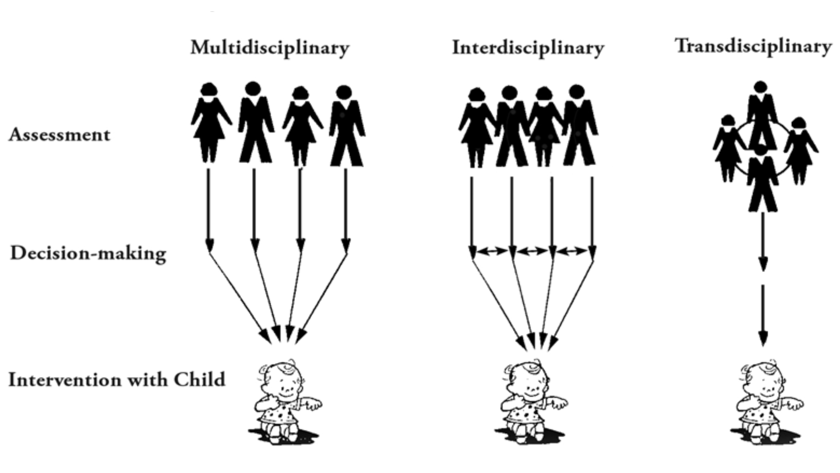
Early Intervention Team Models
Notes:
Discussion Prompts
What do you already know about multidisciplinary teams?
What questions do you have before we compare the models?
Suggested Script
“Before we dig into each model, take a moment to reflect on your own experiences. Which model do you think your field placement uses?”

Slide 11
Multidisciplinary Team Model
Discipline specific members with well-defined roles.
Communication primarily in required meetings.
Assessment and intervention planned and implemented independently of each team member.
Notes:
This team model is sometimes compared to parallel play in which team members “act” independently of each other even when in meetings.
Discussion Prompts
What are the advantages of discipline-specific independence?
What are the disadvantages for families receiving multiple separate services?
Where might you still see this model today?
Suggested Script
“In a multidisciplinary model, each professional works in their own lane. Communication tends to happen in required meetings like the IFSP or IEP. While this model respects disciplinary expertise, it risks fragmentation and duplication.”

Slide 12
Interdisciplinary Team Model
Discipline-specific members and roles.
Team members meet and/or communicate regularly.
Assessment and intervention jointly planned and implemented by separate disciplines.
Team members integrate plans and recommendations into one report or service plan.
Notes:
The interdisciplinary team model may be described as similar to associative play in which each team member provides services based on their respective discipline. However, there is some regular communication among team members regarding those services.
Discussion Prompts
What benefits come from more frequent communication?
What challenges arise when roles stay separate but information is shared?
How might this model support inclusive practice?
Suggested Script
“Interdisciplinary teams still deliver services separately, but coordination improves because professionals communicate regularly. This is often described as ‘associative play’—some interaction, some shared goals.”

Slide 13
Transdisciplinary Team Model
Discipline-specific members and roles that are shared by members.
Ongoing communication among team members.
Assessment and intervention jointly planned and implemented across disciplines by 1-2 team members with consultation by all team members.
Specific discipline recommendations and interventions are integrated into one report and service plan with objectives crossing disciplines and implemented by one service provider with consultation by all team members.
Notes:
The team, including the family, jointly plans, implements, and evaluates progress on IFSP outcomes or IEP objectives. Regular communication occurs across team members both informally and in scheduled meetings or other types of communication. In a home or community Part C setting, professional team members share the practices and strategies that they would use with that child and caregiver to facilitate one team member partnering with the team member to provide those services. In a preschool setting, a team member (e.g., PT) may go into the classroom and work with the child while modeling for the teacher or paraprofessional the strategies that they use to facilitate the child’s involvement in all the classroom activities in order for the classroom staff to then use those strategies.
Discussion Prompts
What benefits might families experience in a PSP model?
What challenges arise when professionals share roles?
Where have you seen role release happen effectively?
Suggested Script
“In a transdisciplinary team, one primary provider partners closely with the family while receiving consistent support from other team members. Everyone shares information and strategies so the PSP can implement a coordinated plan.”

Slide 14
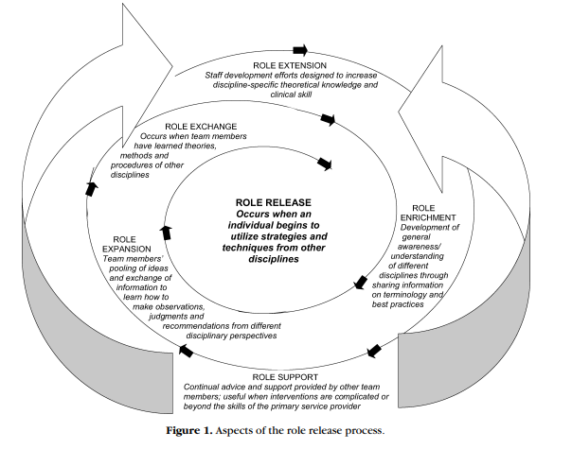
The Role Release Process
(King et al., 2009)
Notes:
King et al. (2009) identify the role release process as one of the identifying features of the transdisciplinary model. They describe it as a spiral process that also includes role extension, role enrichment, role expansion, role exchange, and role support. Each of these is defined on the next slides.
Discussion Prompts
Which steps in the spiral seem most challenging?
How do you build trust necessary for role sharing?
Why is supervision important during role exchange?
Suggested Script
“King and colleagues describe role release as a process—not a single event. It starts with deepening your own expertise, then learning from others, practicing under supervision, and eventually integrating strategies from other disciplines.”

Slide 15
Role Release Activity
Janella’s Story (11:33)
What aspects of the role release process are exemplified in the video?
How are other team members involved?
What does the mother identify as benefits of the transdisciplinary model? The EI?
Notes:
The video illustrates how an EI worked with her team members, including the family, to help 27-month-old Janella maker her choices known and participate in play and family routines. As you watch and listen to the video, think about the questions on the slide. Be prepared o discuss the questions after watching the video.
Discussion Prompts
Which aspects of role release were evident in the video?
How did the PSP incorporate strategies from other team members?
What benefits did the family identify?
Suggested Script
“As you watch, notice how the EI professional models strategies, incorporates team recommendations, and collaborates with the parent. We’ll discuss how this mirrors the role release framework.”

Slide 16
Required for a Successful Transdisciplinary Team Model
Family as equal team members.
Team members share information and practices.
One primary provider with other professional team members in consultant role.
Leadership support is critical during meetings.
Commitment of all team members to model.
Team members willing to share expertise with other team members.
Funding policies that support teaming.
Notes:
Services are coordinated in this model through ongoing communication and inclusion of the family as an equal team member. Services are typically provided by one primary service provider with the other professionals on the team serving in a support role sharing information about their discipline and skills with other team members. In EI, this is typically advantageous for the family who can develop good rapport with one professional and not have multiple providers coming into the home.
Leadership support is critical for this model to be effective as time is needed for team members to meet, share their expertise with other team members, and communicate in other ways on an ongoing basis. In addition, all team members must be committed to this model and be willing for other team members to implement practices relevant to their discipline with their support. Financial support is also needed for this model. However, in many Part C programs, providers are only reimbursed for direct services with children and families and not time spent collaborating with team members. And in center-based programs, funding may be very limited for related services professionals. Thus, allowing time for services for children, not team meetings, etc.
Discussion Prompts
Which advantages matter most for families?
How does leadership facilitate teaming?
How does funding shape team model choices?
Suggested Script
“Transdisciplinary teaming offers strong benefits—coordinated care, strong rapport, and unified goals. But it requires time, leadership support, and policies that recognize collaboration as essential work, not optional.”

Slide 17
When Role Release May Not Be Appropriate?
Child with specific diagnosis that requires expertise of a specific discipline.
Child with specific issues requiring specific expertise (e.g., feeding).
Child who is medically fragile.
Notes:
Some children may have a significant medical and/or biological condition that requires the expertise of a specific discipline to ensure that the services provided meet the needs of the child and family and “do no harm”. For some children and families, professionals from two disciplines may provide the services together, referred to as “co-treatment” in some states. As the family’s priorities and concerns change and the child develops, role release may become an option.
Discussion Prompts
When might role release compromise child safety or quality?
What does ethical practice look like in these situations?
How can teams still collaborate even when role release isn’t appropriate?
Suggested Script
“Role release is powerful, but not always appropriate. Some children need direct intervention from specialized professionals. Collaboration still occurs—but without cross‑disciplinary role transfer.”

Slide 18
Activity: Which Teaming Model?
Three-year-old is being assessed individually by a PT, OT, SLP, and School Psychologist for possible developmental delay and each writes a summary report.
The EI provider makes a home visit to the Garcia family one time per week and implements the motor, communication, and cognitive outcomes from the child’s IFSP in collaboration with the mom. The EI provider meets with the other team members to discuss the child’s ongoing intervention and progress.
The PT, SLP, and EI provider each go to the ABC Childcare one time per week and work with a 1 ½ year old with Down syndrome on their IFSP outcomes. They meet monthly to discuss progress, status changes, and any changes to the intervention.
Notes:
Ask the learners to apply what has been discussed to identify which team model is being represented in each example and to have a rationale for the team model identified. For each of the examples below, determine if the multidisciplinary, interdisciplinary, or transdisciplinary model is being used.
Discussion Prompts
Which clues in each scenario helped you identify the model?
How might the model affect family experience and child outcomes?
What systemic factors shape why a team uses a certain model?
Suggested Script
“These scenarios help you practice applying the characteristics of each model. Focus on how services are coordinated—or not coordinated—which is often the clearest indicator.”

Slide 19
Communicating With Technology
Notes:
**Presenter Script:** Today we’re looking at the slide titled 'Communicating With Technology'. This section focuses on the key ideas shown here: . As we explore this content, I want to highlight how these concepts support interdisciplinary and interagency collaboration. We’ll talk through examples, reflect on your current experiences, and consider how these ideas apply to your team’s functioning.
**Discussion Prompt:** What aspects of this slide resonate most with your current team experiences? How might these concepts improve collaboration?

Slide 20
Using Video to Promote Communication
Video can assist professionals and the family to:
Review child and adult performance, make recommendations, and monitor progress.
Facilitate reflective and constructive feedback on specific interventions.
Support decision-making about individual goals/outcomes.
Notes:
**Presenter Script:** Today we’re looking at the slide titled 'Using Video to Promote Communication'. This section focuses on the key ideas shown here: Use of video can assist professionals and the family to:
Review child and adult performance, make recommendations, and monitor progress.
Facilitate reflective and constructive feedback on specific interventions.
Support decision-making about individual goals/outcomes.. As we explore this content, I want to highlight how these concepts support interdisciplinary and interagency collaboration. We’ll talk through examples, reflect on your current experiences, and consider how these ideas apply to your team’s functioning.
**Discussion Prompt:** What aspects of this slide resonate most with your current team experiences? How might these concepts improve collaboration?

Slide 21
Using Video Conferencing to Promote Communication
Make home visits and co-visits.
Conduct team meetings.
Attend center-based programs virtually.
Promote family to family connections.
Conduct observations of staff and provide reflective supervision.
Provide professional development activities.
Notes:
**Presenter Script:** Today we’re looking at the slide titled 'Using Video Conferencing to Promote Communication '. This section focuses on the key ideas shown here: Make home visits and co-visits
Conduct team meetings
Attend center-based programs virtually
Promote family to family connections
Conduct observations of staff and provide reflective supervision
Provide professional development activities. As we explore this content, I want to highlight how these concepts support interdisciplinary and interagency collaboration. We’ll talk through examples, reflect on your current experiences, and consider how these ideas apply to your team’s functioning.
**Discussion Prompt:** What aspects of this slide resonate most with your current team experiences? How might these concepts improve collaboration?

Slide 22
Using Video Conferencing to Enable Team Meetings
Using Video and Video Conferencing to Enable Team Meetings over Distances (6:35)
Watch the video and:
Reflect on the benefits of virtual meetings for team members that were identified.
Reflect on the challenges of virtual meetings for team members that were identified.
Identify, based on your participation in videoconferencing, additional benefits and challenges you have experienced.
Notes:
**Presenter Script:** Today we’re looking at the slide titled 'Using Video Conferencing to Enable Team Meetings'. This section focuses on the key ideas shown here: Using Video and Video Conferencing to Enable Team Meetings over Distances (6:35)
Watch the video and:
Reflect on the benefits of virtual meetings for team members that were identified.
Reflect on the challenges of virtual meetings for team members that were identified.
Identify, based on your participation in videoconferencing, additional benefits and challenges you have experienced?. As we explore this content, I want to highlight how these concepts support interdisciplinary and interagency collaboration. We’ll talk through examples, reflect on your current experiences, and consider how these ideas apply to your team’s functioning.
**Discussion Prompt:** What aspects of this slide resonate most with your current team experiences? How might these concepts improve collaboration?

